Slide 1


Branching Out:
Cultivating Evidence-Informed Decision Making at Monash Health
Cass Gorton
Manager - Access & Discovery
Monash Health
Notes:
\

Slide 2


Acknowledgement of Country
Monash Health respectfully acknowledges the Bunurong/Boonwurrung and Wurundjeri Woi-wurrung peoples, the Traditional Custodians and owners of the lands where our facilities are located and programs operate.
We recognise the ongoing spiritual link Aboriginal people have to their lands, culture and lore; and acknowledge that their connections build healthier families and communities.
Monash Health pays respect to the Elders of the Wurundjeri Woi-wurrung and Bunurong/Boonwurrung peoples; past, present and future.
We extend our respect to our Aboriginal and Torres Strait Islander employees, consumers and stakeholders.

Slide 3




In this session
Why “evidence reports”
Introducing the service
Librarian expertise
Repository and sharing
Analytics and uptake
Value and impact
Challenges and lessons learned

Slide 4



The Need for Fertile Ground
Why “evidence reports”?
Timely, reliable evidence
Healthcare complexity
Large, multi-site health service

Slide 5




Planting the Seed
Introducing the service
Service: Comprehensive search, screen, branded report
Audience: Decision makers, practice changers
Aim: Embed evidence-informed decision-making, save clinician time

Slide 6






Growing Strong Roots
Workflow overview
User requests service via form
Search multiple databases and grey literature
Screen and deduplication in Covidence
Add results to branded report
Send and record details

Slide 7
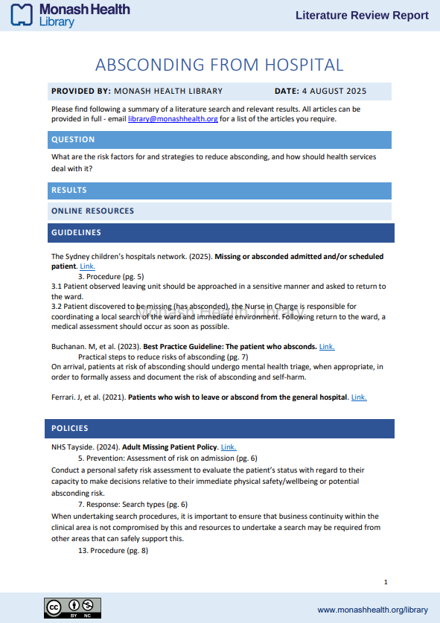
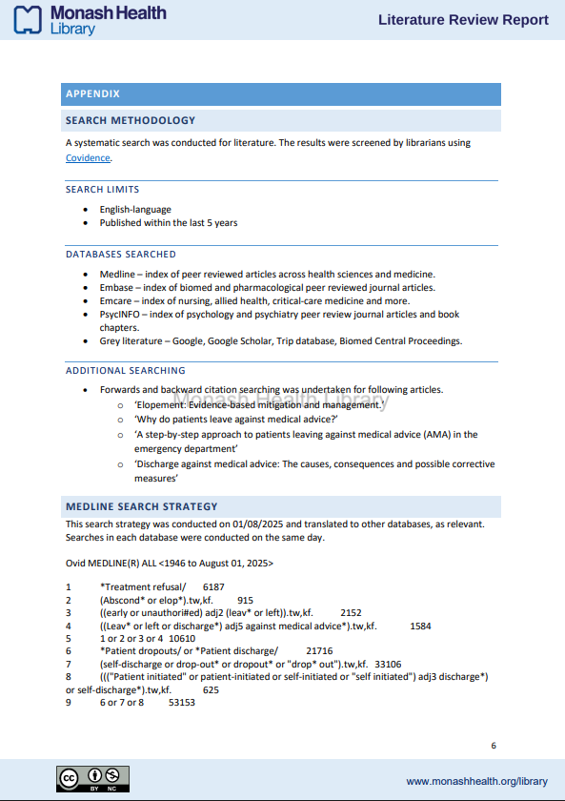
Report
example

Slide 8
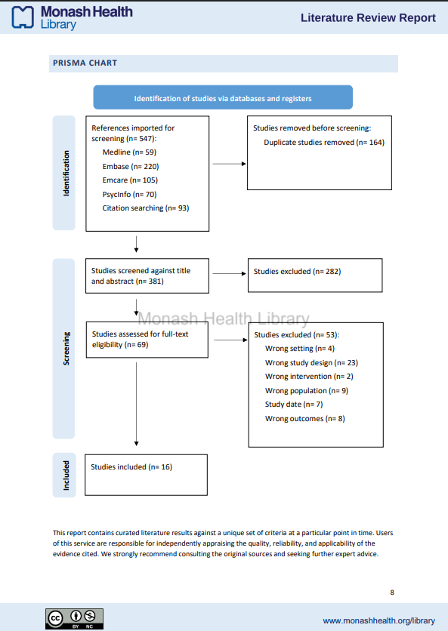
Report
example

Slide 9

The Trunk of the Tree
Librarian expertise
Consistent brand
PRISMA demonstrates time saved
Limit to displayed results
Essential to evidence-informed decisions

Slide 10
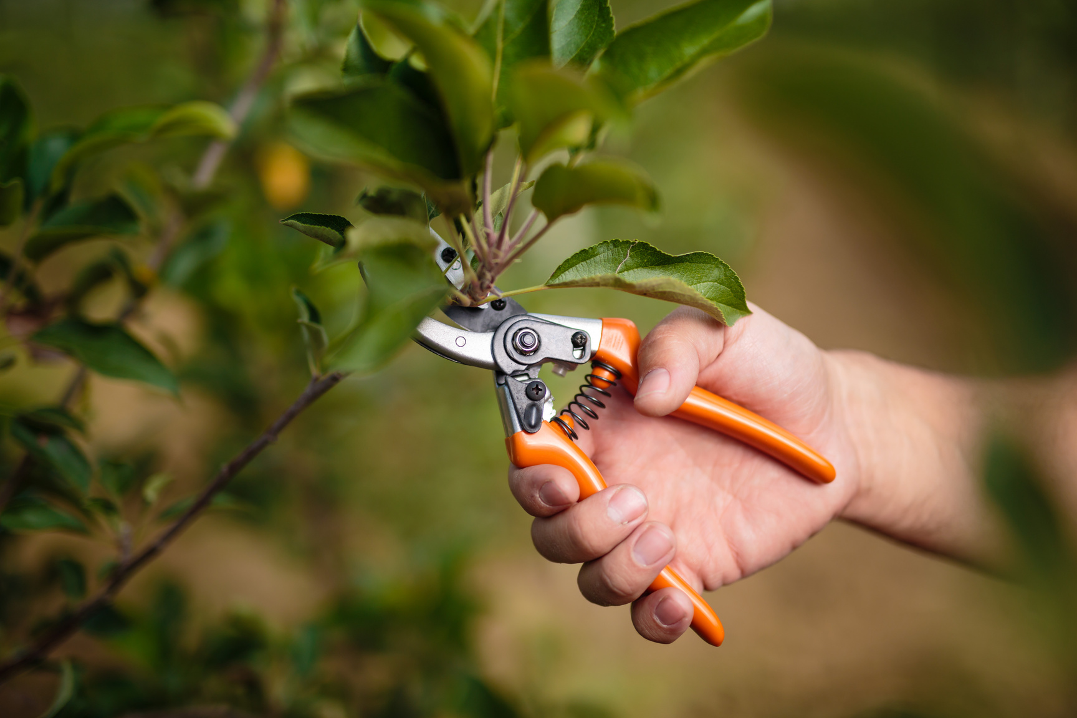
Pruning the overgrowth
Refining the service
Reorganise report
Request form update
Clarify eligibility
Introduce service charter

Slide 11

Branching Out
Repository and sharing
Collection in institutional repository
Additional metadata - databases, year coverage, and licencing
Addition of watermark, CC licence, disclaimer

Slide 12
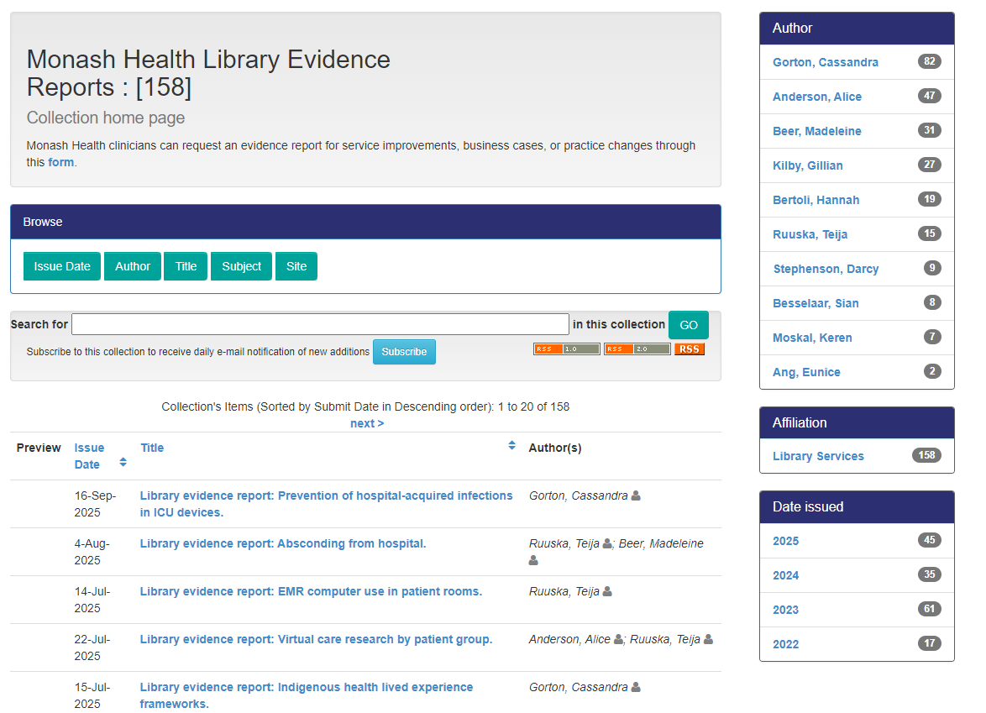
Collection
homepage

Slide 13
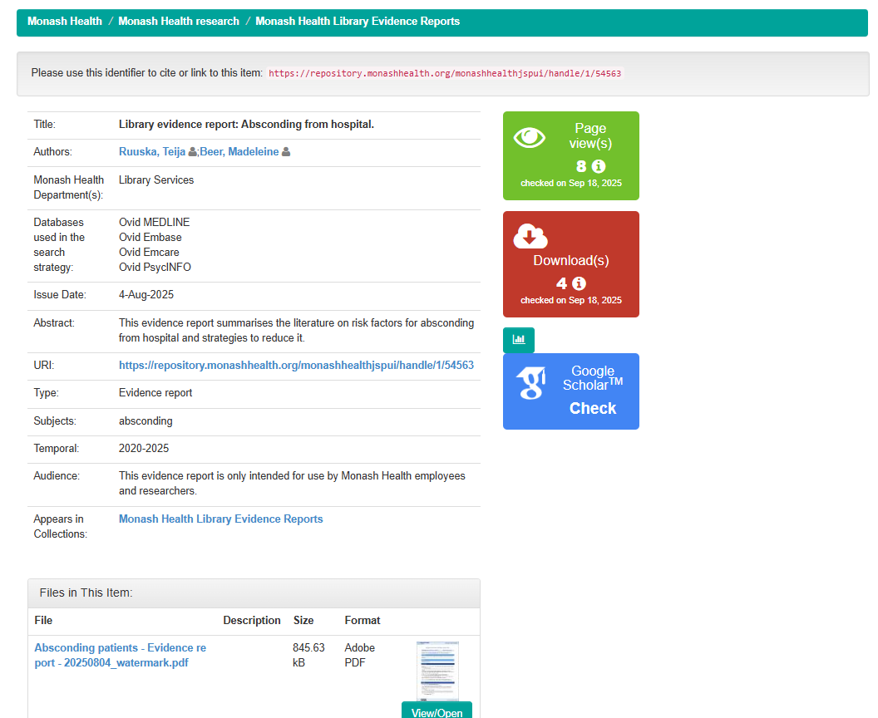
Repository example

Slide 14
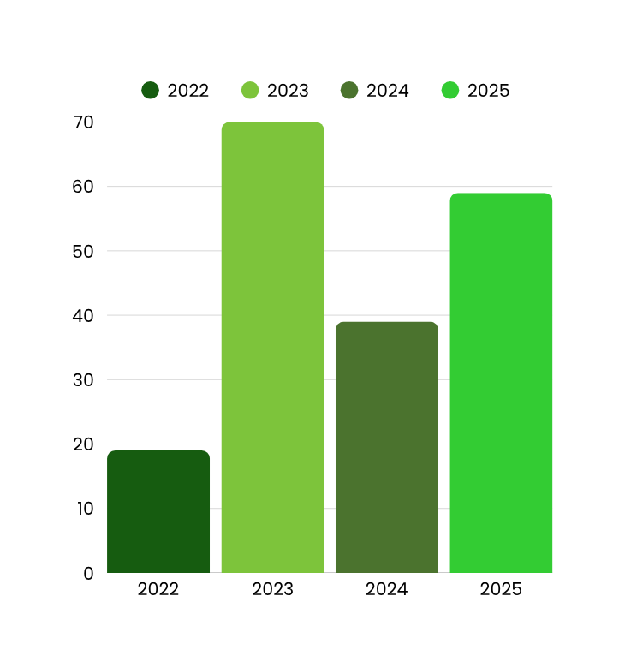
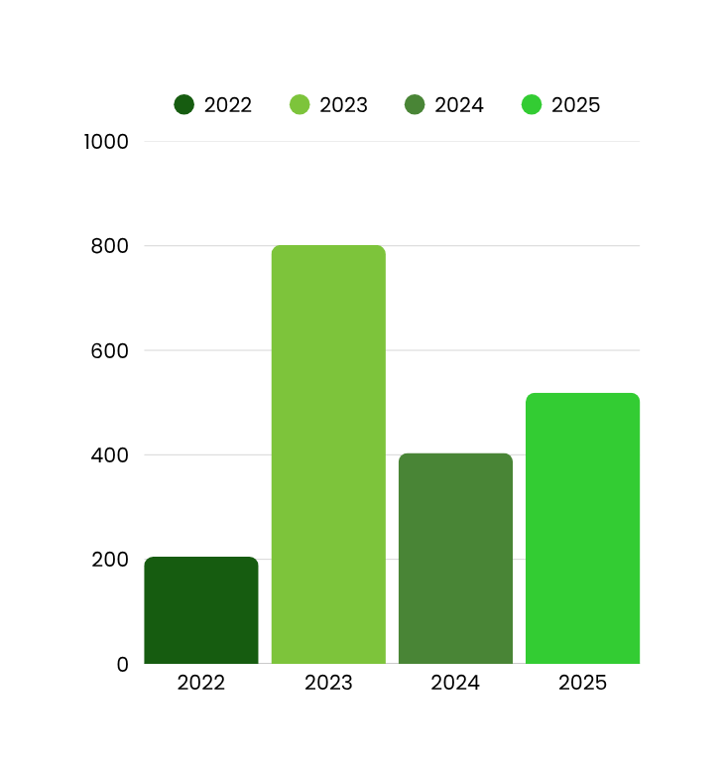
Measuring Growth
Analytics and uptake
Reports completed
Hours taken

Slide 15
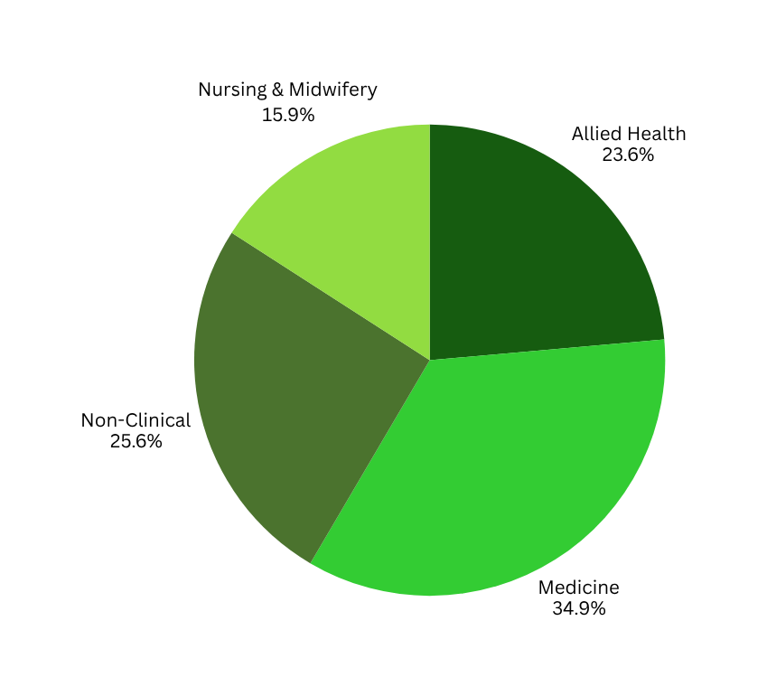
Measuring Growth
Analytics and uptake
Top user department
Transformation Office
Nursing & Midwifery Education
Strategy
Occupational Therapy
Rehabiliation & Subacture Care
Corporate Services
User profession

Slide 16
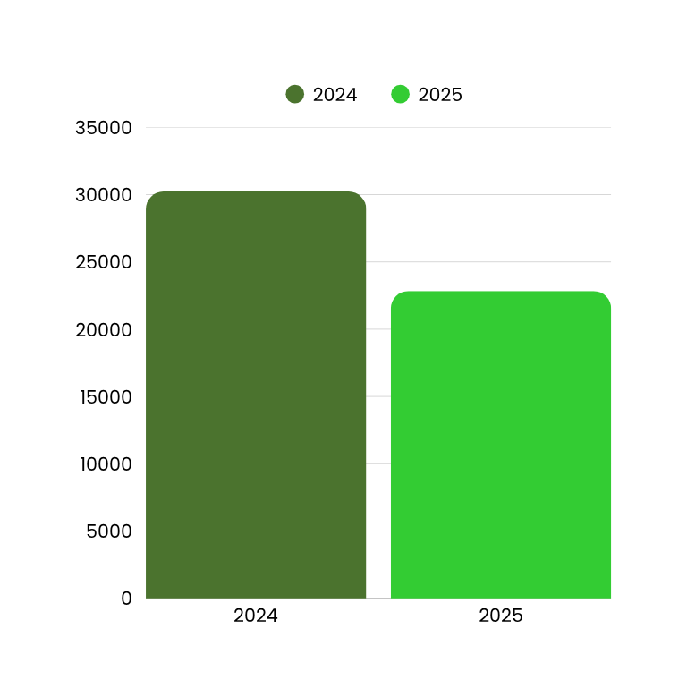

Measuring Growth
Analytics and uptake
Most downloaded :
Cushions and the prevention of pressure injuries
Repository downloads

Slide 17

Measuring Growth
Qualitative experiences
I cannot speak more highly of this efficient and critical service.​
Exceptional service quality
Staff professionalism and support
Impact on outcomes

Slide 18

Measuring Growth
Impact story
Incident highlighted gaps in pregnancy screening for trans and non-binary patients
Published literature review
Monash Health practice changed

Slide 19
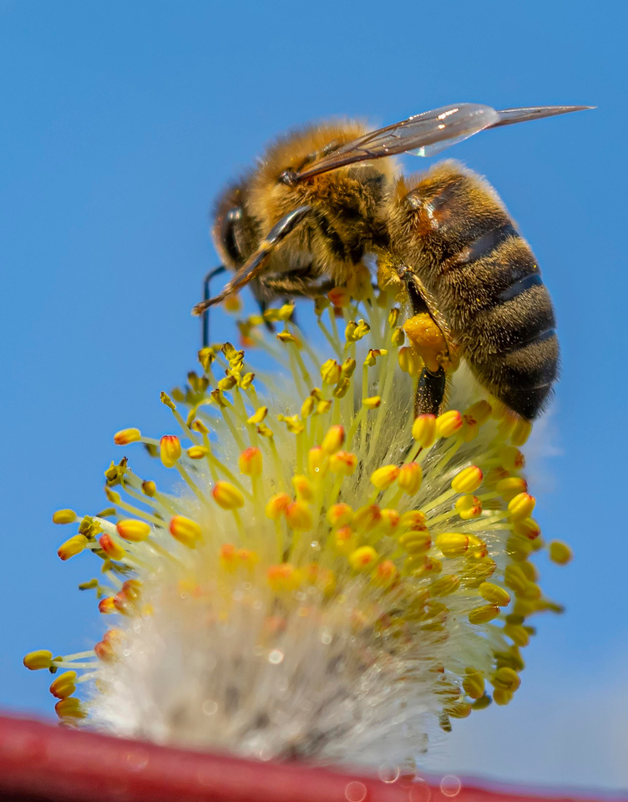
Pollination & Spread
Dissemination strategies
Regular promotion
Indexing in catalogue and Google Scholar
Greater recognition of the library

Slide 20




Shade and Fruit
Value and impact
Benefits to clinicians, managers, organisation
Enhances library reputation
Committment to open data and open science

Slide 21



Weathering the Storms
Challenges and lessons learned
Staffing: Sustainability, turnover, training
Risk and uncertainty

Slide 22

Seeds to Share
Inspiration for other libraries
Start small, grow steady
Leverage existing tools
Brand and share your outputs
Measure and tell the story
Embrace imperfection

Slide 23






Harvesting the Benefits
Conclusion
Libraries as cultivators of knowledge
Every library has a seed to plant
Share with your colleagues

Slide 24
Questions
Cassandra.Gorton@monashhealth.org

