Slide 1


Microsoft Copilot has been used to generated images in this presentation. AI images include used prompts below.
AI in Research:
Weed or Wonderful?
Gabby Lamb

Slide 2




5 varieties of AI: Weed or Wonderful?
Microsoft Copilot (Enterprise)
Google Notebook LM (Enterprise-ish)
Scopus AI and Deep research
Covidence
EndNote 2025
Wikipedia:1970s American film video covers
https://share.google/images/F49Pq80qqCwV8xWXx
https://share.google/images/1gk5nckpQUsEho5Z9

Slide 3

Weed or Wonderful?: Microsoft Copilot
Formally Bing Chat
On a par with doing research with just Google
Useful for generating keywords
eg. Give me a list of keywords based on semantic similarity for (X)
Grey literature searching
Better for regular as opposed to research tasks
Potential for grant applications
Video: https://www.youtube.com/watch?v=G2fqAlgmoPo
🌿 Copilot as a Plant: The "Synthowillow" Tree
Prompt: If Microsoft Copilot were a flower, plant, shrub or tree, what would it look like? 17 September 2025

Slide 4

Weed or Wonderful?: Scopus AI
Scopus AI for initial scoping searches or keyword/Boolean initial suggestions
Starting references or finding a ‘gold set’ for a review
Lacks nuance
Needs a SME’s discerning judgement
Deep research for preliminary research on new topic?
Can help in the planning stages for research?
Is it too much ‘cognitive offloading’?
Video: https://youtu.be/TcVC_yR0QVo?si=aoMNMctMLAM7drOg
Wikimedia Commons: Logo for Elsevier

Slide 5

Weed or Wonderful?: Scopus AI
Scopus AI for initial scoping searches or keyword/Boolean initial suggestions
Starting references or finding a ‘gold set’ for a review
Lacks nuance
Needs a SME’s discerning judgement
Deep research for preliminary research on new topic?
Can help in the planning stages for research?
Is it too much ‘cognitive offloading’?
Video: https://youtu.be/TcVC_yR0QVo?si=aoMNMctMLAM7drOg
✨ Creating your natural & symbolic Scopus AI Tree
Copilot Prompt using GPT5: If Scopus AI were a flower, plant, shrub or tree, what would it look like?

Slide 6
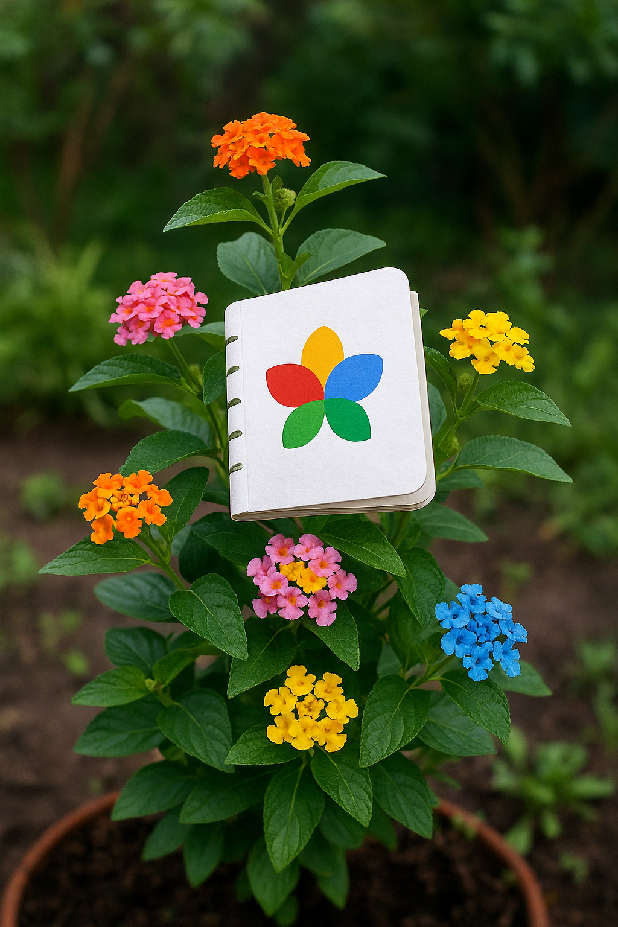

Weed or Wonderful?: Google Notebook LM
Virtual research assistant or fun time waster?
Upload various material sources
What seem like references are better described as anchor points in the original source eg.
Click on the number to take you to the placeholder in the source
Video: https://www.youtube.com/watch?v=FOs4RDTC52Q
Copilot Prompt: If Google Notebook LM was a flower, plant or shrub, generate an image of what that would look like

Slide 7
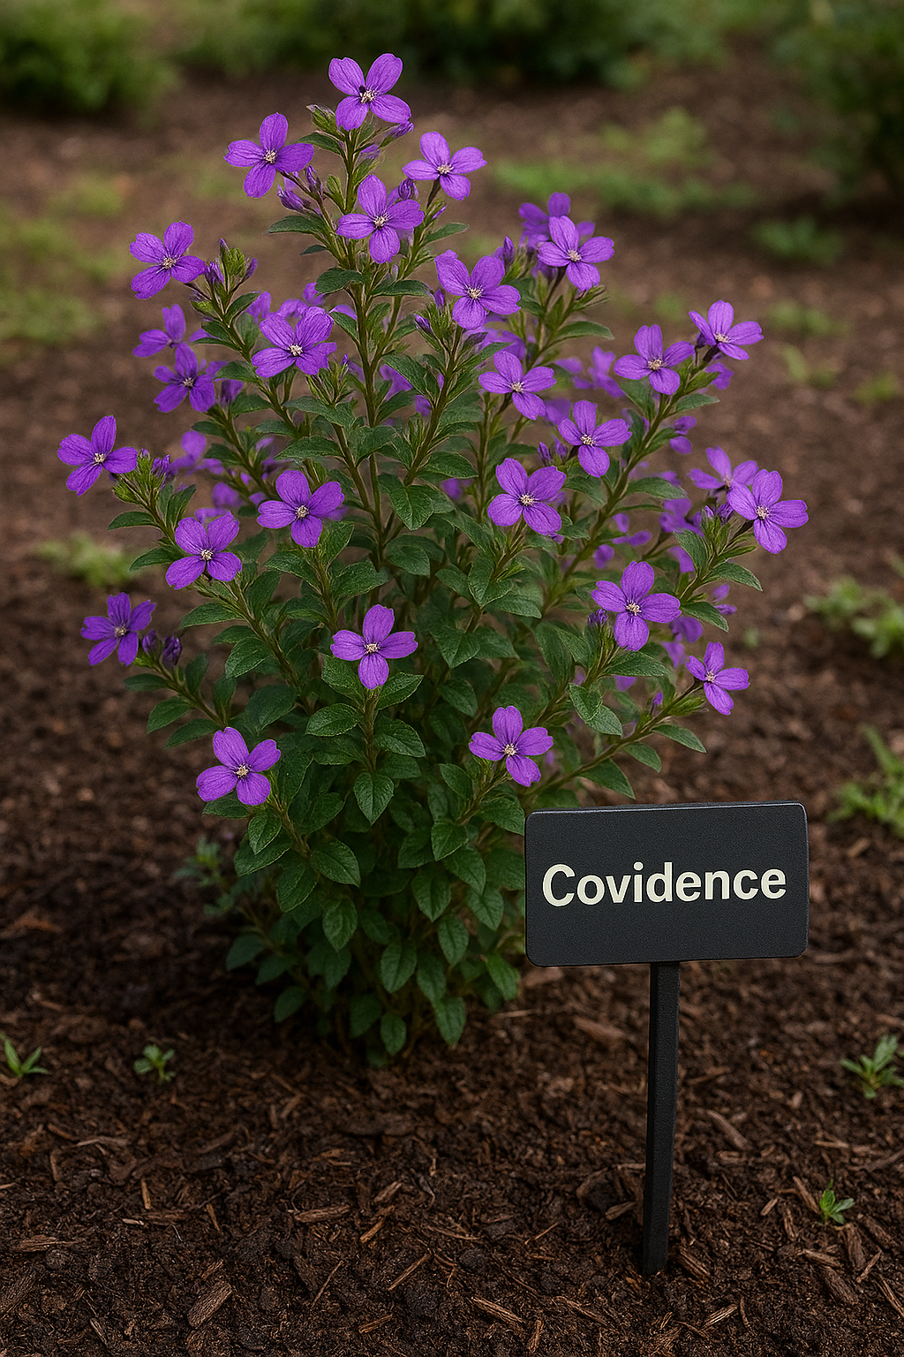
Machine learning = AI
Relevance sorting of references
RCT identification
More AI on the roadmap
More efficient screening? Evidence?
Streamlining the review process
Data extraction templates facilitated by AI suggestions
More: https://www.covidence.org/blog/from-manual-to-machine-how-covidences-ml-is-streamlining-systematic-reviews/
Weed or Wonderful?: Covidence
Copilot Prompt: If Covidence was a flower, plant or shrub, generate an image of what that would look like

Slide 8
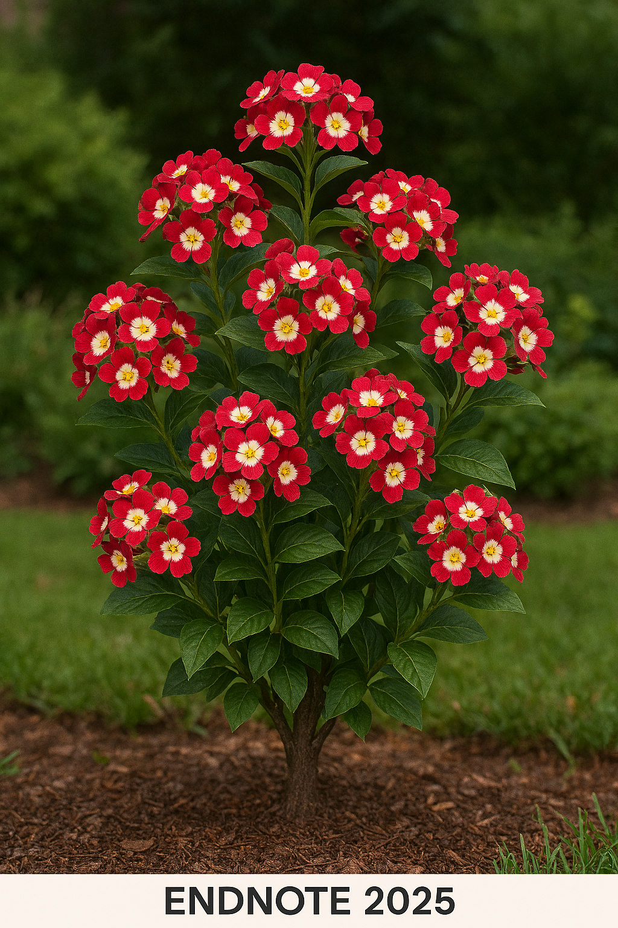
#1 reference management for researchers
AI features dependent on institution security parameters
AI summaries - meh!
NB Research Assistant upgrades in EndNote 2025.1:
    “Chat with your document” interactive research functionality?
    Multilingual document translation support?
Weed or Wonderful?: EndNote 2025
Copilot prompt: If EndNote 2025 was a flower, plant or shrub, generate an image of what that would look like. Don’t ask???

Slide 9
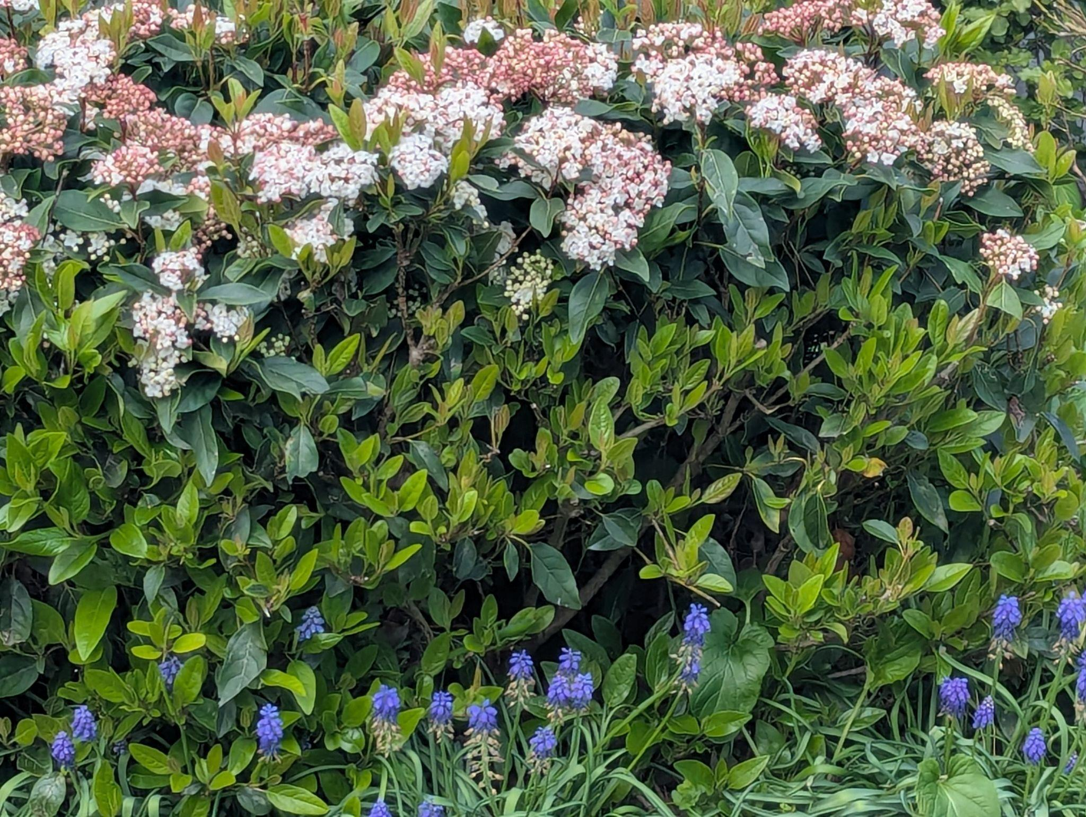
My back garden
References
Faculty of IT. From Code to Cure: AI Solutions for Modern Medicine webinar. Monash University. October 8, 2025 [postponed 2026]. https://www.monash.edu/it/events/2025/from-code-to-cure-ai-solutions-for-modern-medicine
Mollick, E. On speaking to AI: voice changes a lot of things. One Useful Thing. August 1, 2024. Accessed August 19, 2025. https://www.oneusefulthing.org/p/on-speaking-to-ai
Monash University Library. Google and Google Scholar search tips. Grey Literature Library Guide. April 2024. Accessed October 3, 2025. https://guides.lib.monash.edu/grey-literature/findinggreyliterature
ALIA HLA: Grant Writing with AI webinar. Health Libraries Australia. August 6, 2025. Accessed August 6, 2025. [Restricted]
Seckel E, Stephens BY, Rodriguez F. Ten simple rules to leverage large language models for getting grants. PLOS Computational Biology. 2024;20(3):e1011863. doi:10.1371/journal.pcbi.1011863
Tay A. What academic "deep research" is really for: orientation, not copy-paste prose. Aaron Tay's Musings about Librarianship. August 11, 2025. Accessed August 19, 2025. https://aarontay.substack.com/p/what-academic-deep-research-is-really
Veritas Health Innovation. Covidence systematic review software: about us. Accessed October 3, 2025. https://www.covidence.org/about-us-covidence/.
Clarivate. Key Features of EndNote 2025. EndNote LibGuide. September 26, 2025. Accessed October 3, 2025. https://proquest.libguides.com/endnote

