Slide 1
The digital borrower:
A medical and public library joint initiative
Hannah (Han) Bertoli

Slide 2
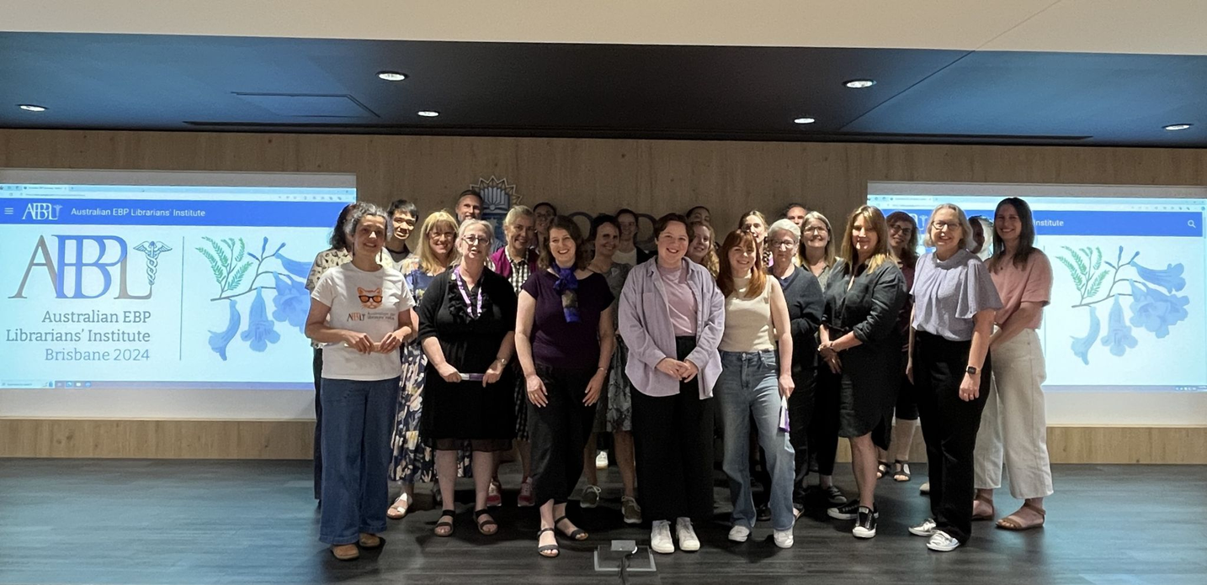

Pat Nakouz Award
  Joint recipient in 2024
  Attended Australian Evidence Based Practice Librarians’ Institute (AEBPLI)
Me! at AEBPLI Brisbane in 2024
Photo credit: AEBPLI

Slide 3
(Rough)
Guideline
  What is the project about?
  How did the project come about?
  Who was involved?
  What happened?
  What did I learn?
  Applause

Slide 4



What Is It All About?
Monash Health Library & local public libraries
Digital Access to apps such as Borrowbox, Libby, Kanopy, Pressreader
Deliver training and insructions

Slide 5
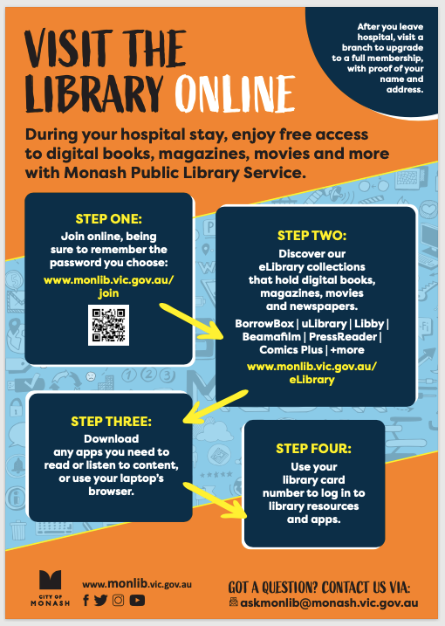

How Did It Start?
2018
Book Trolley
2019
National Simultaneous Storytime
2024
Project is picked back up

Slide 6
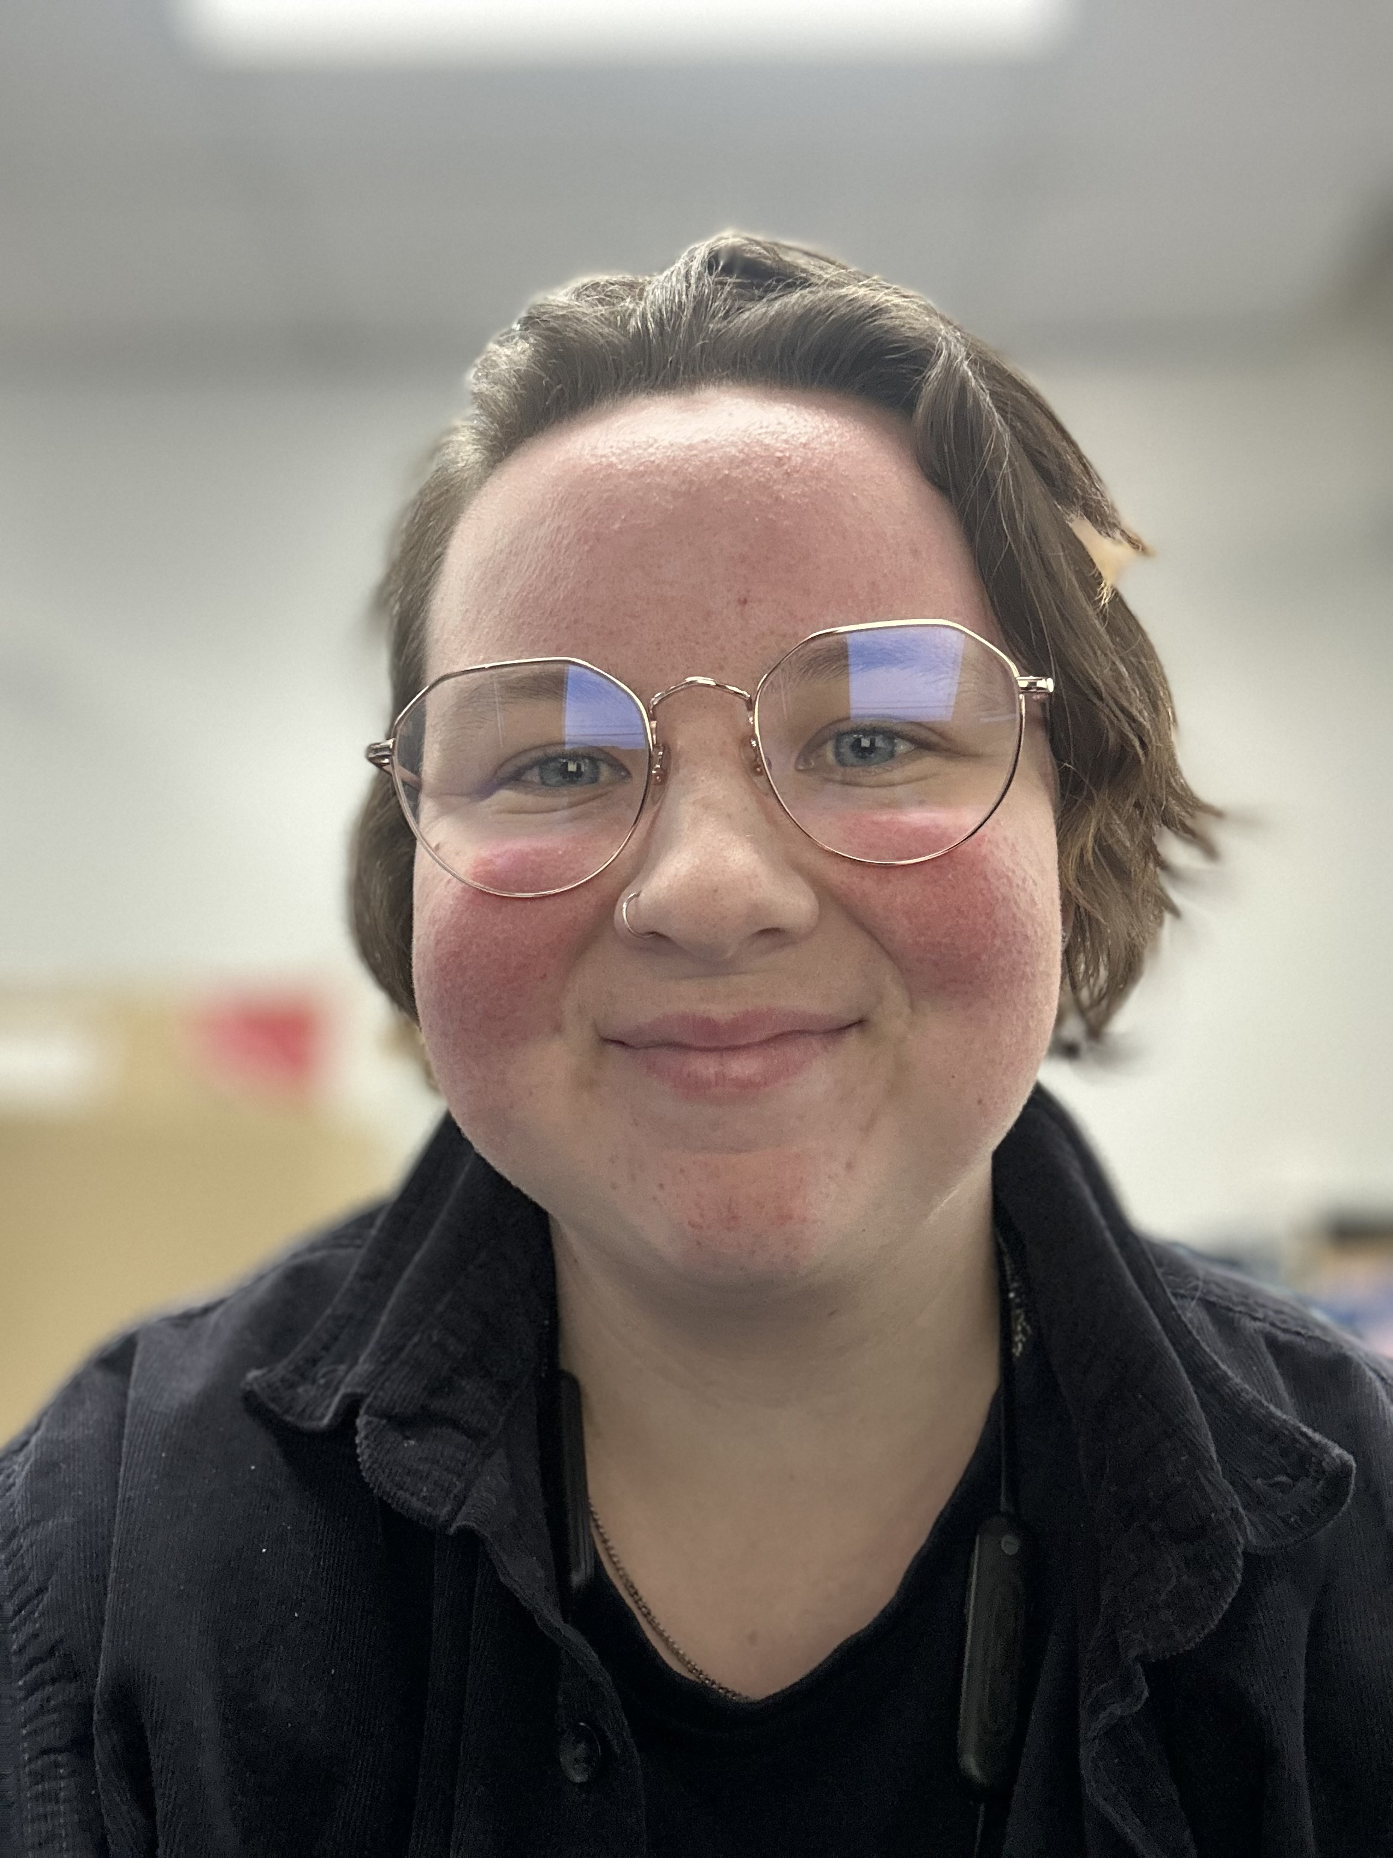

Who Am I?
  Worked in public libraries since 2022
  Library Cadet at Monash Health Library 2024-2025

Slide 7






Meet The Players
Monash Health Hospital
Monash Health Library
Monash Public Library Service
Greater Dandenong Libraries
Casey Connected Libraries
Clayton & Morrabbin
Dandenong
Casey

Slide 8
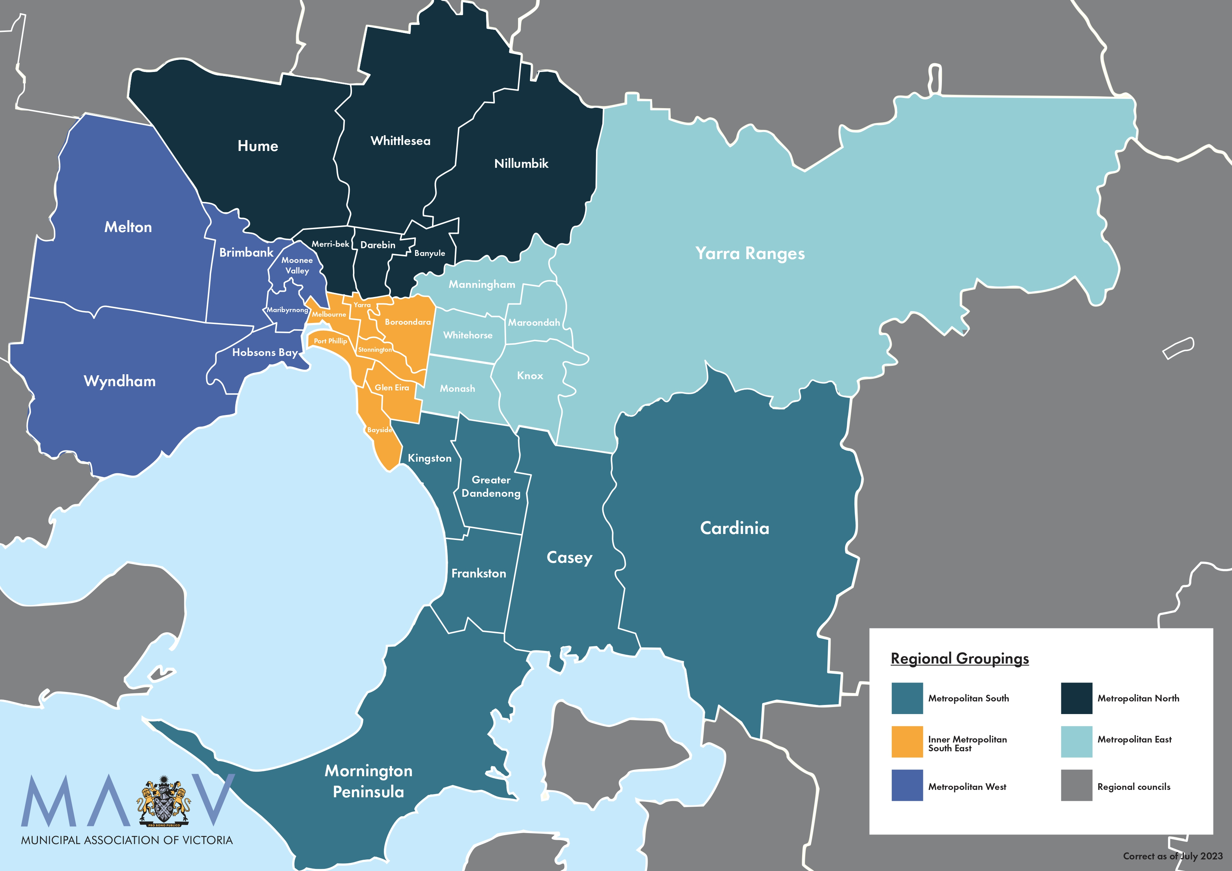


Clayton & Moorabbin
Casey
Dandenong
Image credit: Municipal Association of Victoria

Slide 9
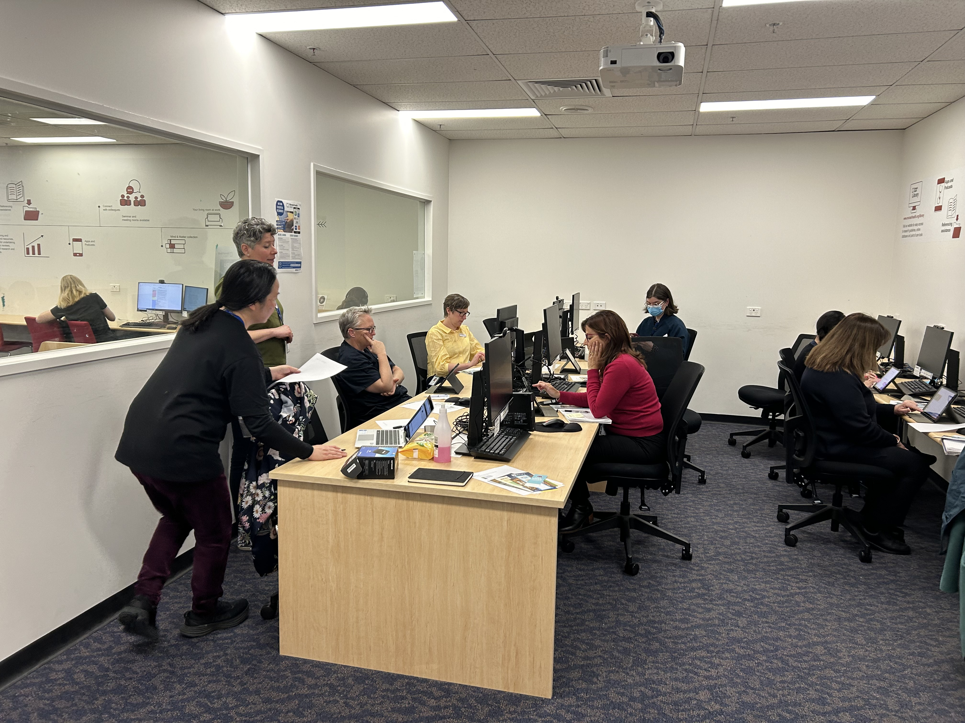
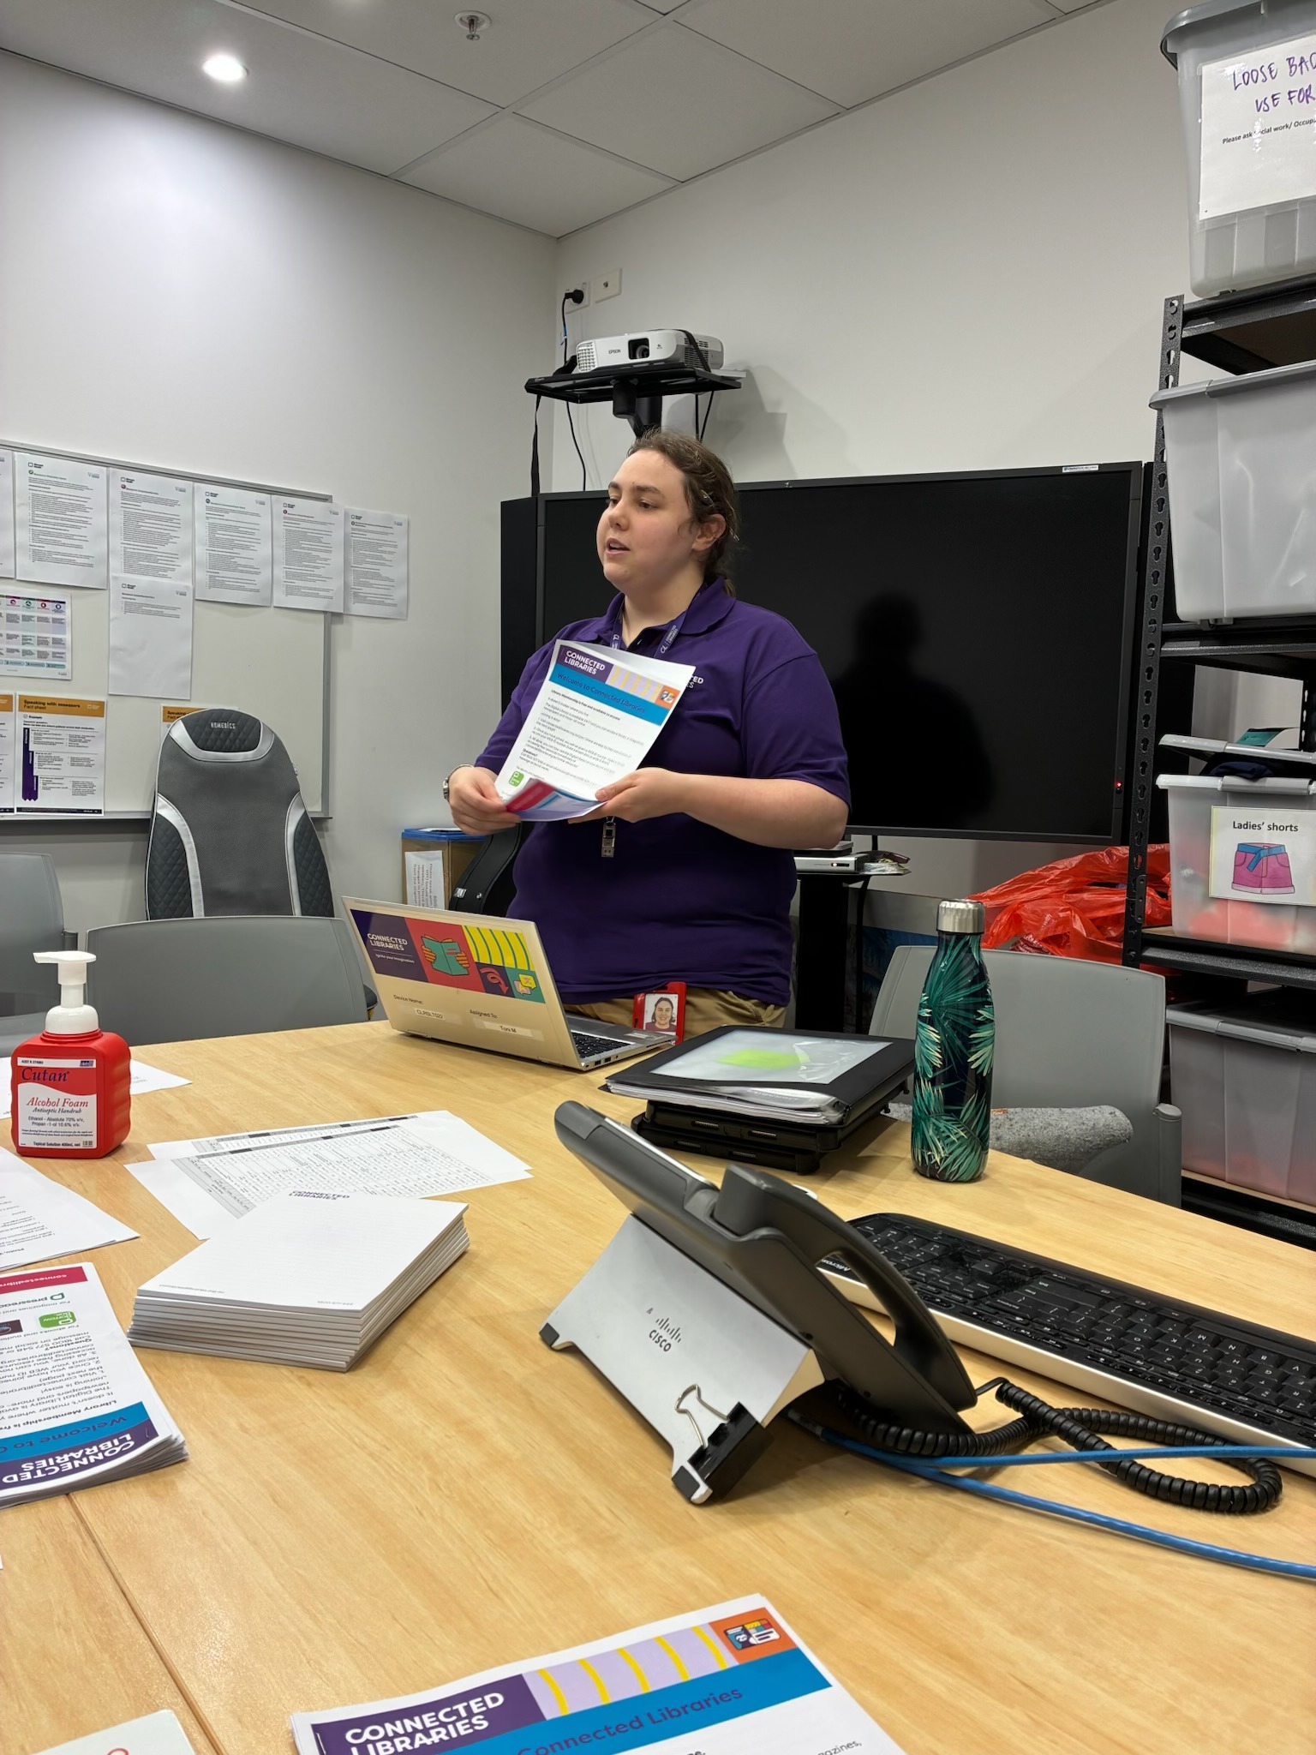
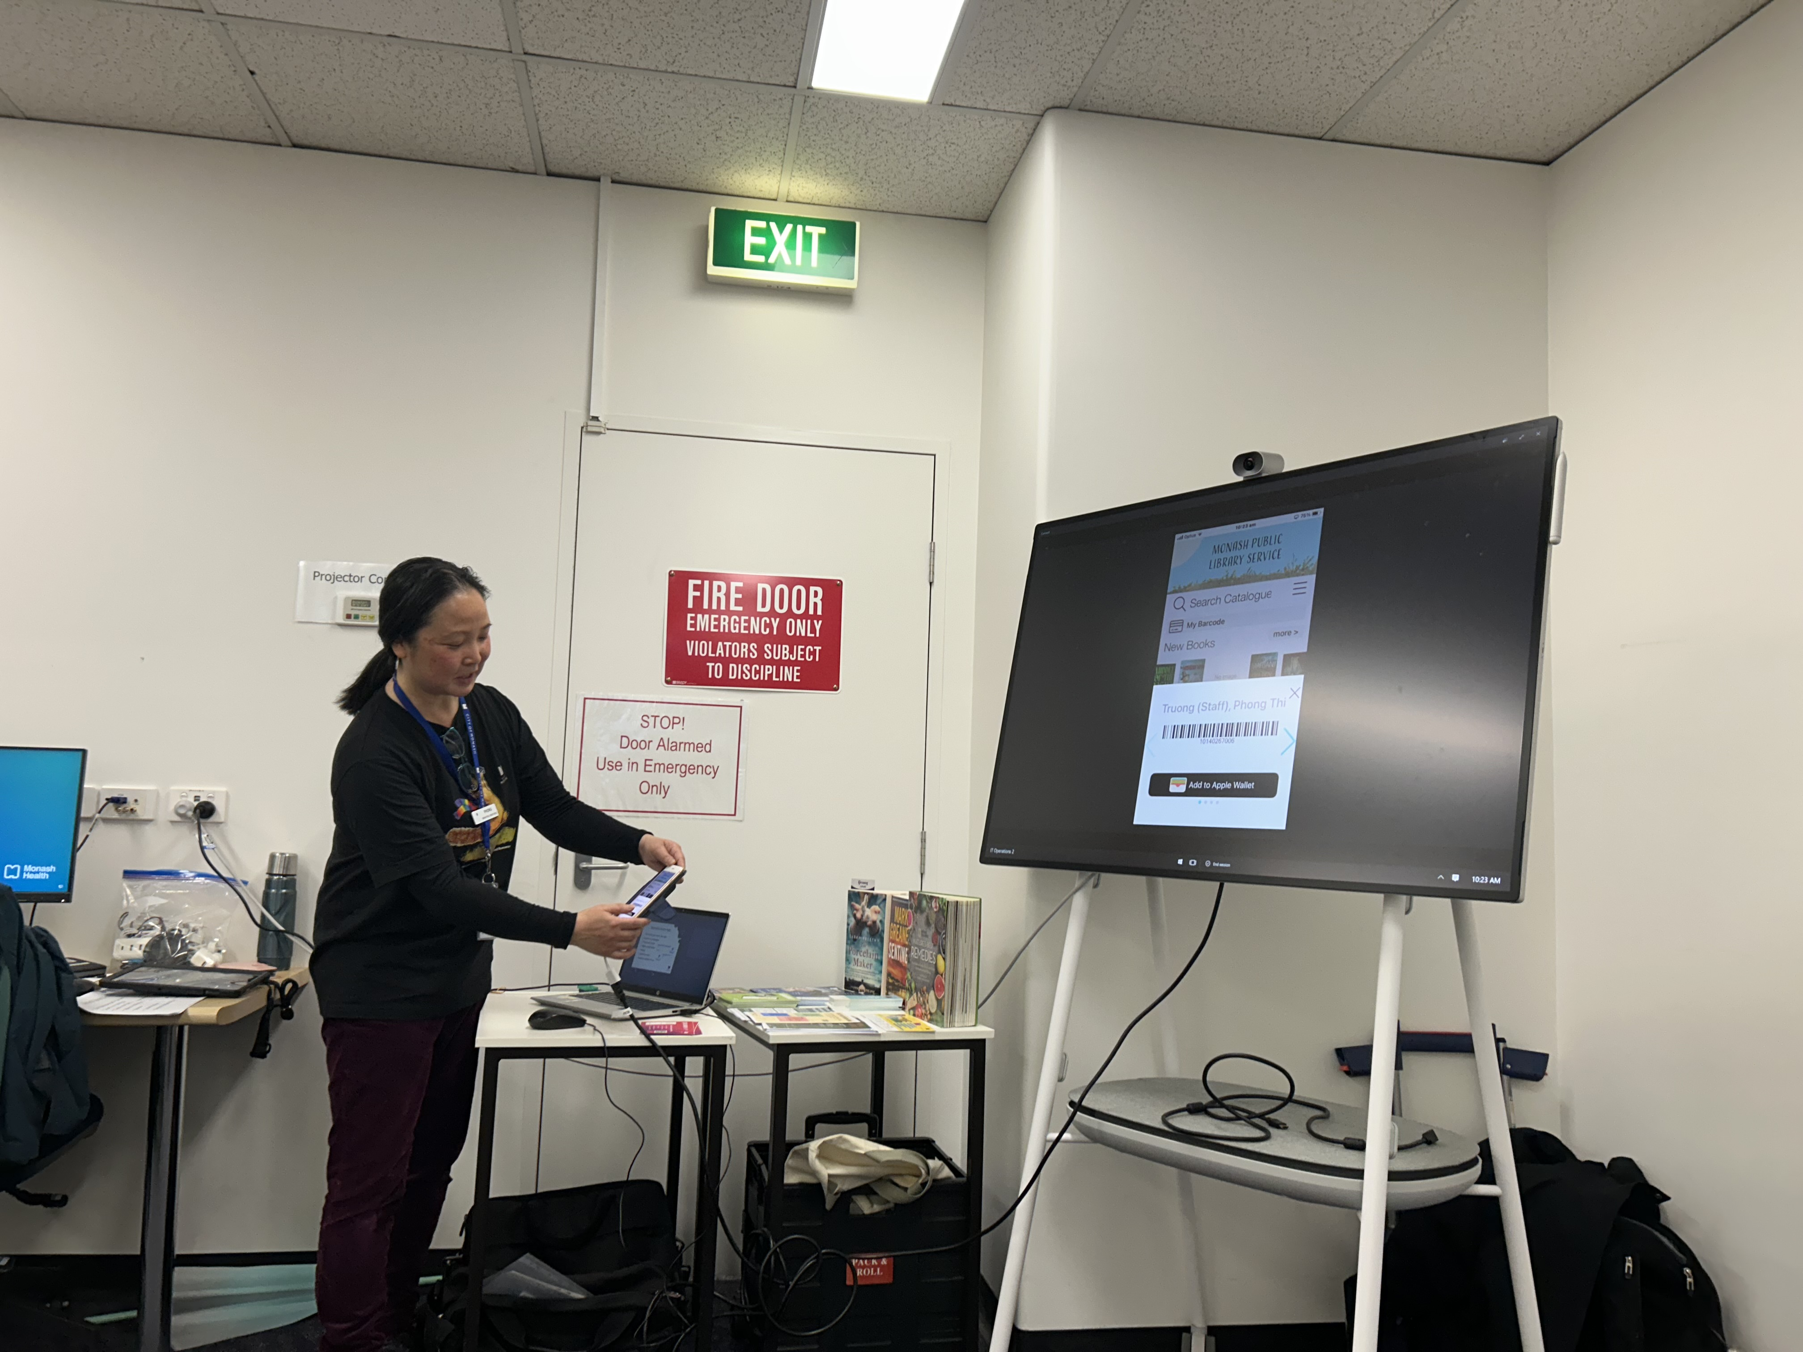
What Happened?
Photo credits: Alice Anderson

Slide 10
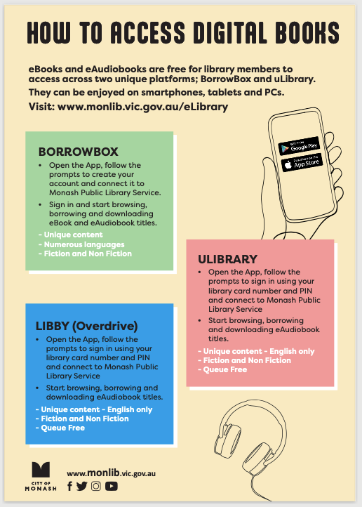
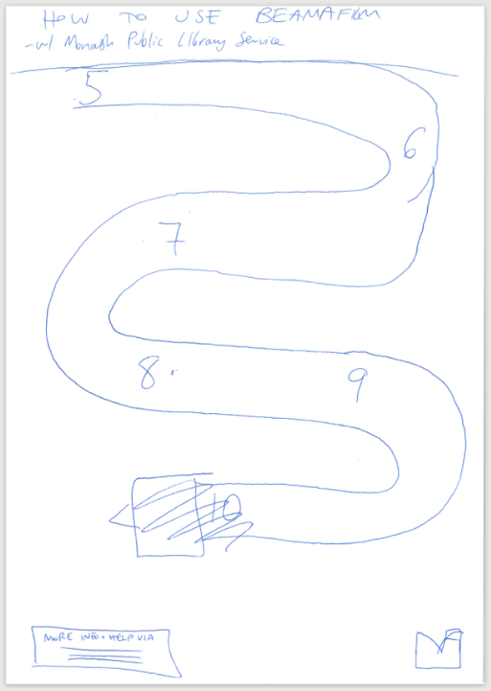
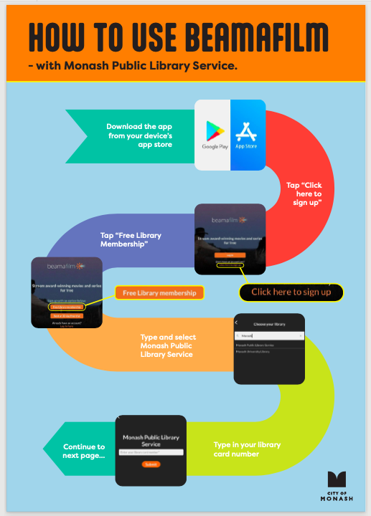
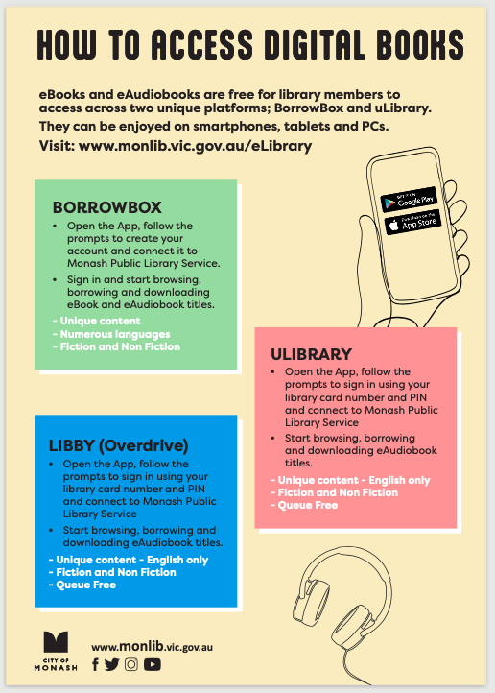
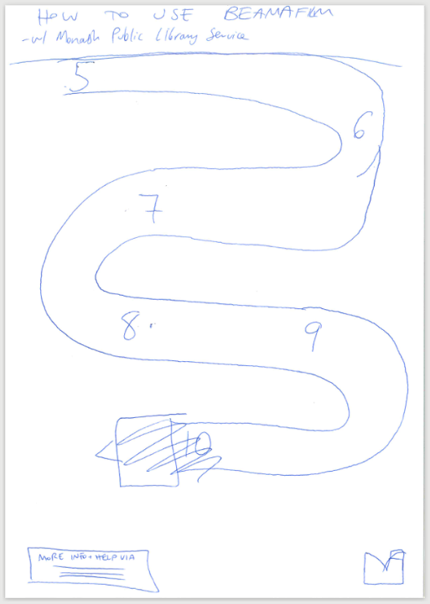
Monash Public

Slide 11
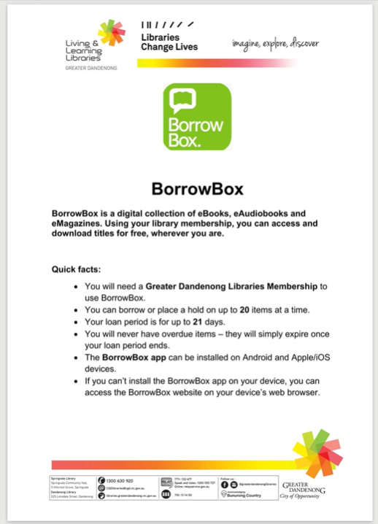
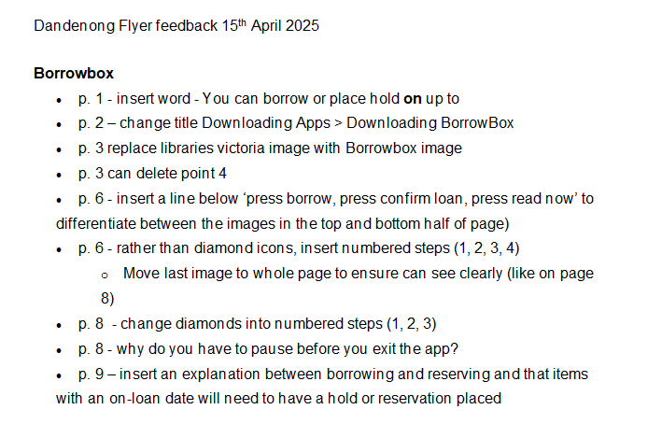
Dandenong

Slide 12
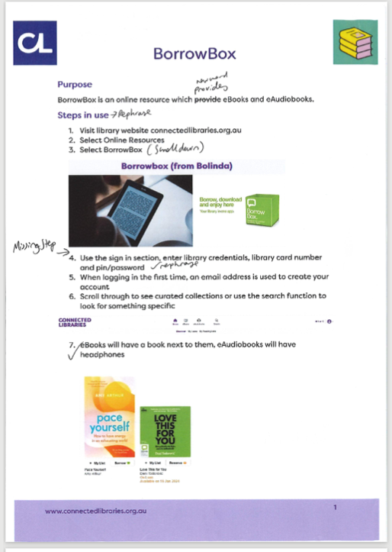
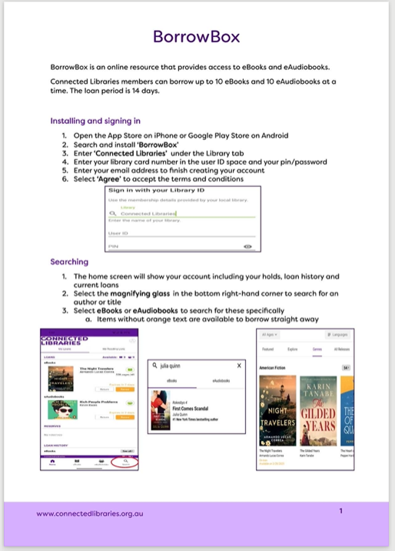
Casey Connected

Slide 13


What Did I Learn?
Take Notes
Give feedback
Proofread
Use your network

Slide 14
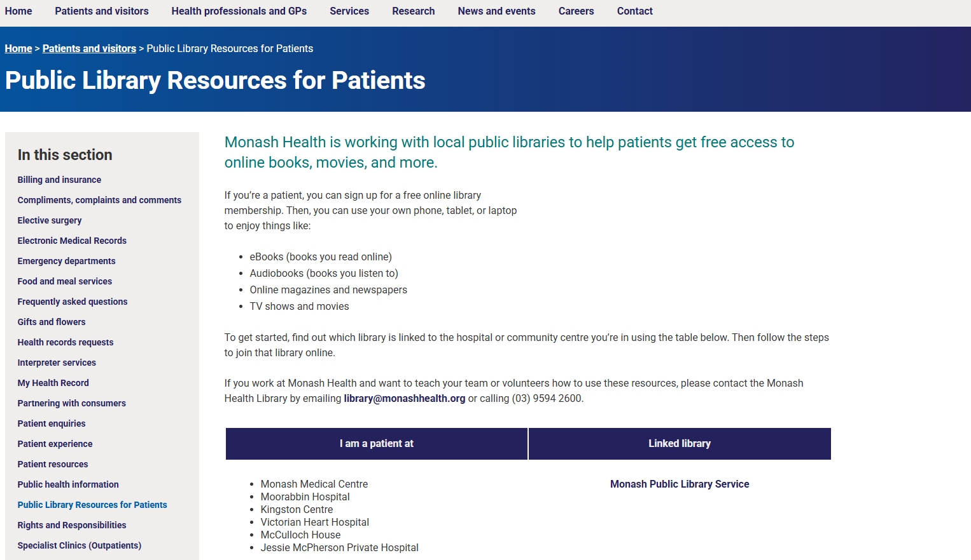
Image courtesy of Monash Health website

Slide 15
Thank you.
Acknowledgements
  Monash Health Library and team
  Monash Health and team
  Monash Public Library Service and team
  Greater Dandenong Library and team
  Casey Connected Libraries and team

