Slide 1

Accelerate Health research with ARDC & Health Libraries
<10 Oct 2025> 21st HLi Conference, Melbourne
<Dr Richard Ferrers, Data Consultant, ARDC
richard.ferrers@ardc.edu.au
Dr Amany Gouda-Vossos, Skills Development Lead - People, ARDC >
amany.gouda-vossos@ardc.edu.au
See slides at:
https://eresear.ch/accelerateHealth25HLi
Resource Document at:
https://eresear.ch/Tools4Medical2025
Notes:
Planning doc | Conference: Cultivating Knowledge: Nurturing Health Leadership; nurturing health librarianship
MND = Motor Neurone Disease, FightMND have funded over $120million investment into curing MND.
Image credits clockwise:
Mario Purisic - jG1z5o7NCq4 / unsplash.com
Video at: https://fightmnd.org.au/cure/for-researchers/fightmnd-scientific-seminar-series/
Janifest – 379768765 / adobestock.com
Gorodenkoff - 236237514 / adobestock.com
Hero Images - 316159695 / adobestock.com
themorningglory - 391783296 / adobestock.com
Gorodenkoff - 402341966 / adobestock.com
Marc Grimwade / ARDC
Planning doc | Planning | video(VIDEO)

Slide 2
See slides at:
https://eresear.ch/accelerateHealth25HLi
Search: MND
Datacite DOIs; 105M This Yr 26M; 2024 21M
Notes:
Add QR code?

Slide 3

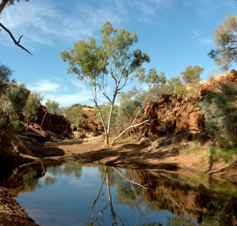


Acknowledgement of Country
We acknowledge and celebrate the First Australians on whose traditional lands we meet, and we pay our respect to their elders past and present.
Uluru
Notes:
ACKNOWLEDGEMENT OF COUNTRY
I wish to acknowledge the people of the Kulin Nations, on whose land we are gathered today. I pay my respects to their Elders, past and present. (Monash)
I would like to acknowledge the Traditional Owners of the lands on which we meet today (include the name of the people) and pay my respect to their elders past and present.
Image credits clockwise:
federico-Garcia - MQxP65uEfJE / unsplash.com
ake1150 - 220246410 / adobestock.com
Tristan McKenzie - 715v3NOlVhU/ unsplash.com
René Riegal - 0VFr6ub7HlA / unsplash.com

Slide 4



Showcasing ARDC tools to accelerate research for Health Librarians to support 21st Century research
What is 21st Century research?
The challenge: a data deluge
The solution: ARDC; what is a data commons?
How ARDC supports health and medical? New tools => The People RDC
Research Link Australia - connecting industry, research topic, grants
4. Nectar - cloud compute
5. Resources, Health & Skills infrastructure
Nectar user training and services
Health Data Australia demo
Clinical research data sharing frameworks
Secondary data use materials
ARDC resources
Planting
Watering
Harvesting
Notes:
Themes:
Plant the seeds of knowledge
Tend to emerging trends
Harvest the benefits

Slide 5

21st Century - Challenges for researchers
Image
Digital Data deluge
Literature deluge
Tools deluge
Sharing (collaborating over) data
Lack of time
Grants very competitive
Declining pool of funding
(except for MRFF)

Slide 6
Image
Search: MND
Datacite DOIs; 105M This Yr 26M; 2024 21M

Slide 7
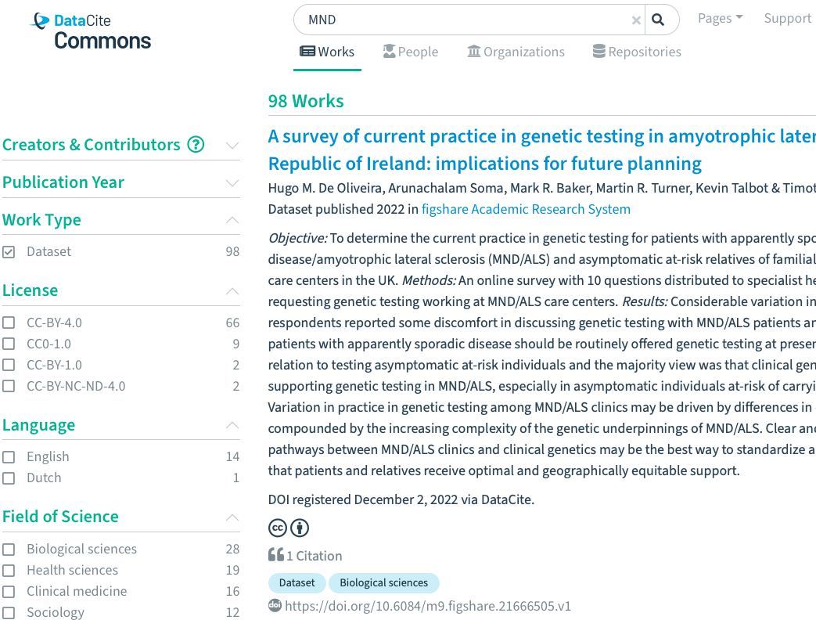
Find health data: MND @Datacite
124 datasets - 98 Mar
99 licensed to reuse 79 Mar
Compare Australia’s - Research Data Australia 200,000 data collections inc 1 MND
Eg Dementia in MND; MRI diagnosis https://doi.org/10.6084/m9.figshare.7515848
Search MND

Slide 8
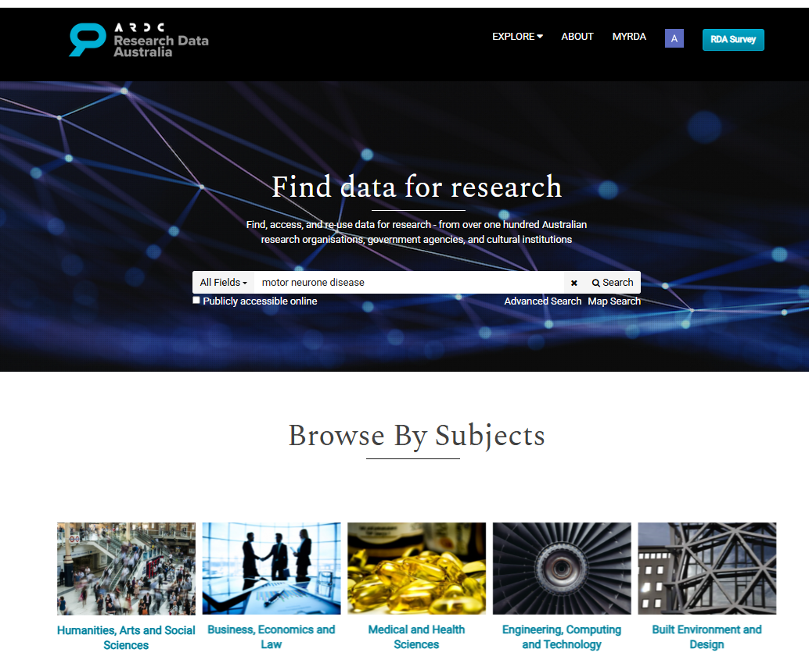

Research Data Australia
researchdata.edu.au/
1500 AU health datasets from total 200,000 datasets

Slide 9
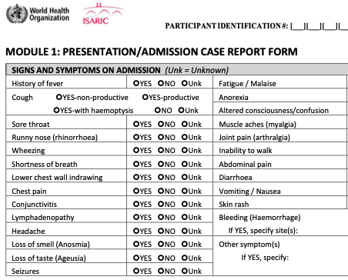
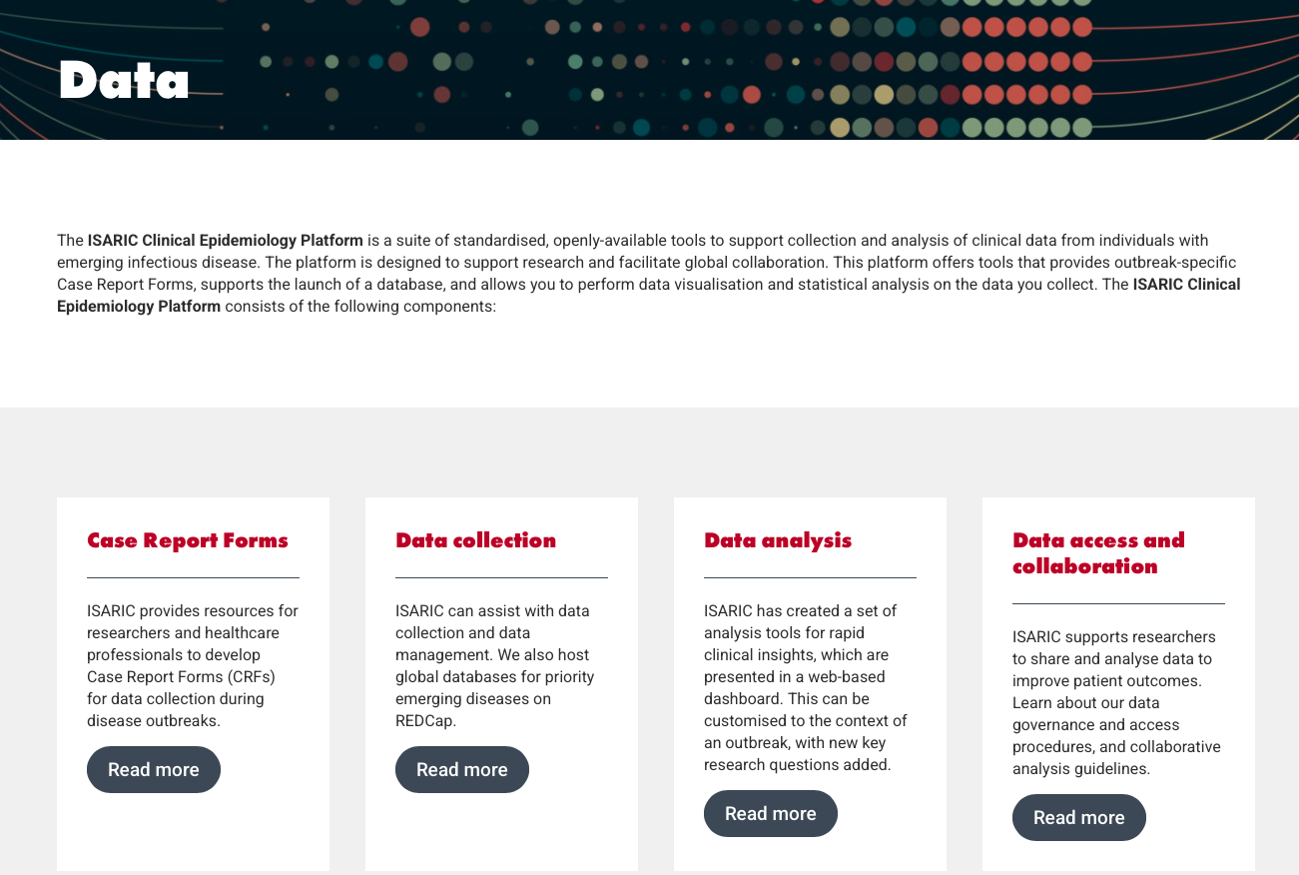
Share health data: COVID-19
Data collection (form)
Data storage; Redcap Oxford
Data reporting (pre-print) - 18 reports over 3 years
  762,000 patient outcomes
  Fatalities 22%, 36% in ICU
  Data dashboard
More on COVID and FAIR data
More data MiMiC docs
https://isaric.org/resources/data/
International Severe Acute Respiratory and emerging Infection Consortium (ISARIC)
Health at the speed of data

Slide 10
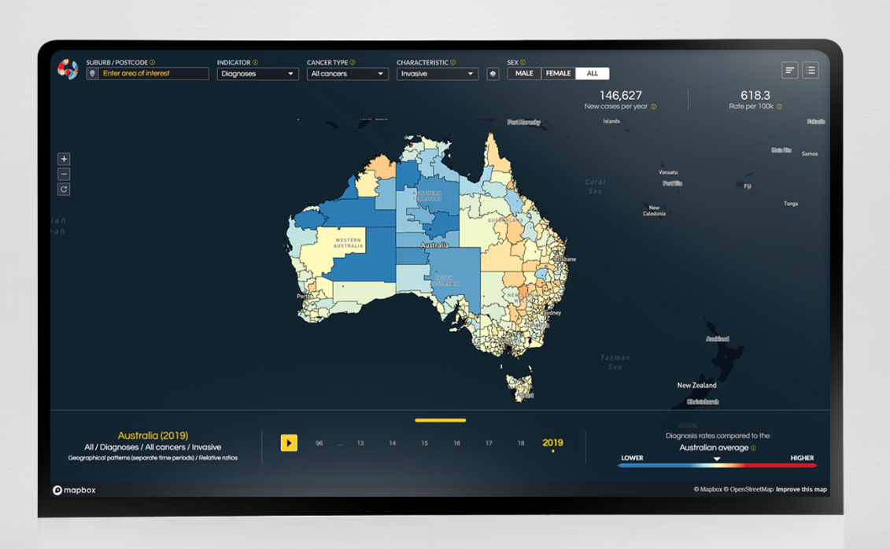
Analyse health data: Australian Cancer Atlas
“develop a greater understanding of cancer’s geographical patterns”
atlas.cancer.org.au/
Project
Notes:
Also NIH - Data sharing policy 2023 - https://grants.nih.gov/policy-and-compliance/policy-topics/sharing-policies/dms/policy-overview?utm_source=chatgpt.com
Source:

Slide 11
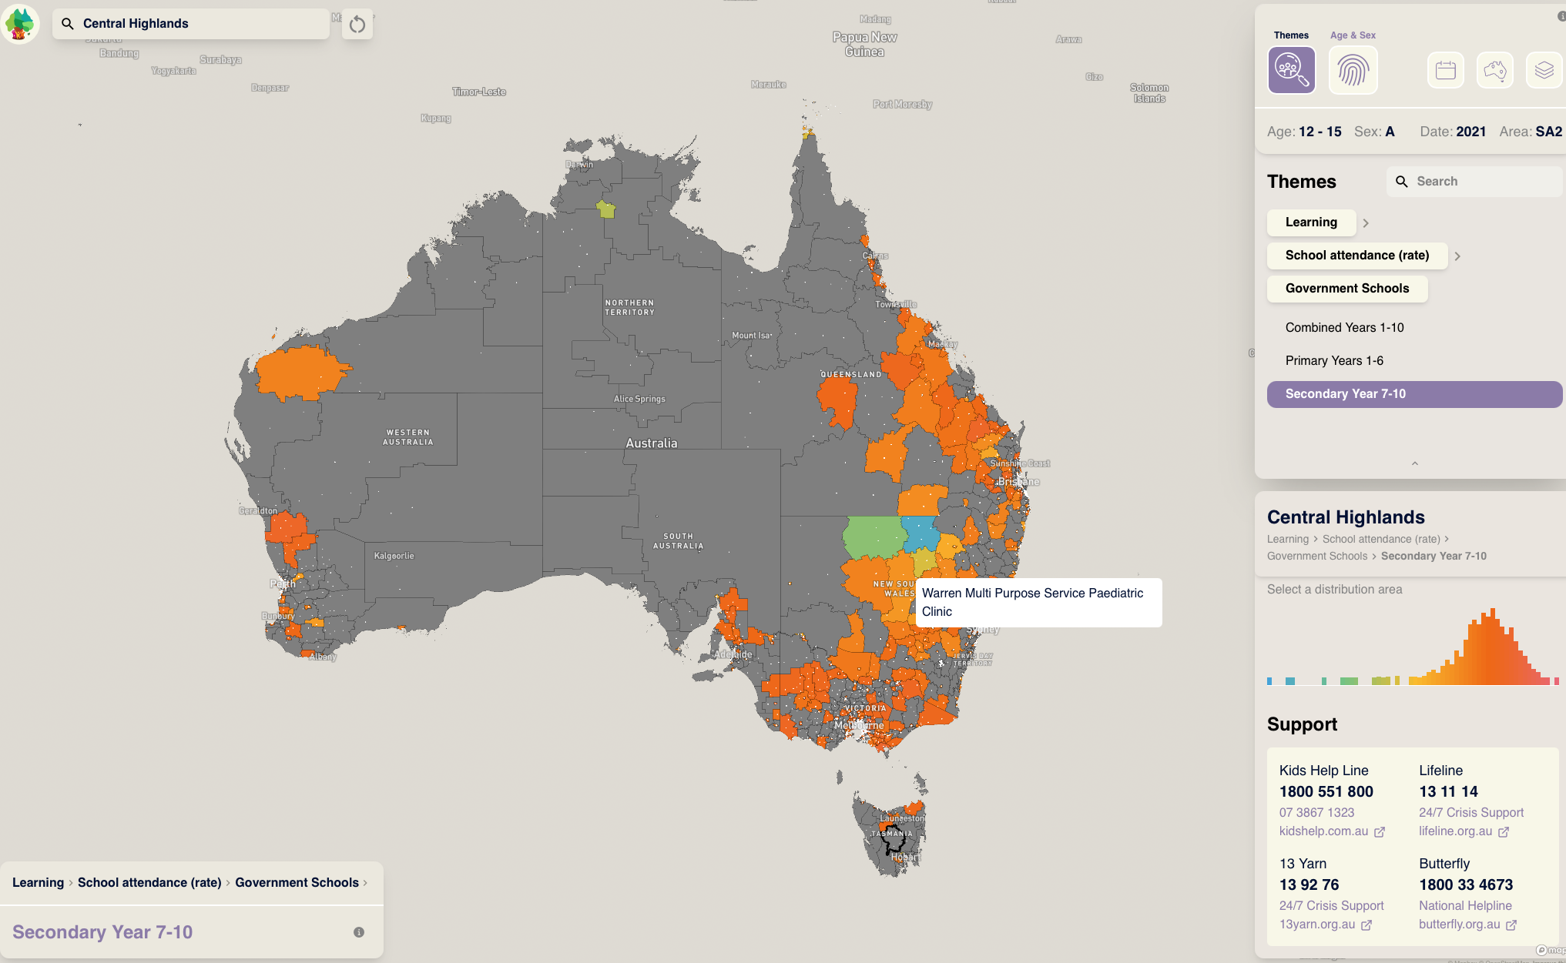
Analyse: Australian Child and Youth Wellbeing Atlas
”enables the visualisation, analysis, and monitoring of health and wellbeing metrics for children and young people.”
australianchildatlas.com/
Project
Notes:
Also NIH - Data sharing policy 2023 - https://grants.nih.gov/policy-and-compliance/policy-topics/sharing-policies/dms/policy-overview?utm_source=chatgpt.com
Source:

Slide 12
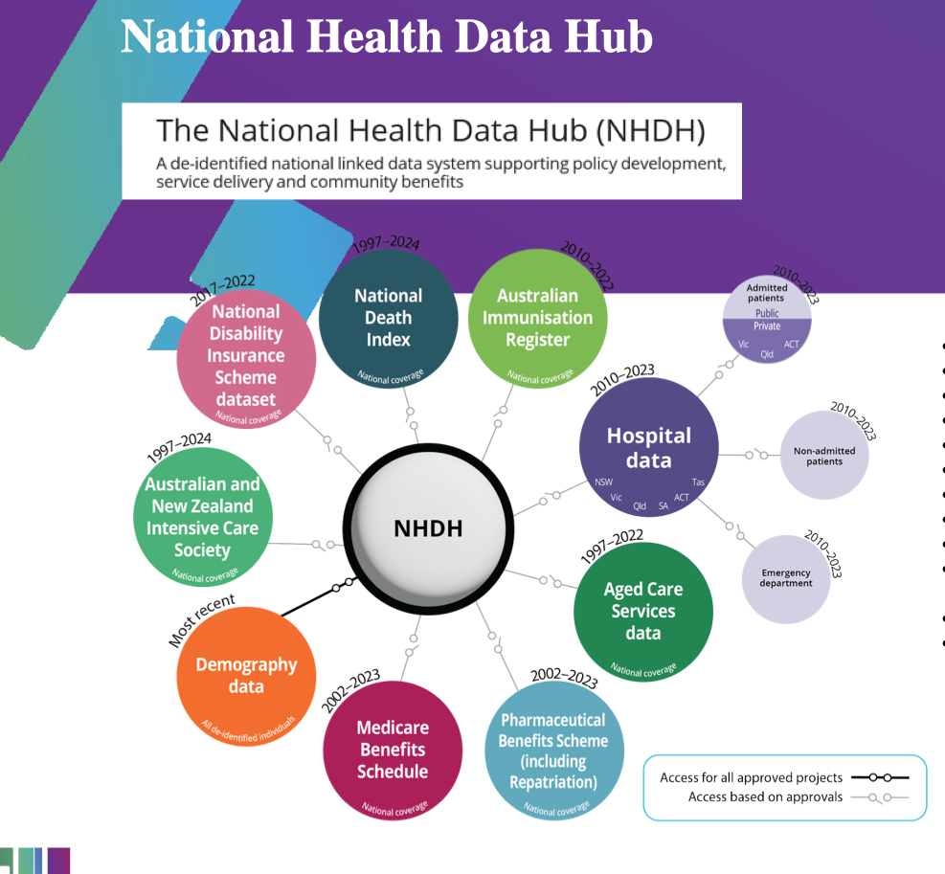
Connect Data: National Health Data Hub
“a major national data linkage system for health and welfare research and analysis..de-identified… state,territory, Commonwealth… data sources”
National Health Data Hub (NHDH)
View launch presentation slides.
Project
Notes:
NHDH - National Health Data Hub (NHDH) https://www.aihw.gov.au/reports-data/nhdh
Also NIH - Data sharing policy 2023 - https://grants.nih.gov/policy-and-compliance/policy-topics/sharing-policies/dms/policy-overview?utm_source=chatgpt.com
Source:

Slide 13
International Drivers for FAIR data and Open Science
OECD 2021; discovery in the digital age
UNESCO Open Science Recommendation 2021 - 194 countries
APEC Open Science Statement 2020
G20 Science Ministers support for Open Science 2021
Science as an Open Enterprise The Royal Society 2012
“Data should be available in ..human and machine-readable and actionable format in accordance with principles of good data governance, notably FAIR principles.” (p.10) UNESCO
slides :https://eresear.ch/accelerateHealth25HLA
Notes:
Also NIH - Data sharing policy 2023 - https://grants.nih.gov/policy-and-compliance/policy-topics/sharing-policies/dms/policy-overview?utm_source=chatgpt.com

Slide 14
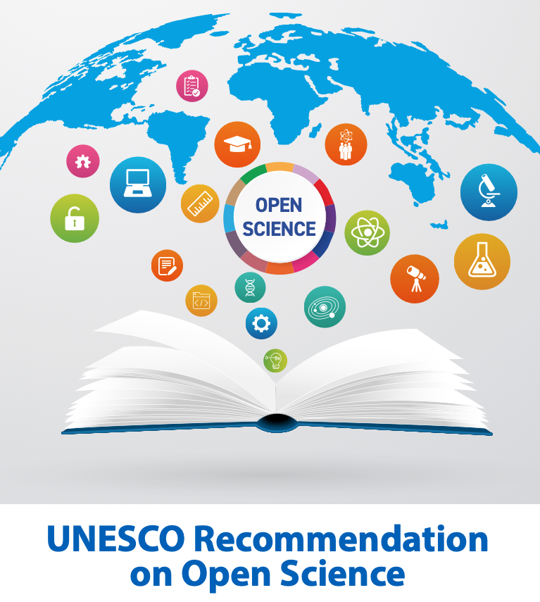
UNESCO and Open Science - Recommends 2021
The key objectives and areas of action of this Recommendation are as follows:
I. promoting a common understanding of open science, associated
benefits and challenges, as well as diverse paths to open science;
Ii. developing an enabling policy environment for open science;
Iii. investing in open science infrastructures and services;
Iv. investing in human resources, training, education, digital literacy
and capacity building for open science;
V. fostering a culture of open science and aligning incentives for open
science;
Vi. promoting innovative approaches for open science at different
stages of the scientific process;
Vii. promoting international and multi-stakeholder cooperation in
the context of open science and with view to reducing digital,
technological and knowledge gaps.
6
doi.org/10.54677/MNMH85

Slide 15

Australia Open Science and FAIR data
Australian Open Science Network 2023 (CAUL, OAA, ARDC)
  Inc National and State Libraries Australasia, NHMRC, ARC, CSIRO
  Advocate for open science; CAUL Libguide
NHMRC guidance on high quality research (Aug 2025) - open science examples (p.16)
ARC Fair Data policy in 2026 per PID Action Plan
Digital Health CRC calls for coordinating effort to unlock value of national health data 2025
Notes:
CAUL Lib Guide - How to be an Open Researcher - https://caul.libguides.com/open-research-toolkit/how-to-be-an-open-researcher

Slide 16
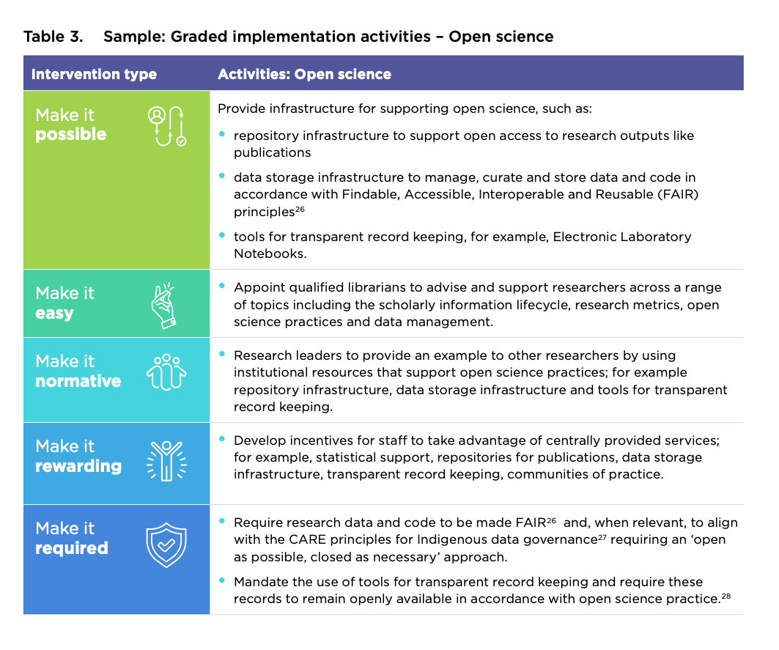
NHMRC guide for Culture Change to Open Science Aug 2025
Make it possible - curate, store data
Make it easy - “qualified librarians to advise and support researchers inc …open science practices and data management”
Make it normal - support open science
Make it rewarding - incentives
Make it required- “make data FAIR”
Source: NHMRC Good Institutional Practice Guide 2025, p.16

Slide 17
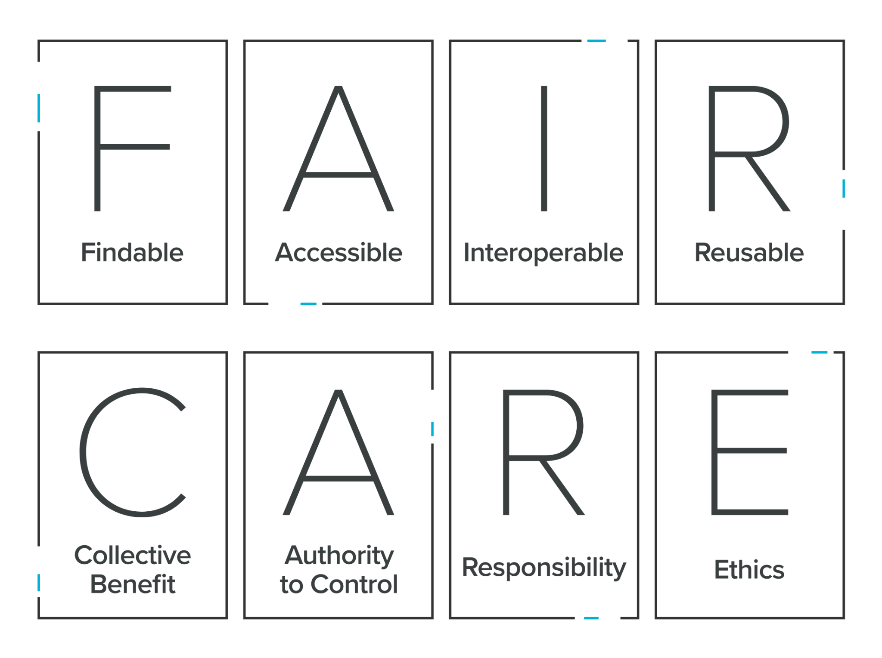

FAIR & CARE Principles
Globally collaborative (FA)
Cross - disciplinary (IR)
Notes:
FAIR AND CARE PRINCIPLES
The FAIR and CARE principles underpin everything we do.
The ‘FAIR Guiding Principles for scientific data management and stewardship’ were published in 2016 and relate to making digital assets findable (F), accessible (A), interoperable (I) (allowing data to work across different platforms) and also reusable (R).
We ask for research assets to be as easily accessible as possible because accessible research inputs and outputs drive research impact, quality, translation and innovation, which is great for research and society.
We recognise that translating the FAIR principles into practice will vary for each discipline.
In the context of the rise of the FAIR principles in the community of international data infrastructure builders, the Global Indigenous Data Alliance formulated the CARE principles, to address a clear deficit in FAIR regarding Indigenous peoples rights and interests.
‘CARE’ is the acronym for:
Collective benefits - Data ecosystems shall be designed and function in ways that enable Indigenous peoples to derive benefit from the data.
Authority to control - Indigenous peoples’ rights and interests in Indigenous data must be recognised and their authority to control such data be empowered.
Responsibility - Those working with Indigenous data have a responsibility to share how those data are used to support Indigenous peoples’ self-determination and collective benefit.
Ethics - Indigenous peoples’ rights and wellbeing should be the primary concern at all stages of the data life cycle and across the data ecosystem.
The CARE principles complement the existing FAIR principles.
While the FAIR principles are about making it easier to share and reuse data, the CARE principles ensure that data is used ethically and with appropriate governance.

Slide 18
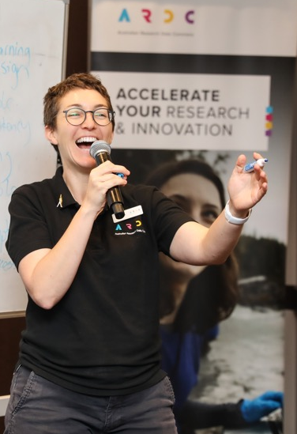
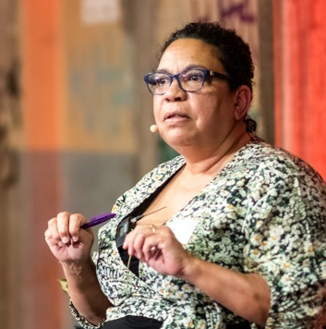


1.About the ARDC
The ARDC is Australia’s leading research data infrastructure facility.
Our Purpose
To provide Australian researchers with competitive advantage through data.
Our Mission
To accelerate research and innovation by driving excellence in the creation, analysis and retention of high‑quality data assets.
Notes:
ABOUT THE ARDC
The ARDC is Australia’s leading research data infrastructure facility.
The ARDC is enabled by the Australian Government’s National Collaborative Research Infrastructure Strategy (NCRIS).
OUR PURPOSE is to provide Australian researchers with competitive advantage through data.
OUR MISSION is to accelerate research and innovation by driving excellence in the creation, analysis and retention of high‐quality data assets.
Images Clockwise
Liz Stokes, ARDC, presenting at the ARDC Skills Summit - Renee Nowytarger / ARDC
Grant Sarra, facilitator, and Uncle Michael Williams, former head of the Aboriginal and Torres Strait Islander Studies unit at The University of Queensland, at the event, Bringing Data to Life: Co-Designing a Language Data Commons - Marc Grimwade / ARDC
Dr Paul Coddington and Darcelle Malby, ARDC, with partners from the ARDC Nectar Research Cloud nodes - Marc Grimwade /ARDC
Associate Professor Sandra Philips, Western Sydney University, at the event, Bringing Data to Life: Co‑Designing a Language Data Commons - Marc Grimwade / ARDC

Slide 19
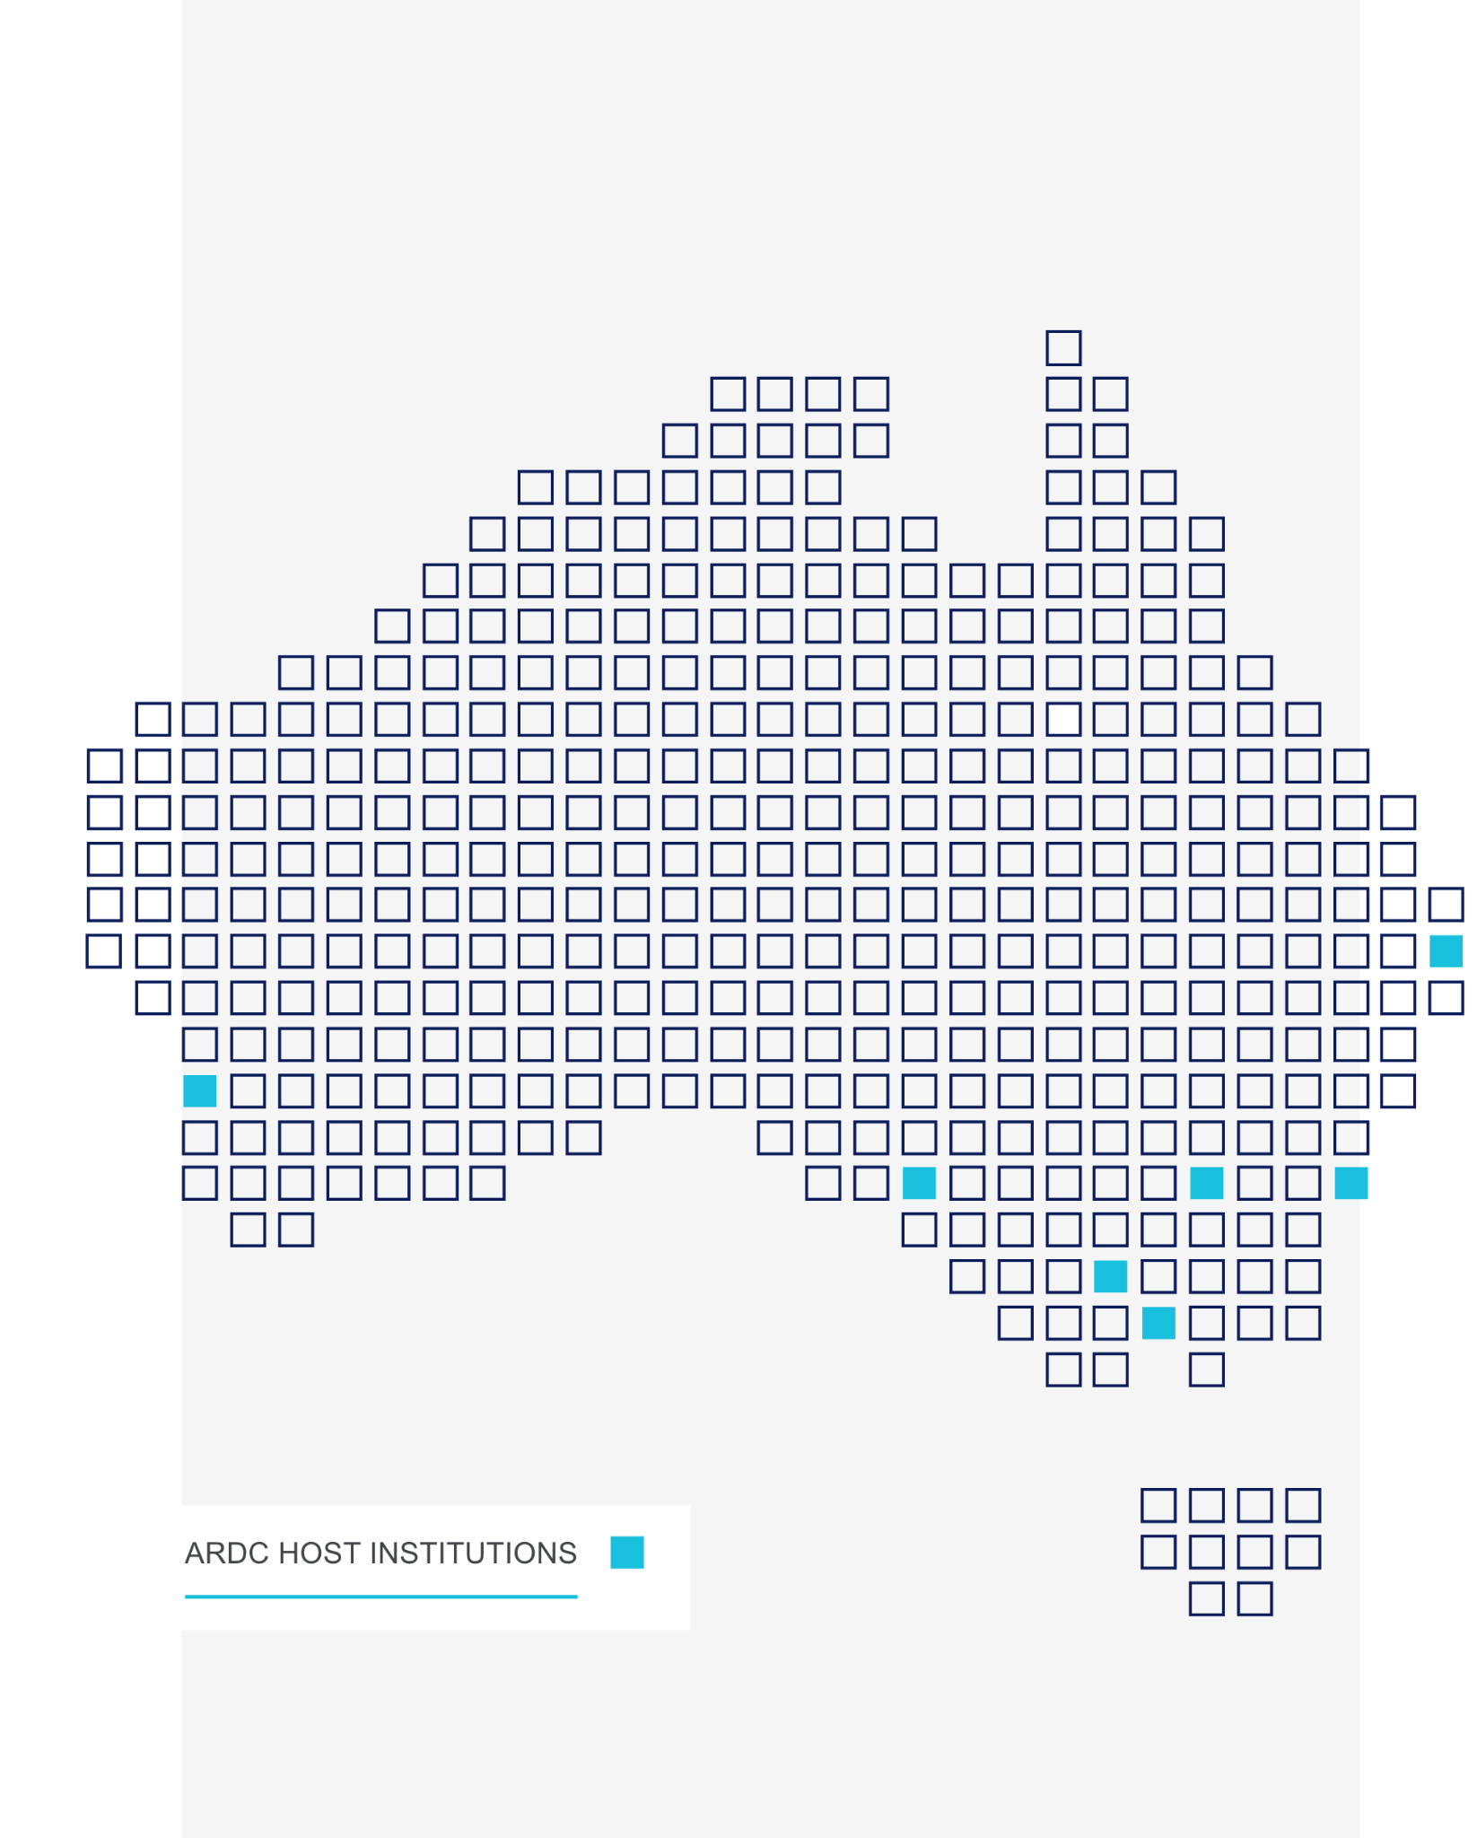

Members
Notes:
ARDC HOST INSTITUTIONS and MEMBERS
The ARDC has over 90 staff embedded at host institutions around Australia, including:
Australian National University
CSIRO
Curtin University
Federation University (our first Regional university host)
Monash University
The University of Adelaide
The University of Melbourne
The University of Queensland
University of Technology Sydney
UNSW Sydney
ARDC also has 28 member institutions, including universities and medical research institutes.
ARDC members:
participate in the development of Australia’s digital research infrastructure
help shape the ARDC’s emphasis and activities
are recognised as a champion of good research data management
attend and vote at Annual General Meetings.
The ARDC welcomes membership applications from Australian universities and research data-generating organisations.
If you don’t see your institution on this list, get in touch to see how you can become a member (NB. the Director, Outreach, ARDC manages memberships)

Slide 20


























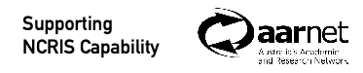
Health & Medical
Australian Centre for Disease Preparedness
Australian Centre for Neutron Scattering
Centre for Accelerator Science
National Deuteration Facility
Notes:
NCRIS NATIONAL RESEARCH INFRASTRUCTURE - SUPPORTING AUSTRALIAN RESEARCH
The ARDC is enabled by the Australian Government’s National Collaborative Research Infrastructure Strategy (NCRIS), which is a unique program that has been running since 2006 and is the envy of the research community in the rest of the world.
The National Collaborative Research Infrastructure Strategy (NCRIS) gives researchers access to equipment, data, services and expertise to enable world-leading research for the benefit of all Australians.
All facilities are established as partnerships with coinvestment from the Australian Government.
Building world class research infrastructure is challenging and no single organisation can do this alone, so partnerships and collaborations with universities and research institutes are critical for making this happen.
Cutting edge research requires cutting edge infrastructure to drive research and industry innovation.
The ARDC is one of 28 national research infrastructure capabilities enabled under this program.
To find out more about all of the national research infrastructure NCRIS services, visit Research Infrastructure Connected https://riconnected.org.au/
Background note: Most of the NCRIS capabilities have their own logo, except:
NDF (uses ANSTO logo + “Nuclear Deuteration Facility” underneath
NSF (uses ANSTO logo + “Australian Centre for Neutron Scattering” and “Centre for Accelerator Science”)
ACDP (uses CSIRO logo)

Slide 21
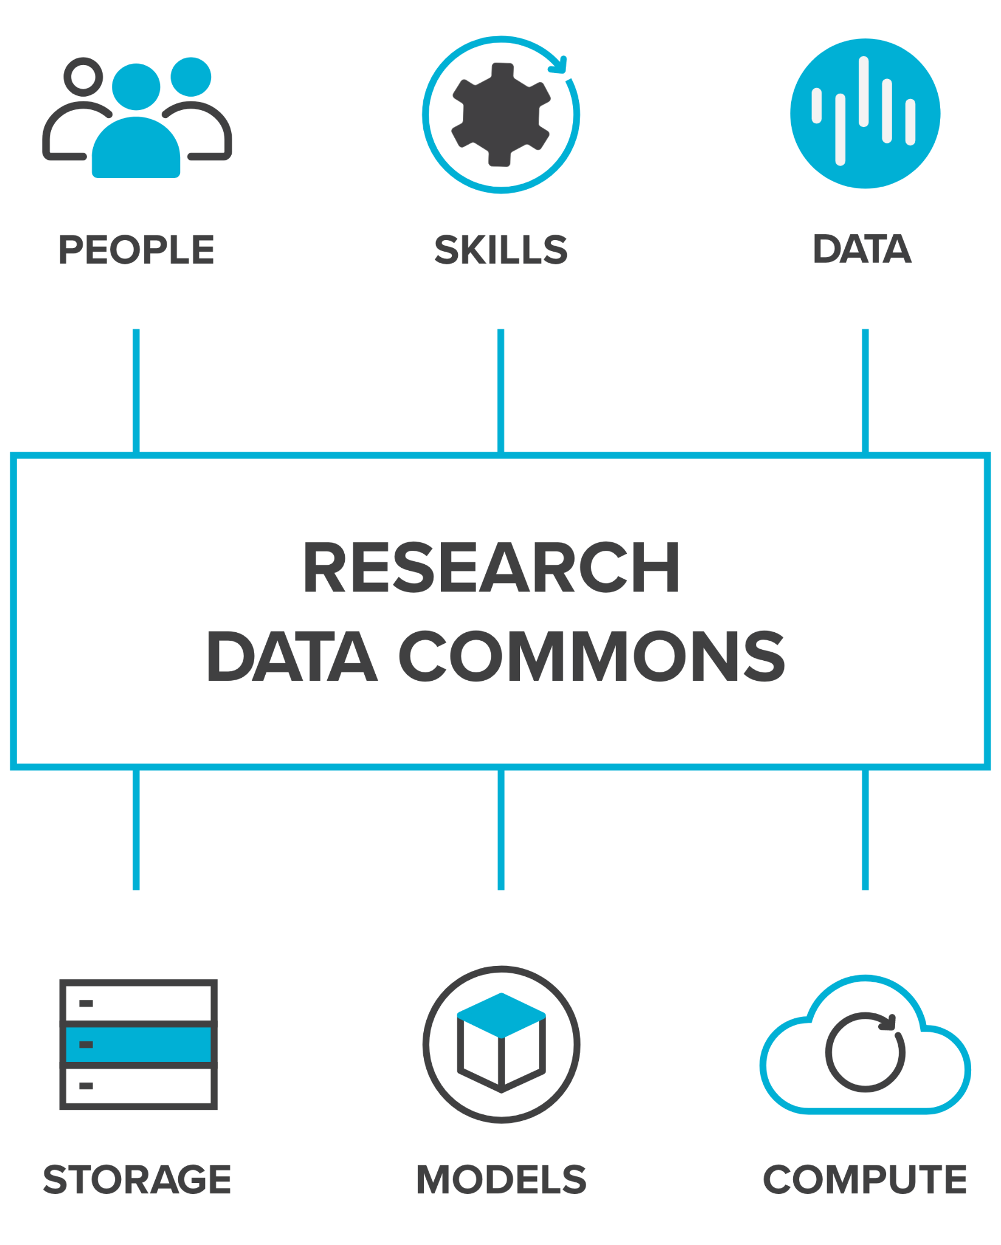
What is a Research Data Commons?
A research data commons brings together people, skills, data, and related resources such as storage, compute, software, and models to enable researchers to conduct world class data-intensive research.
Notes:
WHAT IS A RESEARCH DATA COMMONS?
A research data commons brings together people, skills, data, and related resources such as storage, compute, software, and models into one system.
By providing integrated resources and easy-to-use interfaces, it to enables researchers to speed up their existing research, and to undertake research that wasn’t possible before

Slide 22
Notes:
ARDC STRATEGIC PRIORITIES JANUARY 2024 - JUNE 2025 (18 MONTHS)
Between January 2024 and June 2025 we are conducting significant co-design activities for the Thematic Research Data Commons, as well as activities for the underpinning national cloud, national information infrastructure, skills and Research Link Australia and policy.

Slide 23



World Leading Digital Infrastructure
Enabling Australian Researchers to Transform our Lives
PEOPLE
Research Data Commons
PLANET
Research Data Commons
HASS & INDIGENOUS
Research Data Commons
Notes:
THEMATIC RESEARCH DATA COMMONS
We’re building enduring and targeted data infrastructure to meet the needs of research communities.
Together with our partners, we’re building research data commons that bring together people, skills, and data, with related resources such as storage, compute, and software.
This is to ensure Australian researchers have access to high-quality national data assets, platforms, infrastructure, policies, people and training - to transform the lives of our community.
ARDC recognises that the necessary scale of infrastructure, and the underpinning multi-party collaborations, cannot emerge entirely from individual research organisation investment and activity.
The Thematic Research Data Commons enables us to support the maximum number of researchers through a small number of priority areas selected strategically rather than competitively.
The Thematic RDCs are building on the ARDC’s experience creating national digital research infrastructure for researchers.
There are 3 strategic Research Data Commons developed with the research community:
People RDC for health and medical researchers
Planet RDC for earth and environmental science researchers; and
HASS and Indigenous RDC for HASS and Indigenous Research Data Communities
Subscribing to our newsletter is a great way to keep up to date with what ARDC is doing in this space.
Image credits clockwise
Gorodenkoff - 236237514 / adobestock.com
themorningglory - 391783296 / adobestock.com
Mario Purisic - jG1z5o7NCq4 / unsplash.com

Slide 24
2.PEOPLE
Research Data Commons
National-scale data infrastructure for health research and research translation
Notes:
PEOPLE RESEARCH DATA COMMONS
The ARDC People Research Data Commons (People RDC) is delivering national-scale data infrastructure for health research and translation.
Researchers, innovators and policymakers seek to improve health outcomes for society, which requires data and digital platforms that span multiple layers of government, health service operations, health research studies, institutes, facilities and the private sector.
https://ardc.edu.au/collaborations/strategic-activities/people-research-data-commons/
Image credit
Gorodenkoff - 236237514 / adobestock.com

Slide 25
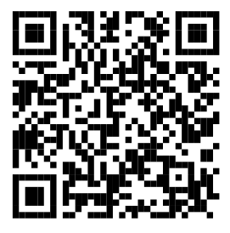
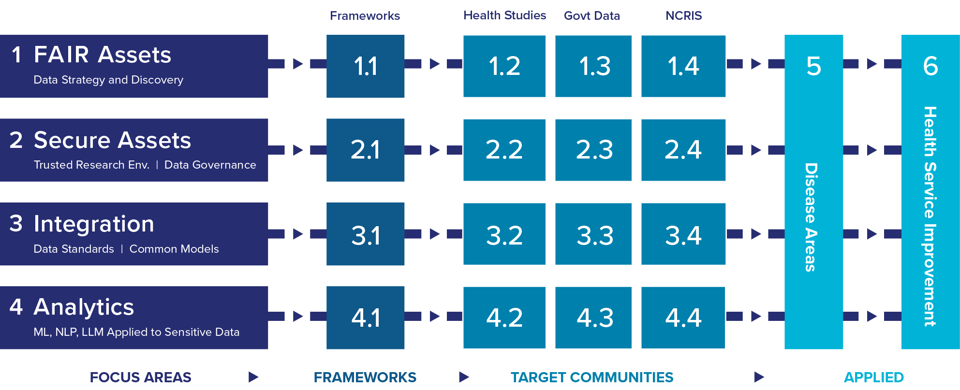
PEOPLE Research Data Commons Design
Register Interest
Learn more about HeSANDA, the People RDC and find resources for Health and Medical researchers
Notes:
PEOPLE RESEARCH DATA COMMONS DESIGN AND DELIVERY
The People RDC is addressing some of Australia’s core digital health research challenges:
FAIR Assets - Findable, accessible, interoperable, re-usable data for health research
Secure Data Access - Trusted research environments and data governance
Data Integration - Data standards, common data models, ontologies, and vocabularies
Advanced Analytics - Modelling, Machine Learning, Natural Language Processing, and Large Language Models applied to sensitive health data.
Many of the data challenges in health research arise from the sensitive nature of health data and jurisdictional and regulatory requirements that lead to a heterogenous digital infrastructure ecosystem.
The ability to deliver consistent practices, technical interoperability and common standards across this diversity will be a defining feature of the People RDC.
Once developed and implemented, the national capabilities built through these 4 focus areas will be brought together and applied to improve health services and address specific disease areas.

Slide 26
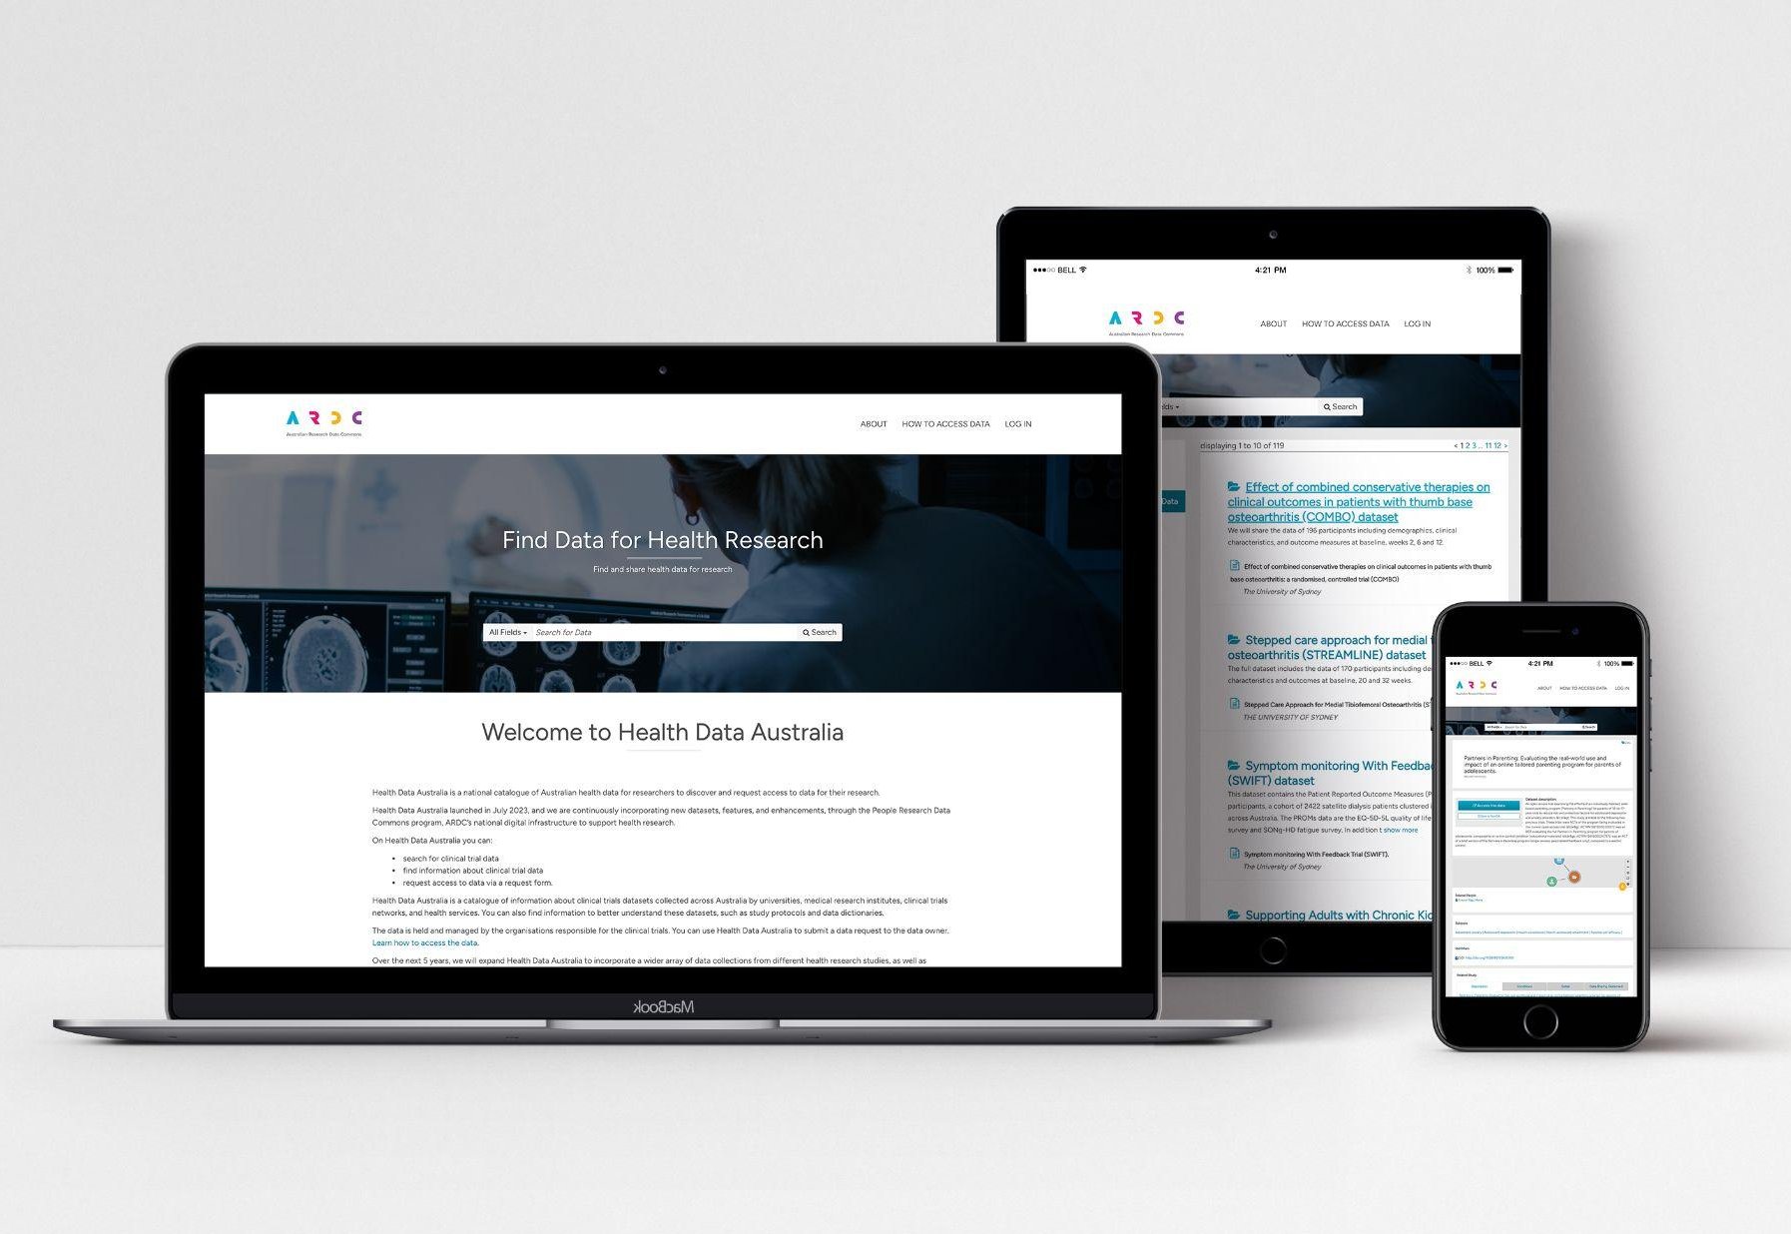
Health Data Australia
Discover and request clinical trial data from around Australia
VIDEO
visit - researchdata.edu.au/health/ ▶︎
View slides: request HDA data
Notes:
HEALTH DATA AUSTRALIA
A major output from HeSANDA was the delivery of a national catalogue of Australian health data called Health Data Australia.
VIDEO: What is HDA? Introducing HDA.
On the Health Data Australia website, health and medical researchers can register a description of their research so it’s easy to discover.
The service is currently available for clinical trial data and will be expanded with other data types, including government and cohort data.
Researchers seeking data can discover and request clinical trial data from around Australia.
205 datasets in Health Data Australia in the first year.
72 organisations participating in Health Data Australia across 9 nodes.
Access Health Data Australia at researchdata.edu.au/health/

Slide 27
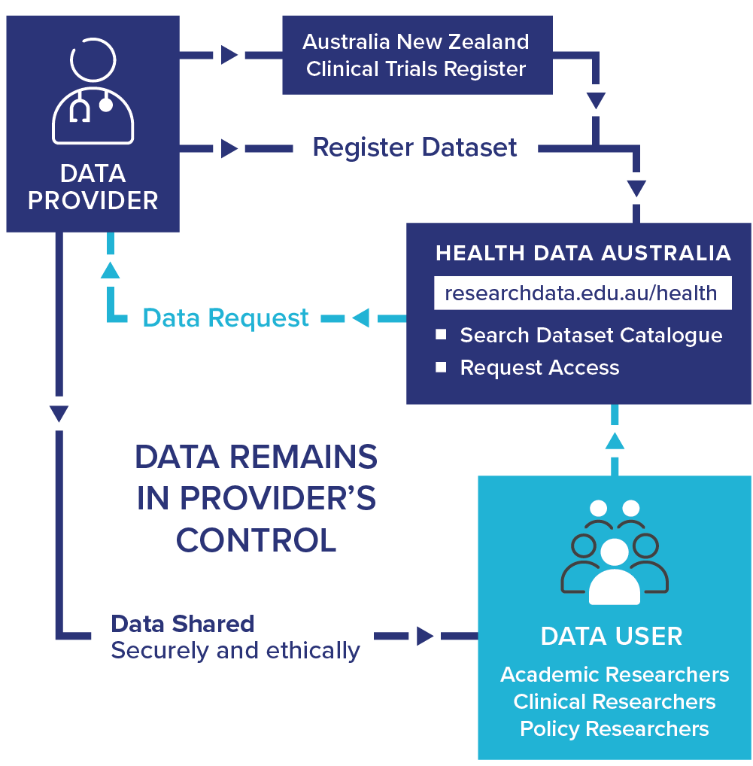
HeSANDA
Health Studies Australian National Data Asset
Mobilising data from clinical trials to provide new insights and improve clinical care
Plan to share your trial data - video (1:30)
Notes:
EXAMPLE: Health Studies Australian National Data Asset (HeSANDA)
VIDEO: Setup your clinical trial for data sharing
The People RDC builds on our experience creating national digital research infrastructure for health and medical researchers.
One example is, HeSANDA, our Health Studies National Data Asset, which is a national research infrastructure that is enabling researchers to share, access and reuse health research data to increase research impact and integrity.
The first phase of HeSANDA has worked alongside the health research community to support the sharing of clinical trials data.
The program includes 91 collaborators from 72 organisations, including 18 universities, 10 medical research institutes, 19 health service operators and 16 clinical trials networks.
Potential Benefits of HeSANDA include:
Collaboration
New health and medical research
Reduce costs, duplication, saves time
Extends the life of initial research
Contributes to data integrity
The next phase of the program has started already to expand the coverage beyond clinical trials data to data from observational studies such as cohort studies, and will integrate technologies to enable secure analysis of data.
https://ardc.edu.au/program/health-studies-australian-national-data-asset/

Slide 28
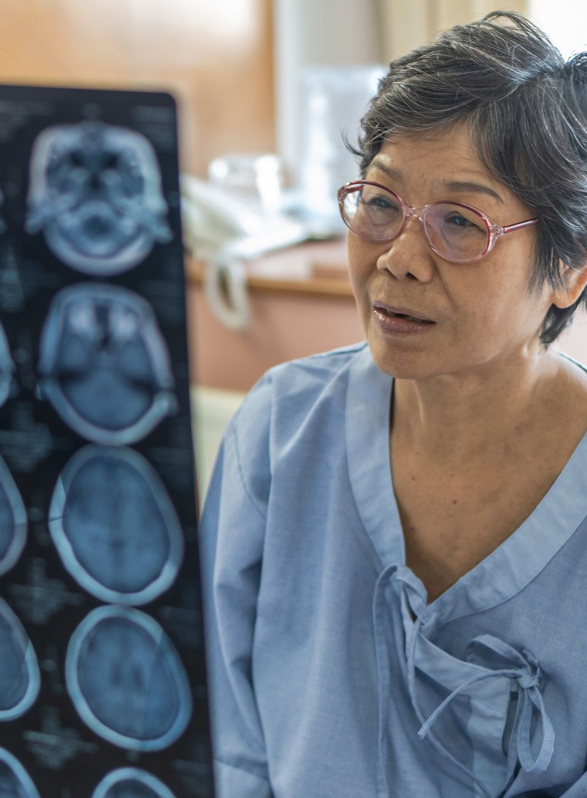



Tools for Researchers
Imaging Monash
Sensitive data systems SeRP
Standard terminology; AHDEN
Machine learning platform
Data
Aust Child and Wellbeing Atlas
Aust Cancer Atlas
Electrophysiology Data Analytics Platform Neurodesk
More: Poster
Images: Adobe Stock 165892158, 402341553, Pixels 4226119, Bigstock 325872880
Notes:
Media Lib: https://drive.google.com/drive/folders/1zVjb9m7syJiW172bs0IOv0mvOfCDt4iW (ARDC internal only)

Slide 29
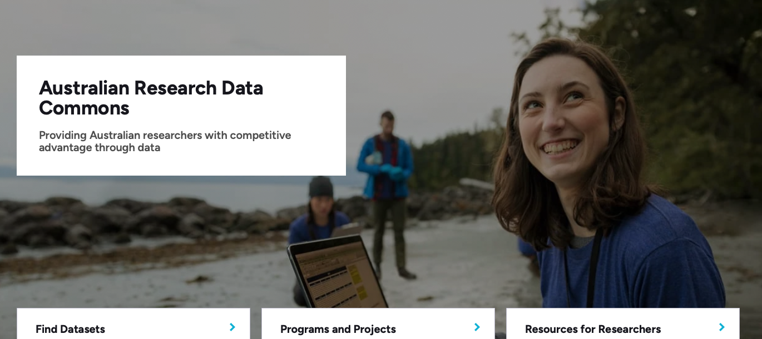
ardc.edu.au/ ▶︎

Slide 30

ardc.edu.au/ ▶︎

Slide 31
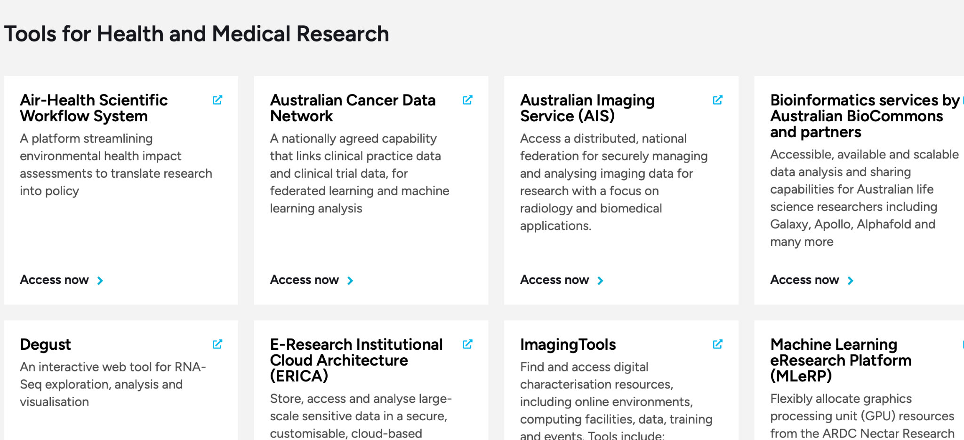

Slide 32
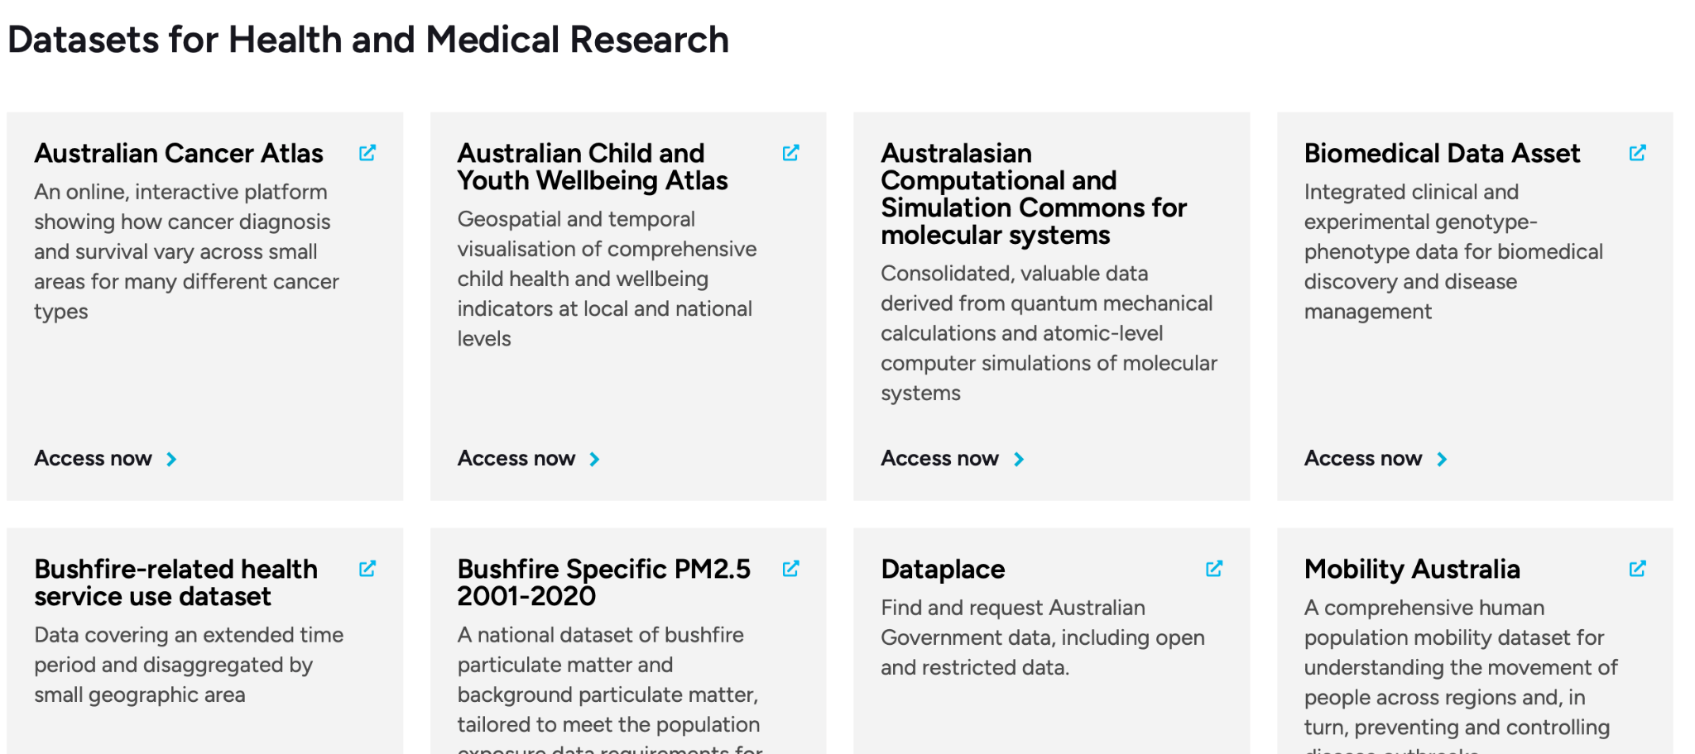

Slide 33
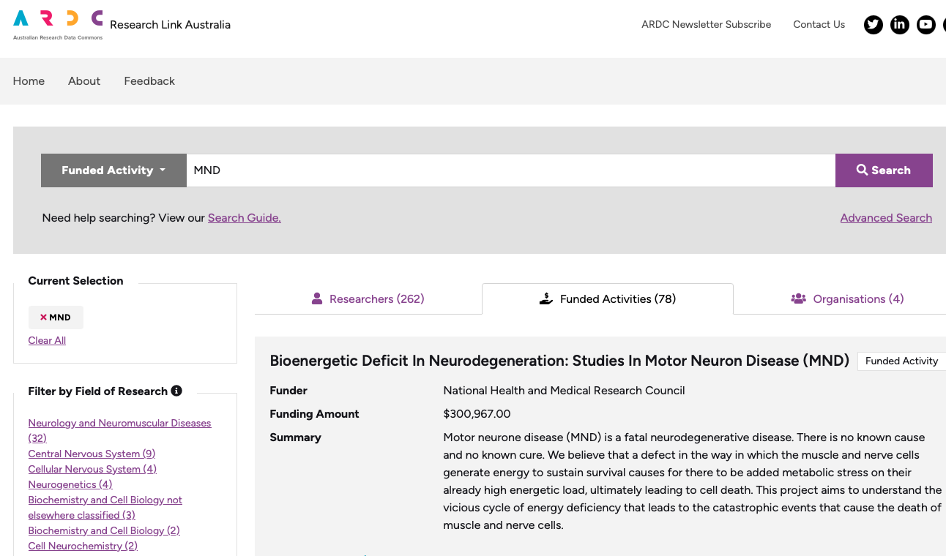
3.Research Link Australia
(RLA)
Better connecting research and industry
Connecting grants, CVs (ORCiD) and publications
11 million records (About)
MND: 262 researchers
MND: 78 grants, over $20 M
researchlink.ardc.edu.au

Slide 34
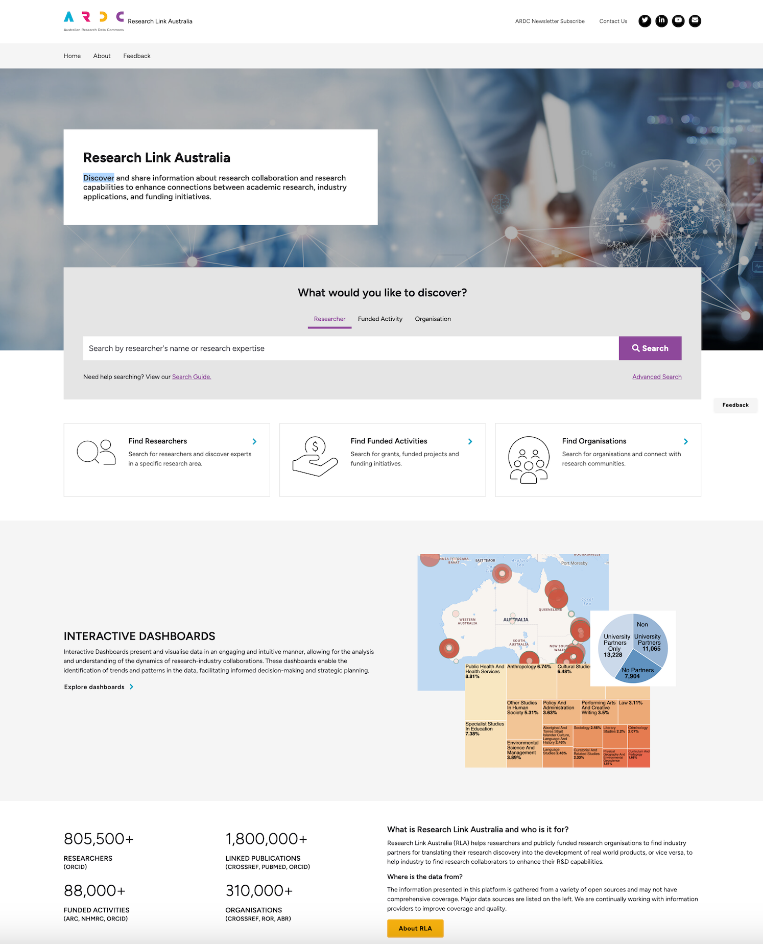
Research Capability Discovery Portal
Search research topics to find research and collaboration capabilities.
Gain insights from interactive dashboards into collaboration in specific research application.

Slide 35
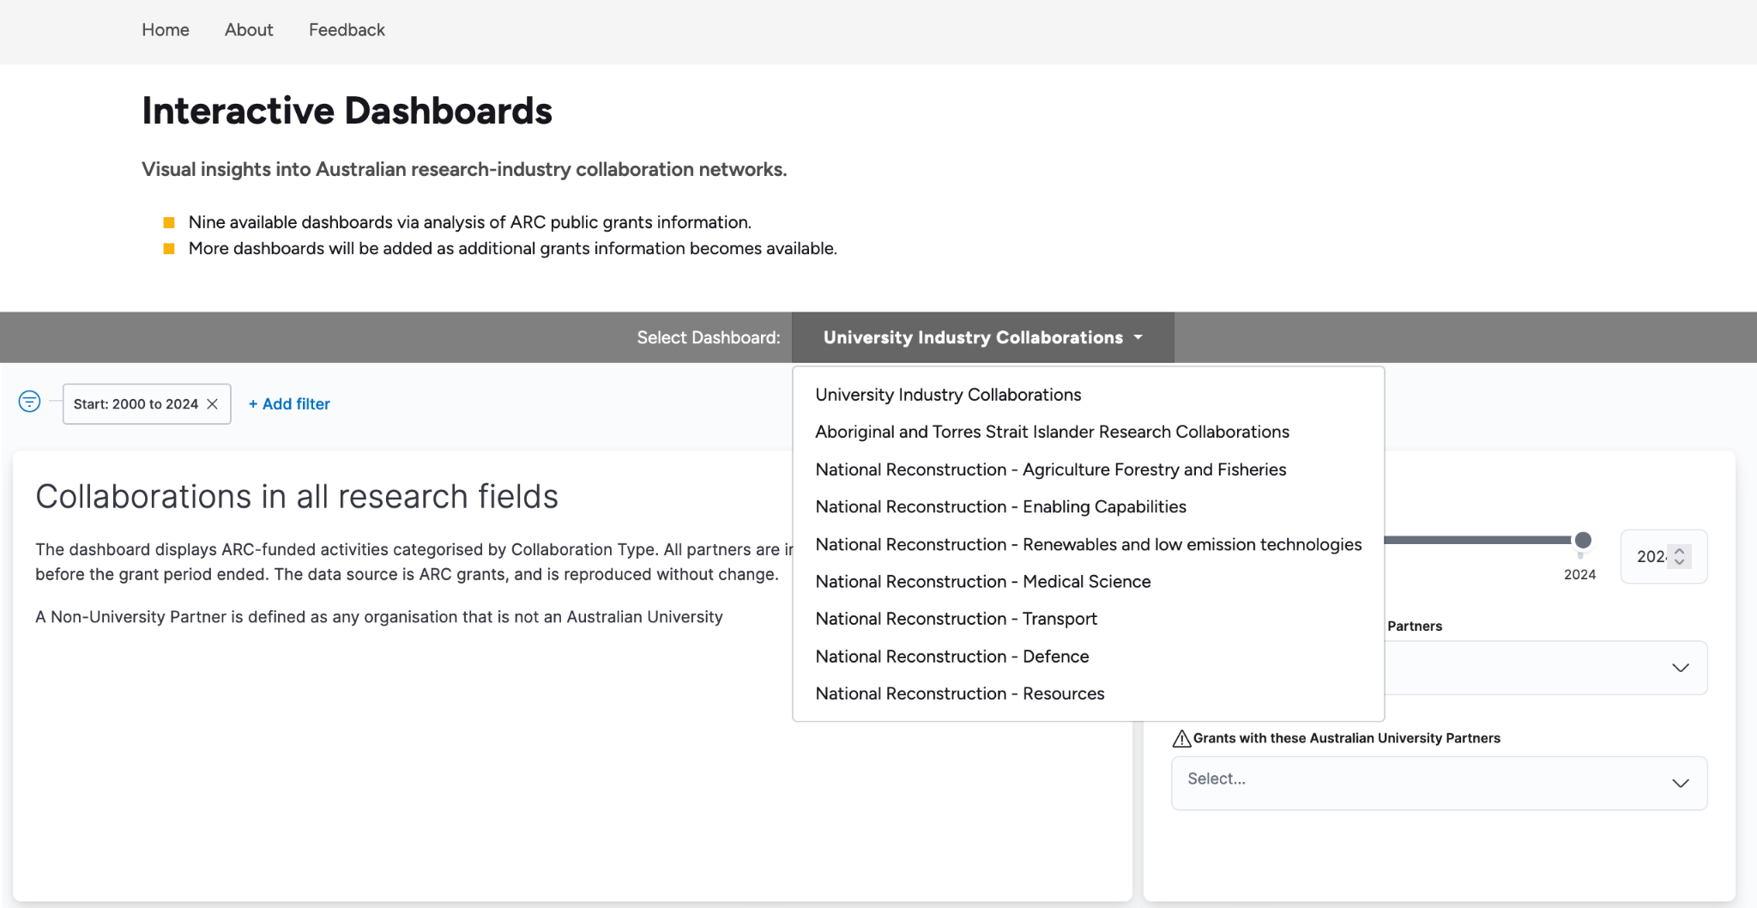
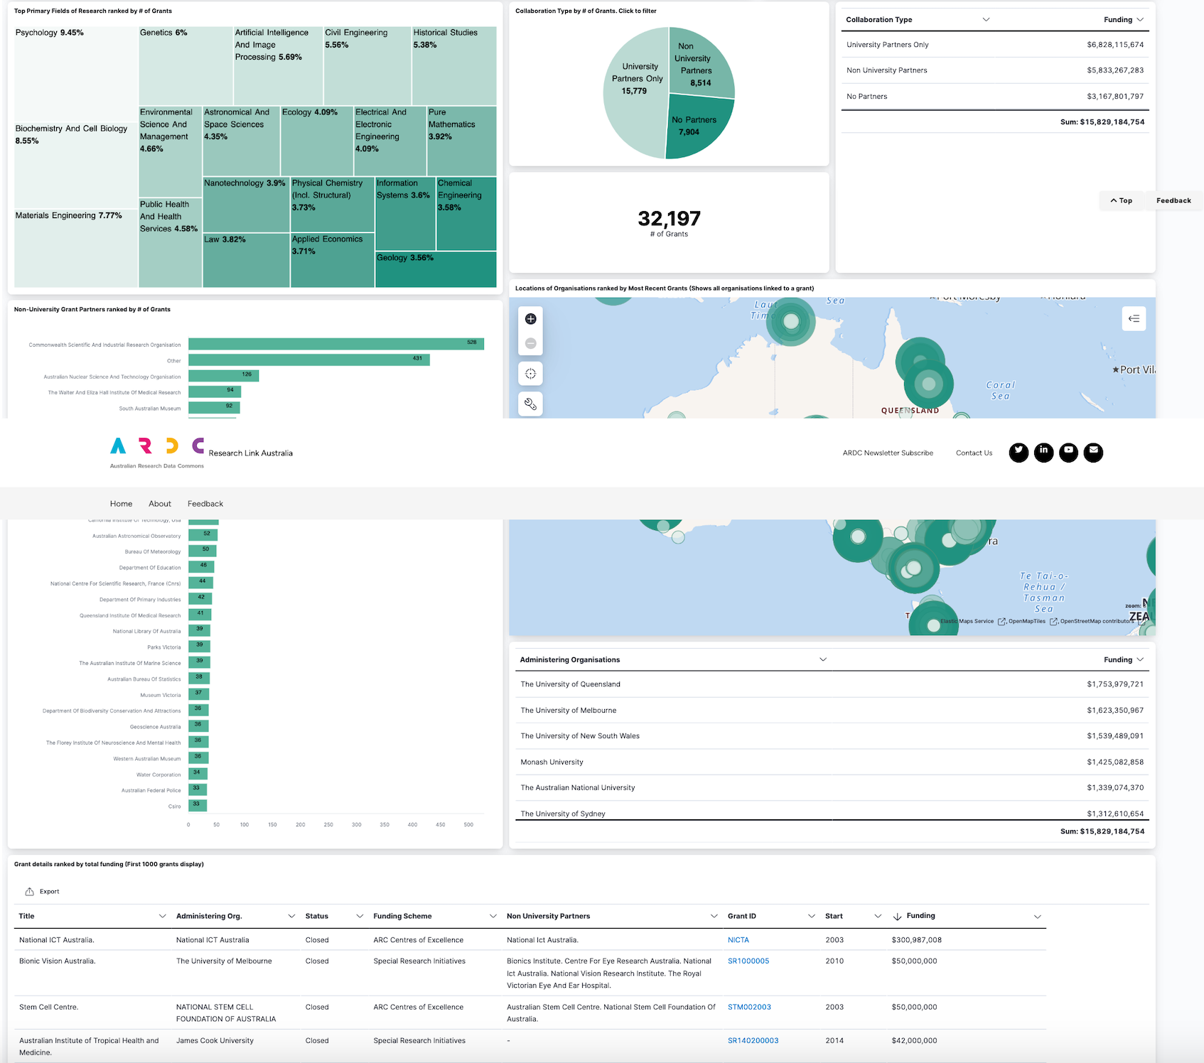
Gain insights from interactive dashboards into collaboration in specific research application.
Data insights dashboards
As a policy maker, research funder or national program initiative, I would like to know national research capability in biodiversity, so we can direct our funding effectively and efficiently; or organise a virtual national collaboration research network to address the biodiversity threat to the nation.

Slide 36

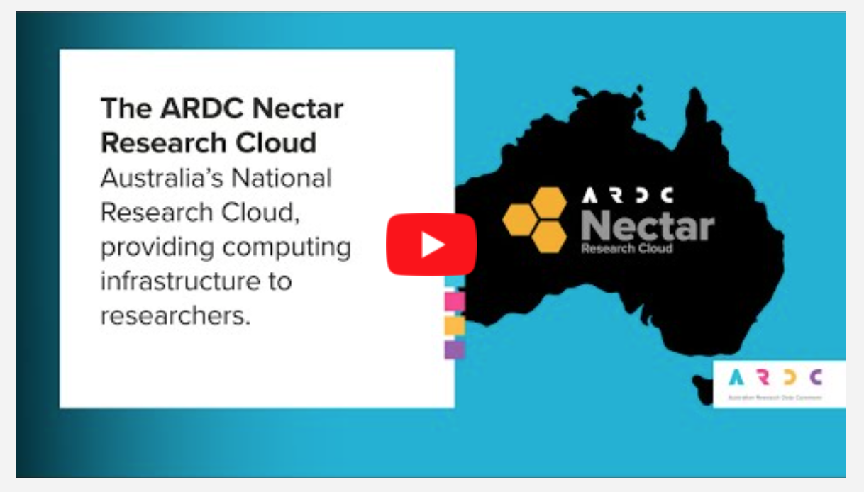
4.Nectar - Cloud Compute
Free, quick to test for 6 mths
Admin rights, duties
Pre-built applications
Shareable with collaborators
Special tools
  Jupyterhub DEMO
  Binderhub DEMO
Linux and Windows
Coming soon - secure compute Q3 ‘25

Slide 37
















8,700+
ARDC Nectar Research Cloud
Virtual Machines
34,000
Physical CPU Cores
QCIF
Brisbane
The University
of Melbourne
Melbourne
150,000+
Virtual CPU Cores
Intersect
Sydney
Swinburne University of Technology
Melbourne
248
VGPUs
Monash
University
Melbourne
The University of Auckland
Auckland
2PB
Object Storage
5PB
University
of Tasmania
Hobart
File Storage
Notes:
IN NUMBERS
Nectar is a federated cloud service, with 7 partner nodes in Melbourne, Sydney, Brisbane and Hobart in Australia as well as Auckland in New Zealand.
We also have strong international connections as members of the OpenInfra Foundation.
Nectar uses the OpenStack open source cloud software and other open source technologies, and we are also contributors to the development of this software.
Its versatile cloud infrastructure can be used in many different ways to support research, such as a virtual desktop for a single researcher, or a powerful computational server that can be shared by researchers in Australia and internationally.
https://ardc.edu.au/services/nectar-research-cloud/

Slide 38






Health and Medical Services
Galaxy Australia Link
Stemformatics Link
National Imaging Facility Link
Services Powered by
ARDC Nectar Research Cloud
ARDC Nectar
Research Cloud
Compute & Storage
Virtual Desktop Service
National GPU Service
Jupyter Notebook Service
Kubernetes Services
BinderHub
Service
Notes:
SERVICES POWERED BY THE ARDC NECTAR RESEARCH CLOUD
Stemformatics (Visualise hundreds of gene expression datasets)
NIF (National Imaging Facility (NIF) is Australia's advanced imaging network. We provide open access to flagship imaging equipment, expertise, tools, data and analysis.)
Galaxy Aust - Galaxy Australia has the following core features:
Hundreds of frequently used community reference genomes and annotation datasets
Thousands of bioinformatics data analysis and visualisation tools
A workflow system that allow tools to be chained together
Sharing of generated content such as data libraries, usage histories, workflows and visualisations
Extensive online training
As well as providing the ARDC Nectar Research Cloud for researchers to use for compute and storage, we also run a number of cloud services for researchers which are powered by Nectar.
Services powered by Nectar include:
Virtual Desktop Service
Jupyter Notebook Service
National GPU Service
Kubernetes Services
BinderHub Service

Slide 39
Demonstrate Jupyter @Nectar
https://jupyterhub.rc.nectar.org.au/
-> File: play.ipynb
Login with your University login (AAF)
Binderhub example: Github
Broadband open data - NZ, Melbourne

Slide 40
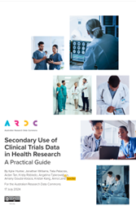
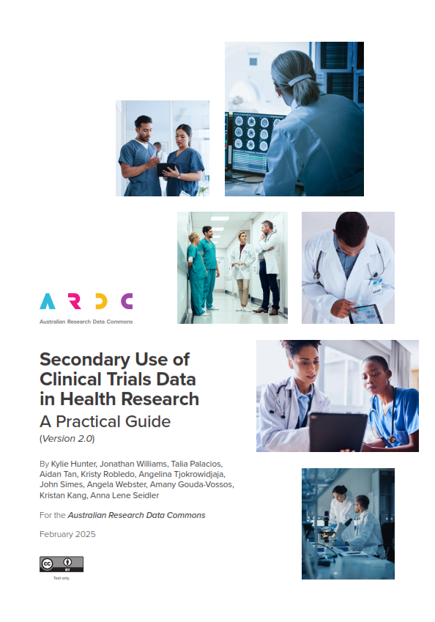
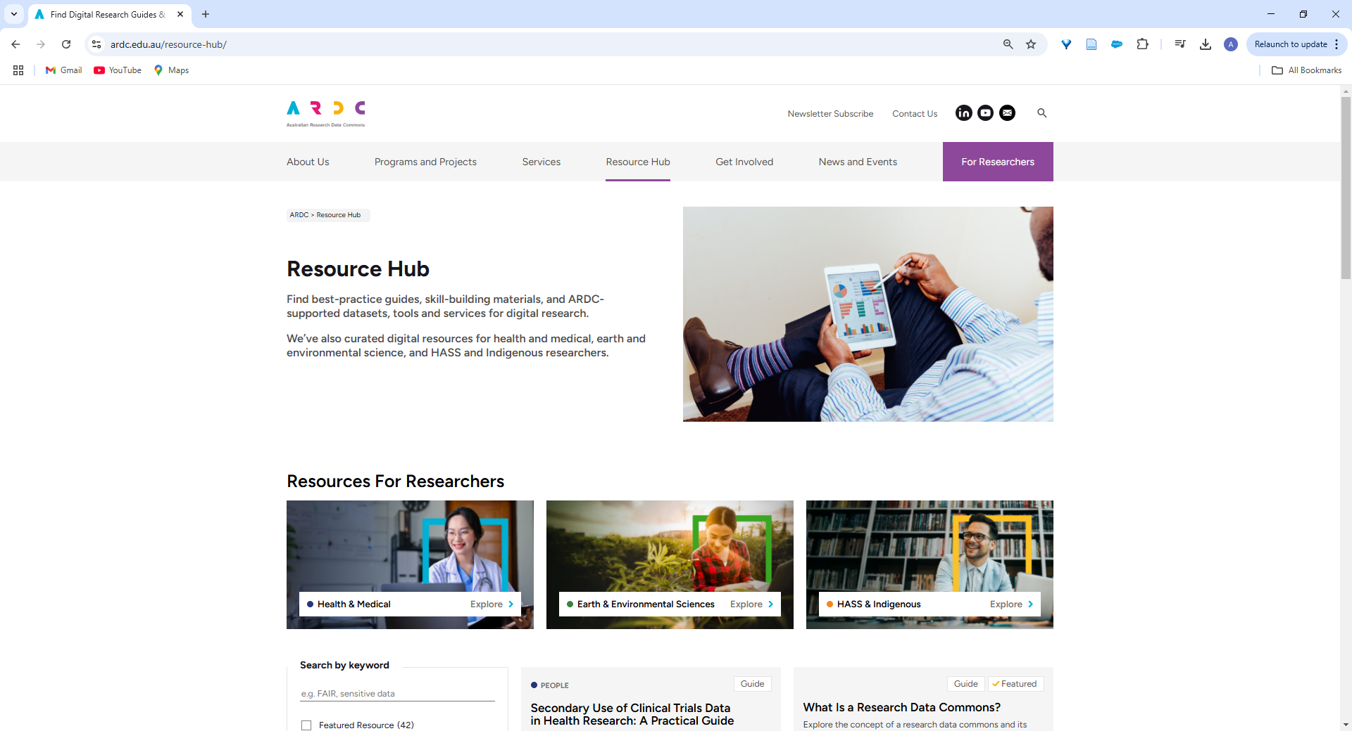
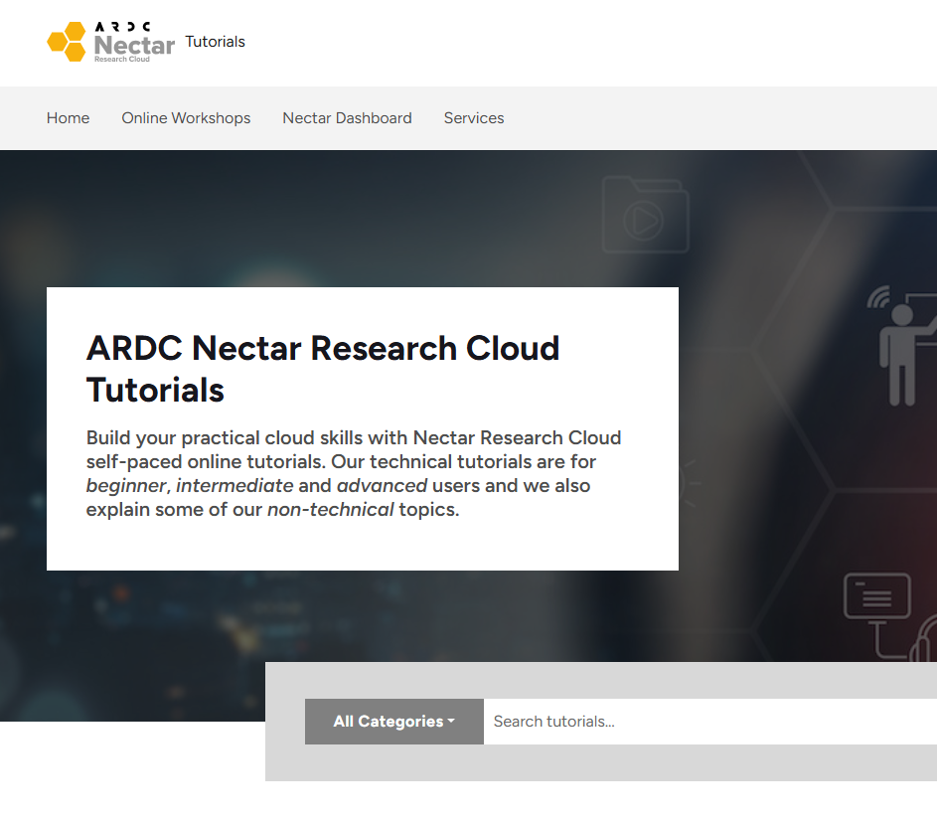
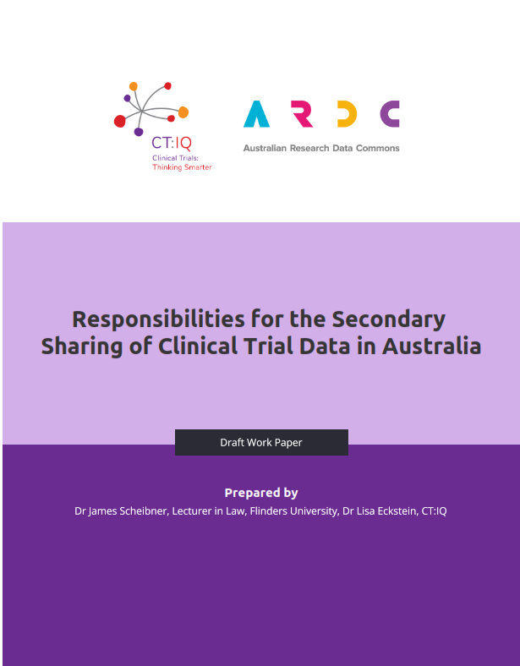
5. Resources, Health & Skills infrastructure
We can help!
Nectar user training and services
Health Data Australia demo
Clinical research data sharing frameworks
Secondary data use materials
ARDC resources
Notes:
Video at: https://fightmnd.org.au/cure/for-researchers/fightmnd-scientific-seminar-series/ at 2700 mins

Slide 41
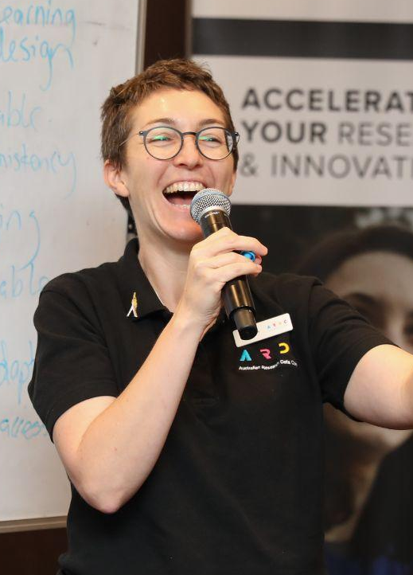
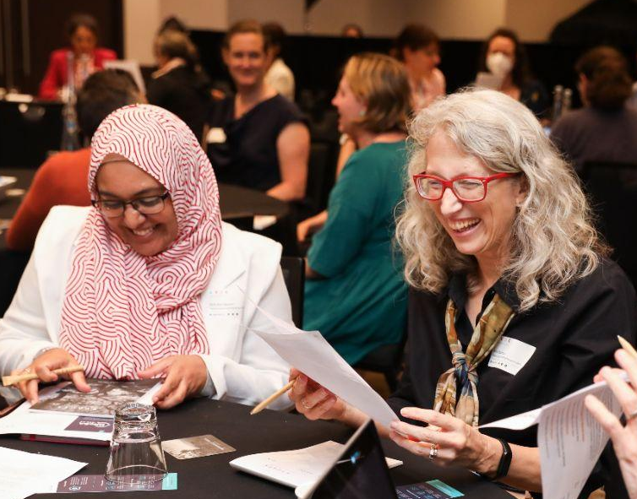
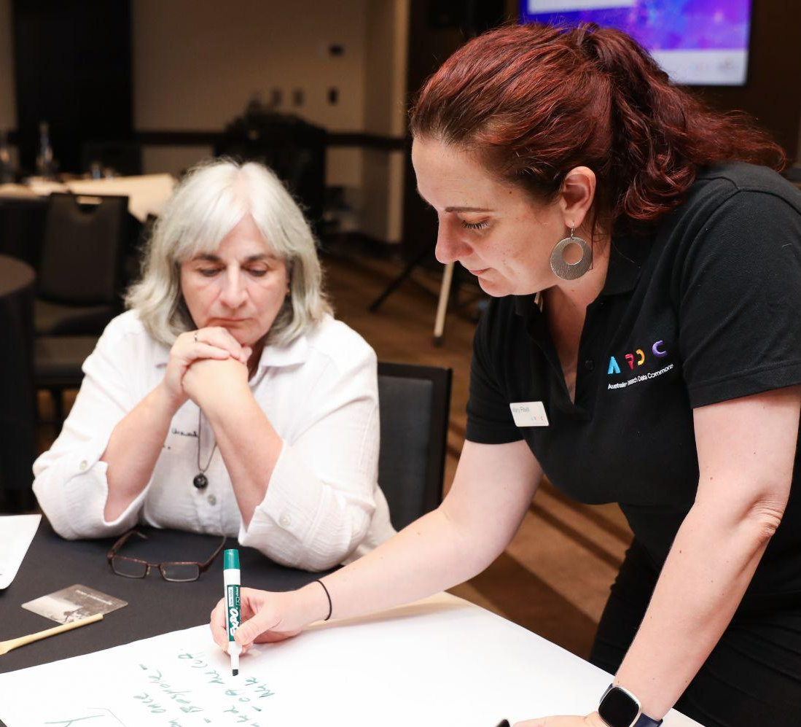
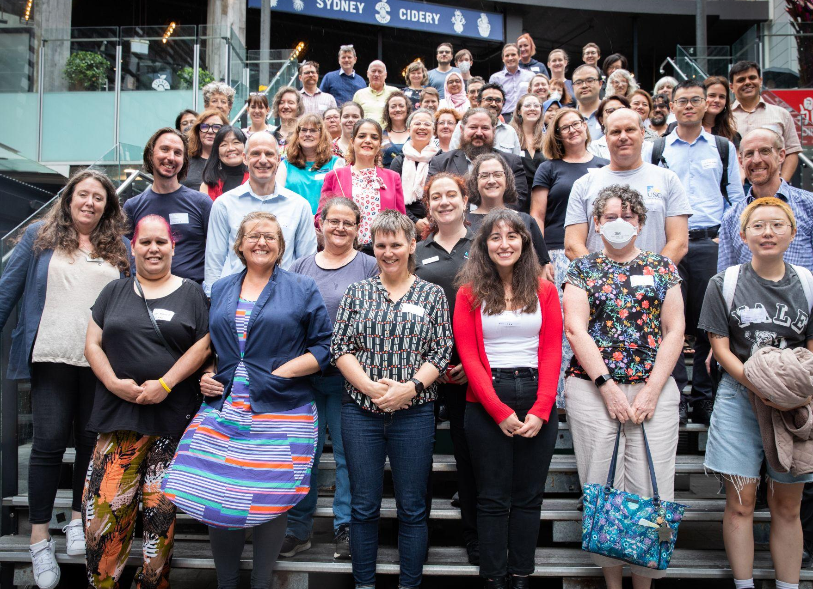
Digital
Research Skills
ARDC provides national leadership in Digital Research Infrastructure (DRI) skills
Notes:
DIGITAL RESEARCH SKILLS
ARDC provides national leadership, working together with research institutions and research infrastructure in building Digital Research skills. This will ensure both the research and the research infrastructure workforce have the skills required to effectively use Digital Research Infrastructure now and into the future.
Learn more visit https://ardc.edu.au/program/skills-and-workforce-development/

Slide 42


Nectar Training Hub
Online tutorials
Live online training
Nectar support
https://support.ehelp.edu.au/support/home
Notes:
Quick walkthrough

Slide 43
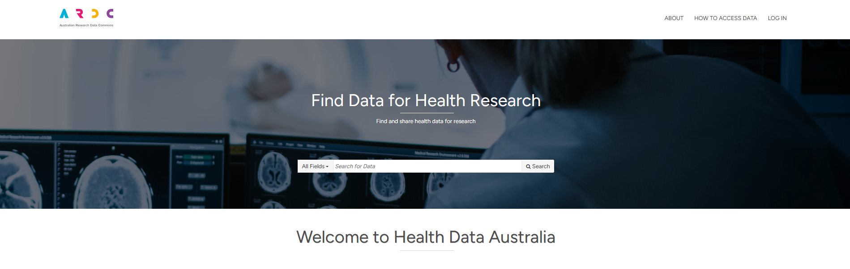


Health Data Australia
researchdata.edu.au/health/
      Scan to visit
      Health Data Australia
Notes:
Quick HDA Demo

Slide 44
HeSANDA
Health Studies Australian National Data Asset
Health Data Australia
Discover and request clinical trial data from around Australia
researchdata.edu.au/health/
Notes:
EXAMPLE: Health Studies Australian National Data Asset (HeSANDA)
The People RDC builds on our experience creating national digital research infrastructure for health and medical researchers.
One example is, HeSANDA, our Health Studies National Data Asset, which is a national research infrastructure that is enabling researchers to share, access and reuse health research data to increase research impact and integrity.
The first phase of HeSANDA has worked alongside the health research community to support the sharing of clinical trials data.
The program includes 91 collaborators from 72 organisations, including 18 universities, 10 medical research institutes, 19 health service operators and 16 clinical trials networks.
Potential Benefits of HeSANDA include:
Collaboration
New health and medical research
Reduce costs, duplication, saves time
Extends the life of initial research
Contributes to data integrity
The next phase of the program has started already to expand the coverage beyond clinical trials data to data from observational studies such as cohort studies, and will integrate technologies to enable secure analysis of data.
https://ardc.edu.au/program/health-studies-australian-national-data-asset/

Slide 45
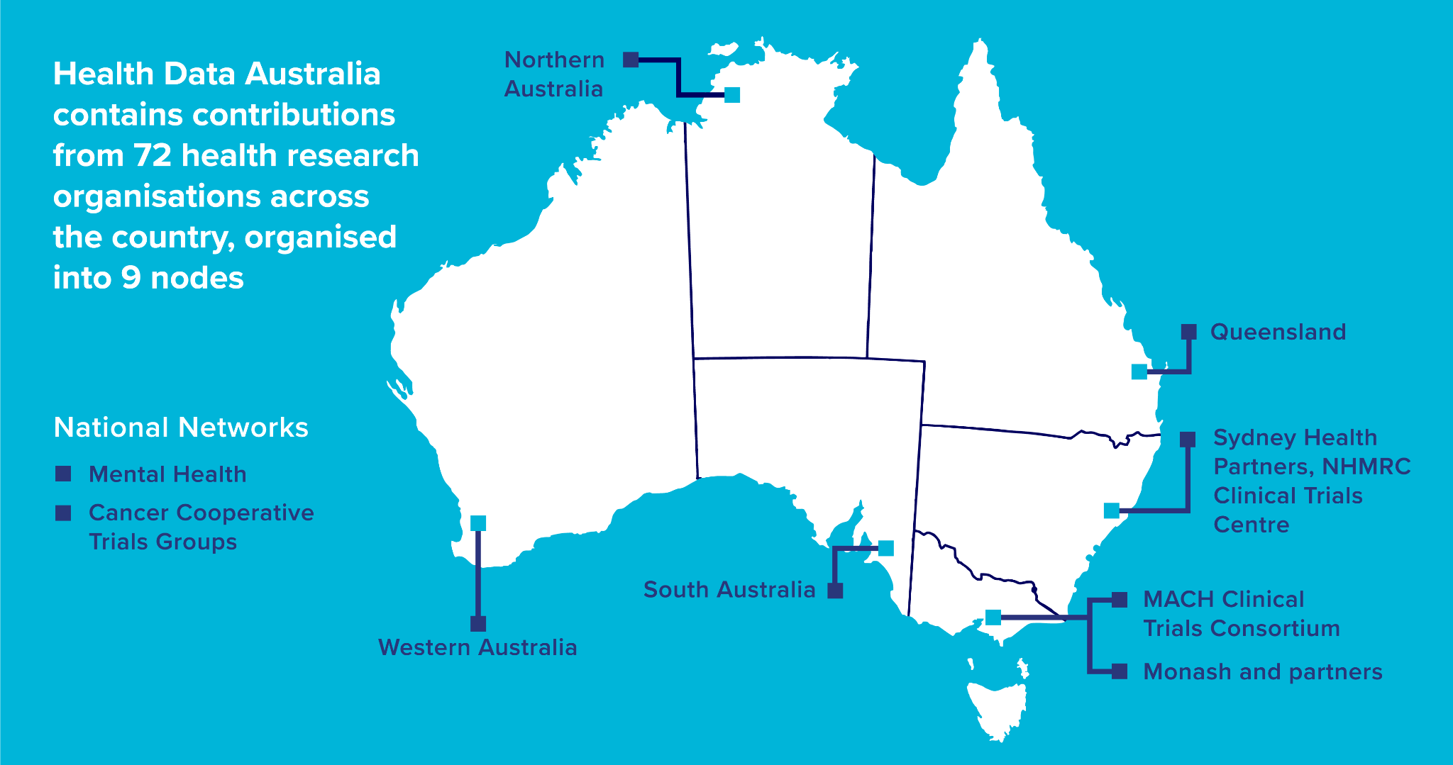
Notes:
72 organisations are leading the way and have created a national data sharing infrastructure network for Australia.
They’re grouped into 9 nodes:
7 of our nodes provide regional coverage in most states and territories
And the other 2 nodes have specialisations - 1 in cancer trials - and 1 in mental health trials
We’re working together as a national community of trials to agree on those standards.
And then each Node is working with their partners to implement the standards in a way that works best for their organisations.

Slide 46
Health Data Australia
3 things to keep in mind…
HDA contains only descriptions of data (metadata), not the data itself
The data is always in control of the data custodians/ data provider
The platform is relatively new
      Scan to visit
      Health Data Australia
Notes:
Quick HDA Demo

Slide 47
Health Data Australia
Why Share Data?
To improve the quality and productivity of your research
Encouraged for publishing and funding
To be on par with the international data sharing research community
How to contribute?
If your institute is a member of a HeSANDA Node Network, you can contact the node directly.
If your institute is not affiliated, email hesanda@ardc.edu.au or contact@ardc.edu.au
Notes:
4. Contributing to HeSANDA
4.1. Who can contribute?
If your institute is a member of a HeSANDA Node Network, you can contact the node directly. See list
here under the title ‘The Partners’ to see if your institute is affiliated with HeSANDA. If your institute is
not affiliated, email contact@ardc.edu.au

Slide 48
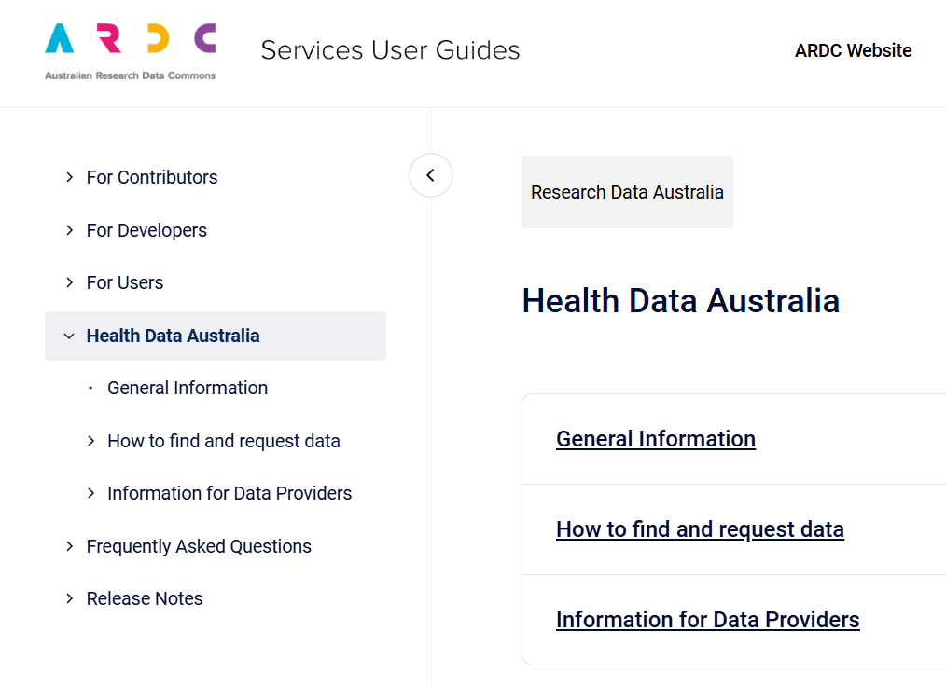

Health Data Australia User Guides
eresear.ch/hdaguides

Slide 49
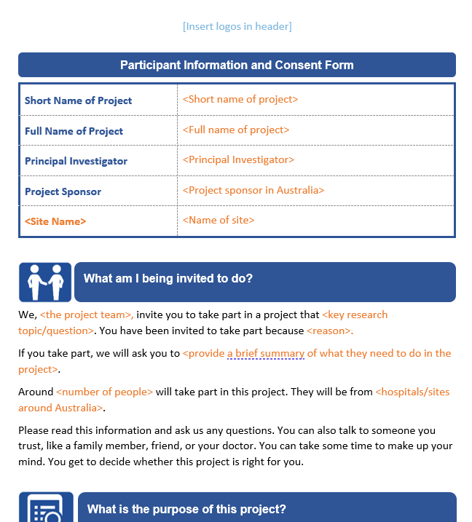
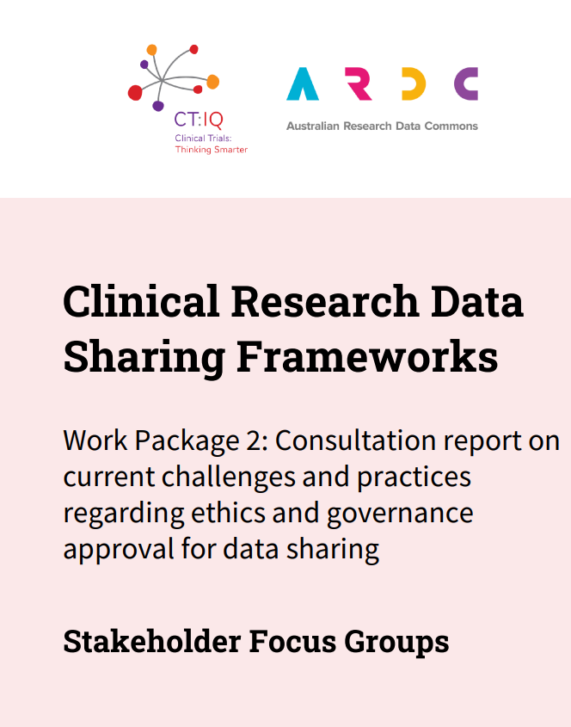
Clinical Research Data Sharing Frameworks
Collaboration with CT:IQ
Improve efficiency & quality of clinical research data sharing decisions by Australian researchers, HRECs, research governance offices & institutions.
Project home

Slide 50
Clinical Research Data Sharing Frameworks
InFORMed Project - PICFs (consent) Template
Governance framework
Consultation report
Upcoming
HREC benchmarking
Resource toolkit

Slide 51
Secondary Data Use
Collaboration with NextGen Team, NHMRC Clinical Trials Centre (based at USYD)
Aims to define and communicate the scientific value and use cases of secondary research using clinical trials data.

Slide 52
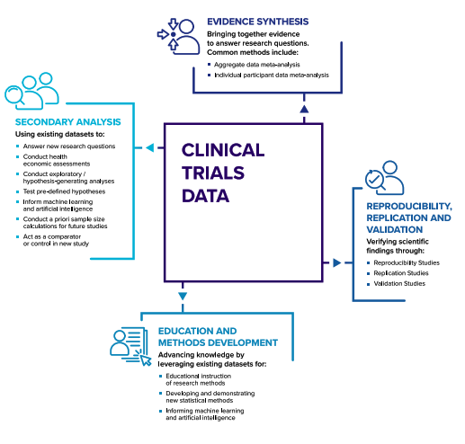
Secondary Data Use
Secondary Use of Clinical Trials Data in Health Research: A Practical Guide
Theoretical framework for the use of clinical trials and other health data for secondary research purposes
Types of Secondary Research Using Clinical Trials Data
Notes:
Webinars
https://vimeo.com/954602843
https://www.youtube.com/watch?v=au5WFzdXF7M
Upcoming

Slide 53

ARDC Resources Hub
ardc.edu.au/resource-hub/
Notes:
Resource Hub Demo
https://ardc.edu.au/resource-hub/

Slide 54
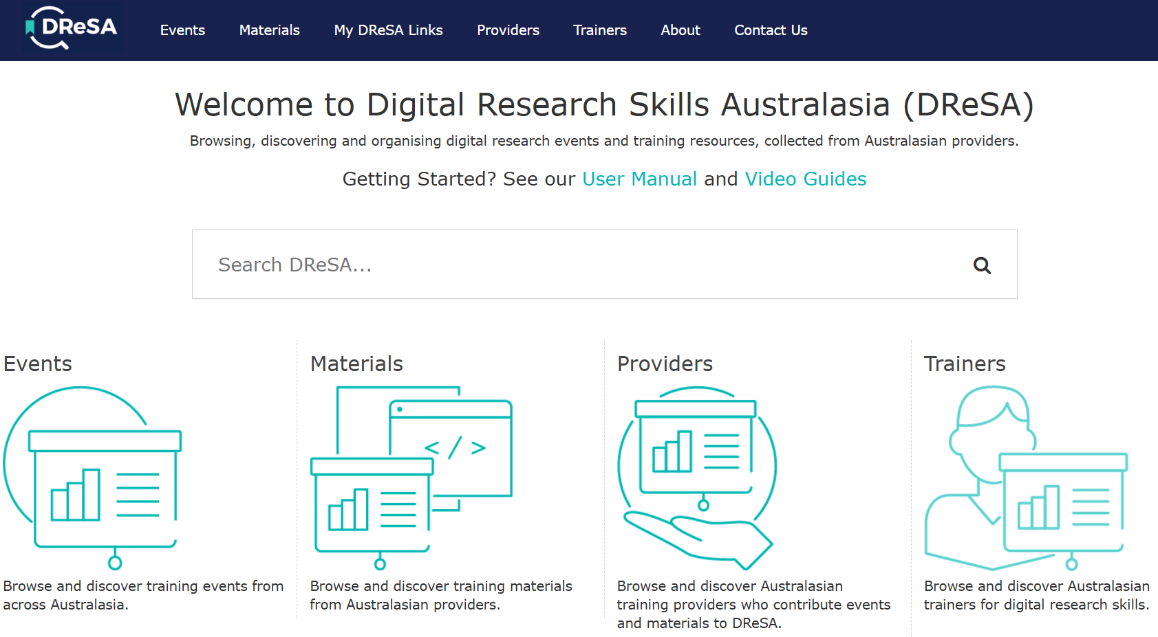

Digital Research Skills Australasia
dresa.org.au/
Notes:
If the website is working - quick walkthrough - https://dresa.org.au/

Slide 55
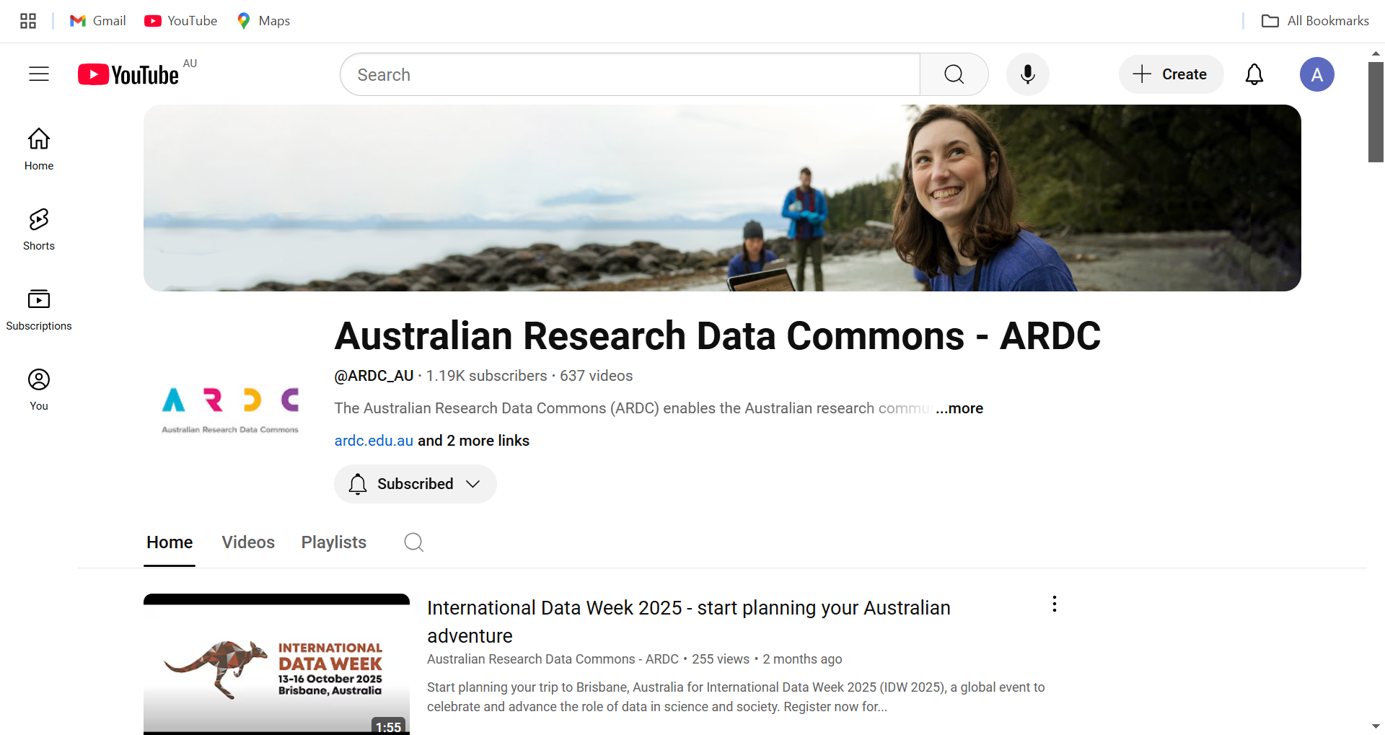
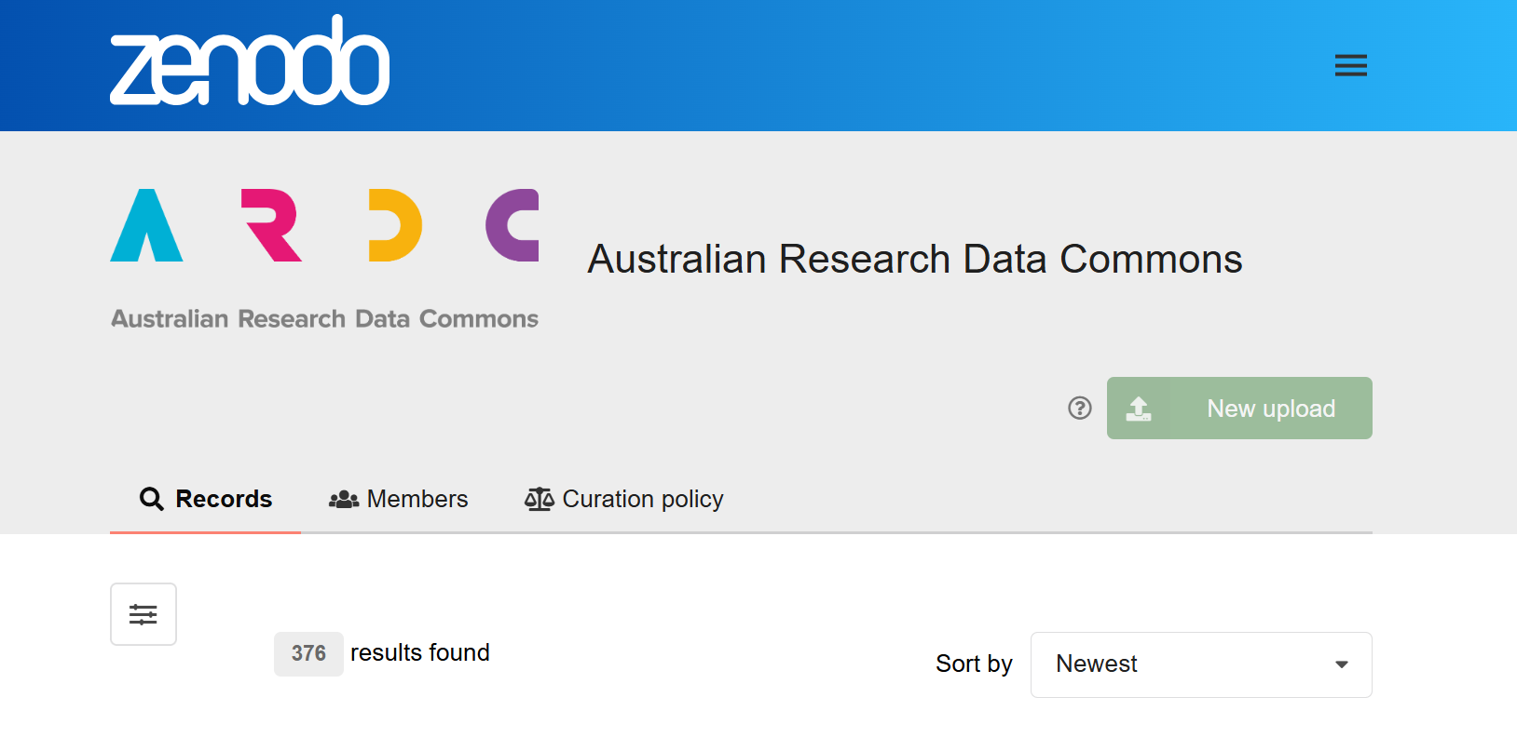


ARDC Resources
eresear.ch/ardcyoutube
eresear.ch/ardczenodo

Slide 56
Contact us
HeSANDA Management Team
hesanda@ardc.edu.au
Skilled Workforce Team
skills@ardc.edu.au
Any general questions
contact@ardc.edu.au

Slide 57

Get Involved
Learn more about and register
your interest in the People
Research Data Commons.
Get your CV into ORCiD and use RLA
Use and contribute to HDA and RDA
Literature review and data review
Sign up for ARDC newsletter, People RDC Register Interest
Share these slides:
https://eresear.ch/accelerateHealth25HLA
More slides ‘23 (more data, more tools) More People RDC Poster ‘24
People RDC
Register your Interest
Subscribe to our newsletter
ardc.edu.au/subscribe
Notes:
RESOURCES FOR HEALTH AND MEDICAL RESEARCHERS
The People RDC builds on the ARDC’s experience creating national digital research infrastructure for health and medical science researchers.
Find existing resources for researchers and get involved with the People RDC at https://bit.ly/ARDCPeople >
Image credit
Gorodenkoff - 236237514 / adobestock.com

Slide 58

Notes:
<PROMO for all audiences>
INTERNATIONAL DATA WEEK 2025
The ARDC is excited to be delivering International Data Week 2025 ARDC on behalf of RDA, CODATA and WDS
It will be held in Brisbane Australia 13-16 October 2025.
Save the date and start planning your visit.
Visit us at ardc.edu.au to sign up for updates
Image credit
Mel Campbell - 433531668 / adobestock.com

Slide 59
Supplementary material - see slides below.

Slide 60
Health Data Australia
researchdata.edu.au/health/
      Scan to visit
      Health Data Australia
Notes:
Quick HDA Demo

Slide 61
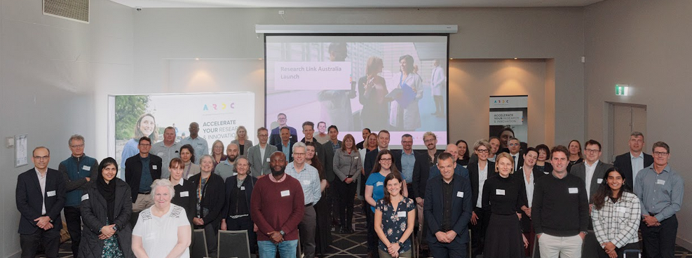
ARDC Research Link Australia
Discover and share information about research collaboration and research capabilities to enhance connections between academic research, industry applications, and funding initiatives.
researchlink.ardc.edu.au
Notes:
ARDC RESEARCH DATA AUSTRALIA
Operating since 2011, Research Data Australia (RDA) is a free, searchable portal which brings together research data collections from projects and institutions across Australia.
Data owners or managers can create metadata records in their own repositories which are then published in RDA.
The data itself is stored and published with the source institution.
Researchers can find, access and reuse data for research from 100+ Australian research organisations, government agencies and cultural institutions in ARDC’s Research Data Australia portal.
There are 193,945 research data collections catalogued.
They can search data by subjects, themed collections, projects and more.
RDA provides metadata and links to data held by publishing partners.
Did you know that RDA is a portal service as well?
One portal allows you to search for Australian Research Grants. You can find principal research funders, project descriptions, grant identifiers and connections to related datasets and publications.
Image credit
Clockwise from top: Language Data Commons of Australia (LDaCA), Australian Child and Youth Wellbeing Atlas and Australian Coronial Law Library are all examples of data assets discoverable in ARDC Research Data Australia.

Slide 62
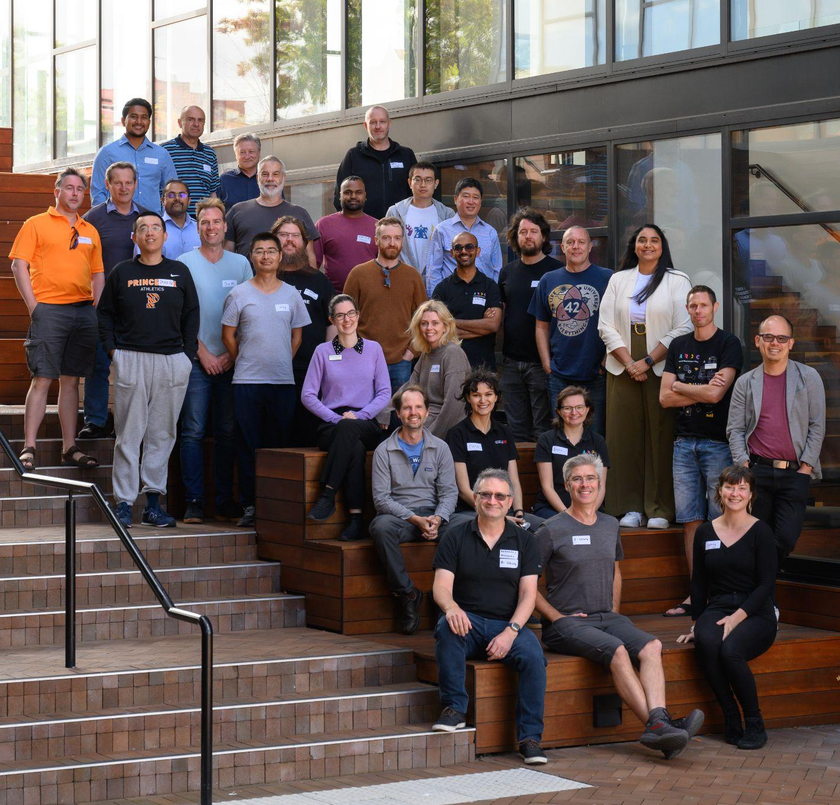

ARDC Nectar Research Cloud
is Australia’s federated national research cloud providing the research community with on-demand computing infrastructure and software
Notes:
ARDC NECTAR RESEARCH CLOUD
Australia’s national research cloud, is specifically designed for research computing is specifically designed for research computing, and enabling services, platforms and data collections <aligned with the Research Data Commons OR for researchers, industry, government and communities>.
Launched in 2012, Nectar provides Australia’s research community with fast, interactive, self-service access to large-scale computing infrastructure, software and data.
A powerful platform for collaboration, it allows researchers and research support staff to access compute resources, software and data from their offices and homes and easily share them with collaborators at other institutions.
Image credits clockwise
Image —Loic Le Guilly / ARDC - The team behind the ARDC Nectar Research Cloud – team members from the nodes and the ARDC at a technical workshop in 2024
Image —Marc Grimwade / ARDC - Jake Yip from the ARDC with Michael Mallon from QCIF, a node of the ARDC Nectar Research Cloud, at a technical workshop in 2022
Image —Marc Grimwade / ARDC - Darcelle Malby and Sonia Ramza from the ARDC at an ARDC Nectar Research Cloud technical workshop in 2022

Slide 63
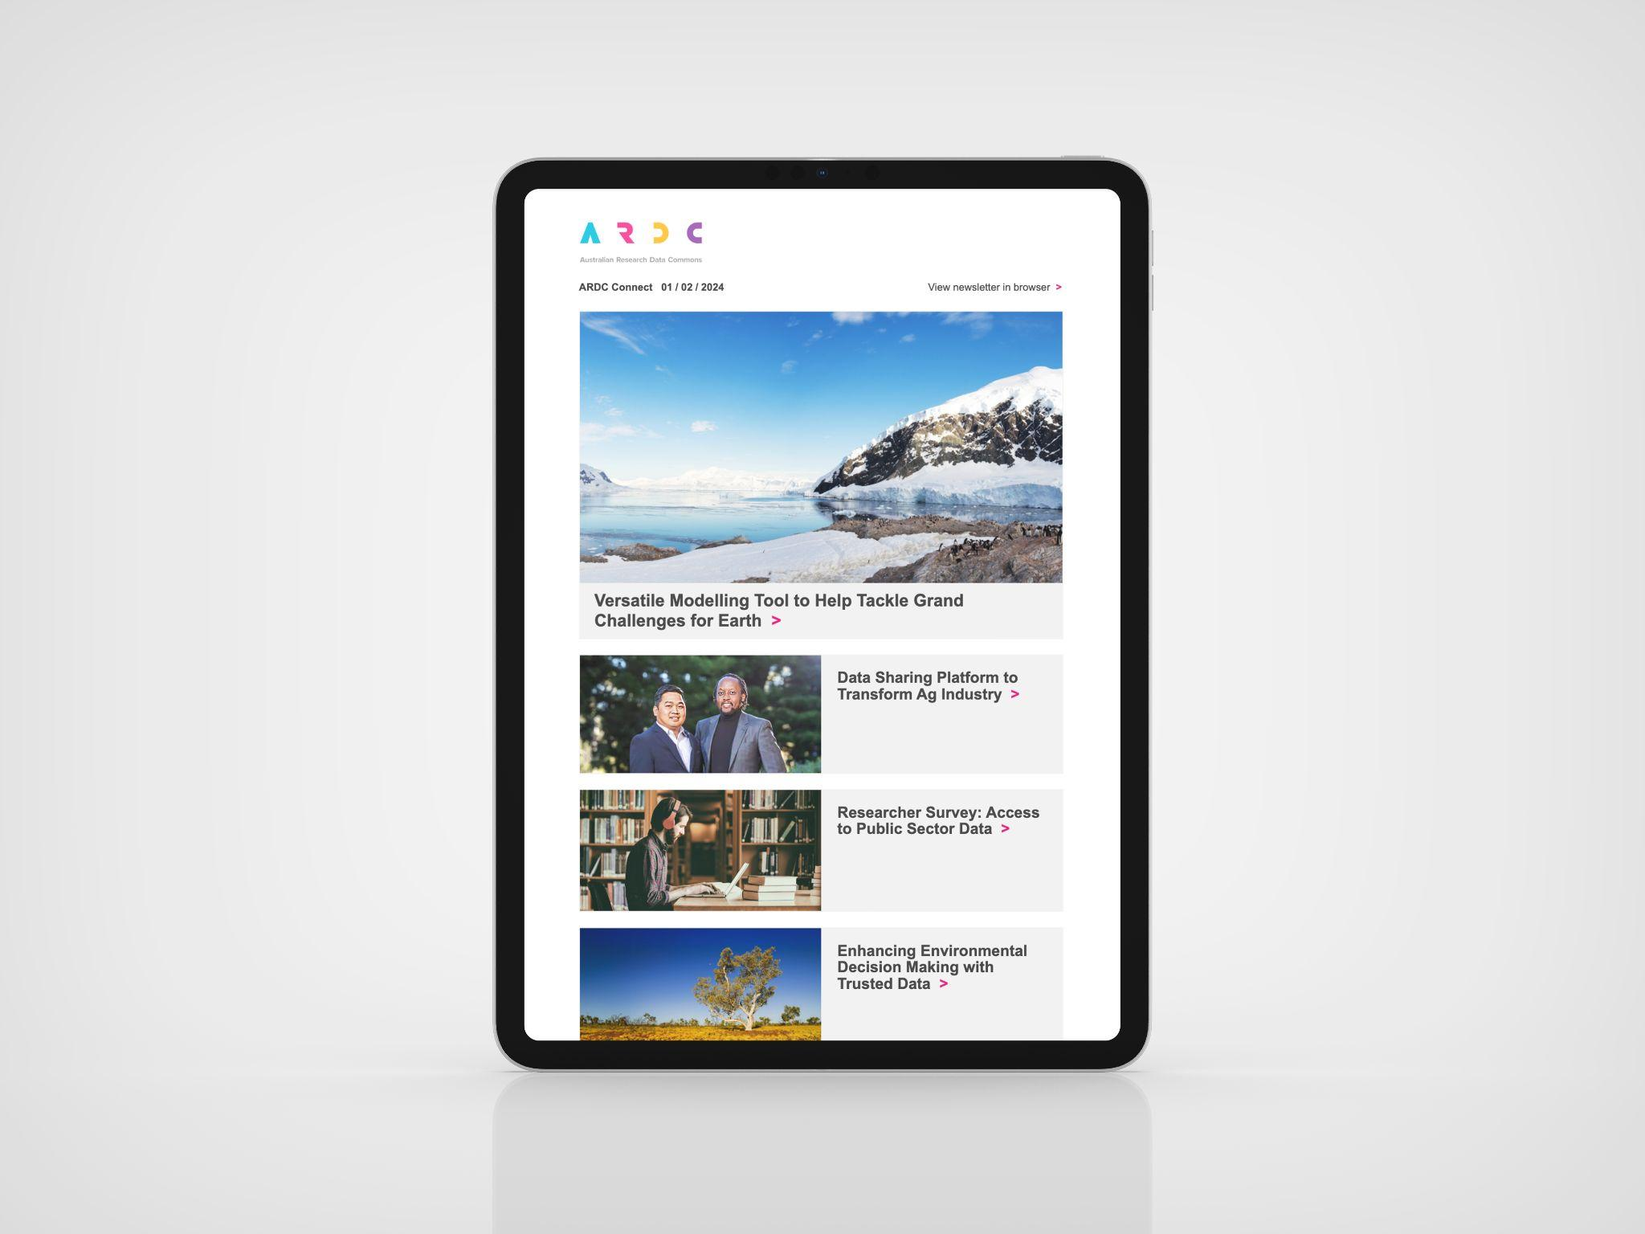
ARDC Connect
Subscribe for digital research news and resources
ardc.edu.au/subscribe
Notes:
<PROMO for all audiences>
KEEP UP TO DATE WITH THE ARDC
The best way to keep up to date with digital research news and resources, is to subscribe to the ARDC Connect email newsletter.
Image
Gorodenkoff - 555636533 / AdobeStock.com

Slide 64


Find Digital Resources for Researchers
ardc.edu.au/researcher
Notes:
<PROMO for researchers>
RESOURCES FOR RESEARCHERS
Accelerate the Research and Innovation for your researchers with the ARDC’s Resources for Researchers
The ARDC provides curated resources for digital research on our website.
We share datasets, platforms, free tools and upskilling materials for data-intensive research in the areas of health and medical, earth and environmental science and the humanities, arts and social sciences and Indigenous research data communities.
Visit ardc.edu.au/researcher
Image credit
Gorodenkoff - 555636533 / AdobeStock.com

Slide 65

ARDC International Goals
Embed Practice
Empower Developments
Expand Networks
Enhance Reputation
Enhance Reputation
Notes:
ARDC International Goals
We want to increase our involvement internationally, but do it in a way that maximises our national leverage and move from a unidirectional flow of DRI IP and effort towards something more bidirectional.
Our four goals are to:
Enhance reputation through high-profile involvement
Empower through doing, not just talking
Expand networks to continue conversations that lead to convergence, not divergence
Embed good practice (ideally practice that we have helped shape) for national benefit
Note that these four goals all act to reinforce each other:
Enhanced reputation means that we will sought as network partners
Expanded networks give us earlier access to international developments
Empowered developments contribute to reputational enhancement
Empowered developments lead to more easily embeddable practice
Embedded practice increases national and international reputation of ARDC

Slide 66




Developing ARDC Partnerships
National Partnerships
International Partnerships
International Memberships
Research Discipline Partnerships
Notes:
OUR PARTNERSHIPS
Partnerships are essential for Australia to develop a national research data commons and collaboration is a core value of the ARDC.
Our national and international collaborations and partnerships ensure valuable data and software assets are developed, made available and sustained for everyone.
Over the past 10+ years, the ARDC has built strong partnerships and collaborations at a national and international level to benefit the national infrastructure being developed to serve the research community.
The ARDC continues to expand our collaborations and partnerships.
Our current partnerships include:
National partnerships
Peak bodies
Research organisations including ARDC members and ARDC host institutions
Research infrastructure providers including NCRIS and ARDC Nectar Research Cloud nodes
Government (state and federal)
Research Activity Identifier Service (RAiD)
Research Discipline partnerships for Thematic Research Data Commons
People RDC - Health and medical research partners
Planet RDC - Earth and environmental science partners
HASS and Indigenous RDC - HASS and Indigenous research data community partners
We also partner with international data and software infrastructure organisations around the world to ensure Australian researchers are best positioned to collaborate on global challenges and to optimise our own operational activities.
Our International partnerships include:
International partnerships
DataCite
Earth Science Information Partners
International Generic Sample Number
Open Research Contributor ID
International Openstack community
Research Data Alliance
Digital Research Alliance of Canada
CODATA
The ARDC is a member of the following international organisations:
International Memberships
Open Infrastructure
International Data Spaces Association
Research Data Alliance
Research Software Alliance
ORCID
https://ardc.edu.au/about-us/our-partnerships/

Slide 67

ARDC Research Vocabularies Australia
Research Vocabularies Australia has been used to create, maintain, find, access, and reuse vocabularies for research.
2023 / 2024
40,146
filtered page views
457
research vocabularies
Notes:
ARDC RESEARCH VOCABULARIES AUSTRALIA
Established in 2015, Research vocabularies are used to organise & classify data across applications & domains.
The ARDC’s Research Vocabularies Australia, or RVA for short, is a free, digital portal to help researchers to find, access, and reuse vocabularies for research.
It caters for researchers and those who support, describe and discover research, including vocabulary managers, ontologists, data managers and librarians.
We have almost 400 research vocabularies available for researchers and institutions to access.
It’s free to access and researchers can use RVA to publish, re-purpose, create and integrate an existing vocabulary into their own system.
Image credit
This is the AusTraits team. Vocabularies are about reconciling ambiguities in data. When one person says a plant has 'broad' leaves, person A might think of one thing and person B might think of another. Vocabularies come in with a community agreement of what "broad" means. In this image 3 researchers are having different understanding of, say, a 'broad' leaf and using the laptop to look up the community definition on a laptop.

Slide 68






What are Persistent Identifiers (PIDs)
PIDs for People
PIDs for Research Grants
PIDs for Data & Research Outputs
Linking the elements of the research community
PIDs for Organisations
& Institutions
PIDs for Instruments
PIDs for Research Projects & Activities
Notes:
WHAT ARE PERSISTENT IDENTIFIERS?
What are Persistent Identifiers?
Persistent identifiers have three main attributes.
First, they’re persistent, which means they are intended to be around, if not forever, then for a very long time.
Second, they’re unique.
You can use the same name to identify two different people or things, and one person or thing can have more than one name.
But a PID is a unique identifier, one that is used only for one person or thing, even if they have lots of different names, or those names change or get abbreviated.
A third quality is that they have open metadata — the metadata provides information about the person or thing it refers to.
Openness enables anything or anyone to have, use, and share their PIDs, for everyone’s benefit.
There are six types of PIDs that are in use or near production, which include:
PIDs for People - these are identifiers for researchers and include ORCID iDs. We support the promotion of these nationally to researchers.
PIDs for Organisations & Institutions - these are for research organisations and include ROR.
PIDs for Research Grants - Crossref offers Grant IDs, and DataCite is trialing their own version (both are DOIs).
PIDs for Instruments - DOIs for instruments are currently being trialed; RRIDs can be used to specify the type or model of instrument, or to reference facilities.
PIDs for Data and Research Outputs - these are for research outputs/inputs like publications, datasets, software, reviews, preprints, etc and include Crossref and DataCite DOIs, IGSNs, Handles, and more.
PIDs for Research Projects and Activities - RAiDs, developed by the ARDC, can be used to identify and relate projects, outputs, contributors, and other research activities.

Slide 69

ARDC Identifier Services
The ARDC offers several services
that enable researchers at Australian institutions to assign globally unique persistent identifiers to their data and to related materials such as samples, files, documents, tools and services.
2023 / 2024
781,485
DOIs minted
480,338
Services include:
Digital Object Identifier (DOI)
International Generic Sample Number (IGSN)
Research Activity Identifier (RAiD)
Handle
Handles minted
16,900
RAiDs minted
Notes:
ARDC IDENTIFIER SERVICES
With our partners, we have developed a National PID Strategy for Australian institutions.
The ARDC offers several services that enable researchers at Australian institutions to assign globally unique persistent identifiers to their data and to related materials such as samples, files, documents, tools and services.
This supports researchers in discovering, citing and attributing these resources.
Services to create and manage Persistent Identifiers for research data, samples, files, document, projects and other digital objects (DOIs, IGSN, ORCiD, RORs, RAiDs)
Contributing to national and international standards and practice for PIDs, inc samples, instruments and activities/projects
Enables the tracking of impact over research outputs
https://ardc.edu.au/services/identifier/
Image credit
Image — Rawf8 - 162076001 / AdobeStock.com

Slide 70





National Information Infrastructure
ARDC Research
Data Australia
ARDC Research Vocabularies Australia
Specialist platforms,
including
Identifier
Services
Health Data Australia
Research Link Australia
Notes:
RESEARCH DATA AND INFORMATION SERVICES
ARDC provides a number of connected data and information services that support the discovery of data, software and tools with related information on grants, research activities, publications, authors and contributors.
Our information services support unambiguous identification of data, materials, projects, vocabularies, activities and services.
This facilitates the interoperability, use and reuse of the data assets created.
Services include:
Research Data Australia - an online data discovery portal
Specialist platforms, including:
Health Data Australia - a national catalogue of Australian health data, starting with clinical data
Research Link Australia - a portal for bridging the information gap between research, industry, business and government for impactful innovation
Grants
Research Vocabularies Australia - an online service for creating, managing, finding and accessing controlled vocabularies, which make the meaning of research data clear and explicit
Identifier Services - a range of services for research organisations to create and manage persistent identifiers
All of these services are hosted on the ARDC Nectar Research Cloud - Australia’s national research cloud service.

Slide 71



Our Audiences
Researchers
Researchers from
any discipline
(academic, but also government and industry)
People Who Work
With Researchers
Project Partners
Infrastructure providers
Universities / Research Institutions
Data Managers
Trainers
Librarians
eResearch / Research
Support Offices
Key Stakeholders
Australian Government (NCRIS)
Research Funders
Government / Policy
International Data Organisations
National Data Organisations
ARDC Members
Notes:
OUR AUDIENCES
These are the ARDC’s key audiences.
On the left we have researchers who are at the centre of everything we do. They are the end-users of the tools, services and resources we develop and support.
This includes academic, government and industry researchers in Australia from any discipline, from any institution, using any technology.
In the middle we have people and organisations that build infrastructure or support researchers to manage their research data, including our project partners.
These are people who work with researchers, like university librarians or those who build and run digital research infrastructure for researchers.
On the right are our key stakeholders, who include the Australian Government, research funders (ARC, NHMRC), national and international research data organisations and ARDC members.

Slide 72

















ARDC Nectar Research Cloud
In 2023/2024 ARDC Nectar Research Cloud supported:
545
25
26,616
ARC Grants
Cooperative Research Centres & Projects
Users
4,163
Active users
36
19
37
1,906
ARC Centres of Excellence & ARC Industrial transformation hubs/training centres
NCRIS Capabilities
Australian Universities
Projects
235
38
6,112
50,000+
ARC, NHMRC &
MRFF Research Grants
Research Platforms /
Virtual Laboratories
Research Projects
Researchers
All
Research Fields
241
>1,300
3.5 billion
370
NHMRC &
MRFF Grants
Research Papers
Virtual-Processor Hours
Collaborative Multi- Institutional Projects
Supporting National Research 2012 - June 2024
Research papers 2018 - June 2024
Notes:
IN NUMBERS
Nectar has enabled more than 24,000 researchers to work on 5,500+ groundbreaking research projects since 2012
In the last year there were over 4,163 active users of Nectar
Nectar hosts many research platforms and services that collectively have more than 50,000 users.

Slide 73



2023 / 2024
ARDC Research Data Australia
220,138
data collections
Research Data Australia is an online portal for finding research data and associated projects, researchers and data services.
948
data services
and tools listed
717,892
page views
84,397
researchdata.edu.au
searches conducted
Notes:
ARDC RESEARCH DATA AUSTRALIA
Operating since 2011, Research Data Australia (RDA) is a free, searchable portal which brings together research data collections from projects and institutions across Australia.
Data owners or managers can create metadata records in their own repositories which are then published in RDA.
The data itself is stored and published with the source institution.
Researchers can find, access and reuse data for research from 100+ Australian research organisations, government agencies and cultural institutions in ARDC’s Research Data Australia portal.
There are 193,945 research data collections catalogued.
They can search data by subjects, themed collections, projects and more.
RDA provides metadata and links to data held by publishing partners.
Did you know that RDA is a portal service as well?
One portal allows you to search for Australian Research Grants. You can find principal research funders, project descriptions, grant identifiers and connections to related datasets and publications.
Image credit
Clockwise from top: Language Data Commons of Australia (LDaCA), Australian Child and Youth Wellbeing Atlas and Australian Coronial Law Library are all examples of data assets discoverable in ARDC Research Data Australia.

Slide 74

Link

Slide 75


Research capability discovery portal eg MND
As an application developer of an agri-business facilitator/intermediary, I would like to know who are the top five researchers from my state in this research area of internet of things, who can help to optimise our network to monitor soil, water, crops, pastures and animals, etc; so that we can make better decisions.
As a research group, we have researched this nanodisk, our clinical research shows nanodisk can stick to the surface of a tumor longer than other shaped disks and thus provide efficient transfer to therapeutic drugs to the tumor. I want to find out who are the top five manufacturers in Australia with whom we can discuss future production opportunities.

Slide 76




Communities of Practice
Sensitive Data Community
Data Repositories Community
Institutional Underpinnings Community
Australian Research Data
Management Community
Identifiers for Instruments in Australia
Australian Research Containers Orchestration Service (ARCOS)
Notes:
COMMUNITIES OF PRACTICE
To support the research community, we run a range of Communities of Practice groups and interest groups to share knowledge, expertise and disseminate best-practice for tackling data challenges.
The communities on this slide are just a few of the communities we support, and we review these groups regularly to ensure they serve the wider community.
Currently we are reviewing these communities to ensure they align with the Thematic Research Data Commons.
Visit our website to learn more and see if one of the groups is relevant for you.
See a full list and join: https://ardc.edu.au/resources/communities-of-practice/
Image credits clockwise
Flamingo Images - 268793099 / adobestock.com
Prostock-studio - 256860388 / adobestock.com
WavebreakmediaMicro - 124980928 / adobestock.com
pressmaster - 107931662 / adobestock.com

Slide 77




Policy Advice
The ARDC provides specialist advice for a coherent research data policy environment.
Monitor data
policy for changes affecting Australian researchers.
Engage with policy stakeholders in Australia and internationally
Advocate to improve existing and proposed data related policies
Build the data policy capacity of relevant stakeholder institutions
Notes:
ARDC POLICY ADVICE - INPUT INTO AUSTRALIAN GOVERNMENT CALLS FOR CONSULTATION
The ARDC provides specialist input into consultations regarding issues affecting data for and from researchers.
NB. ARDC staff can access the ARDC’s Submissions Register via Happeo to access the most recent or relevant examples, or contact the Policy team.

