Slide 1
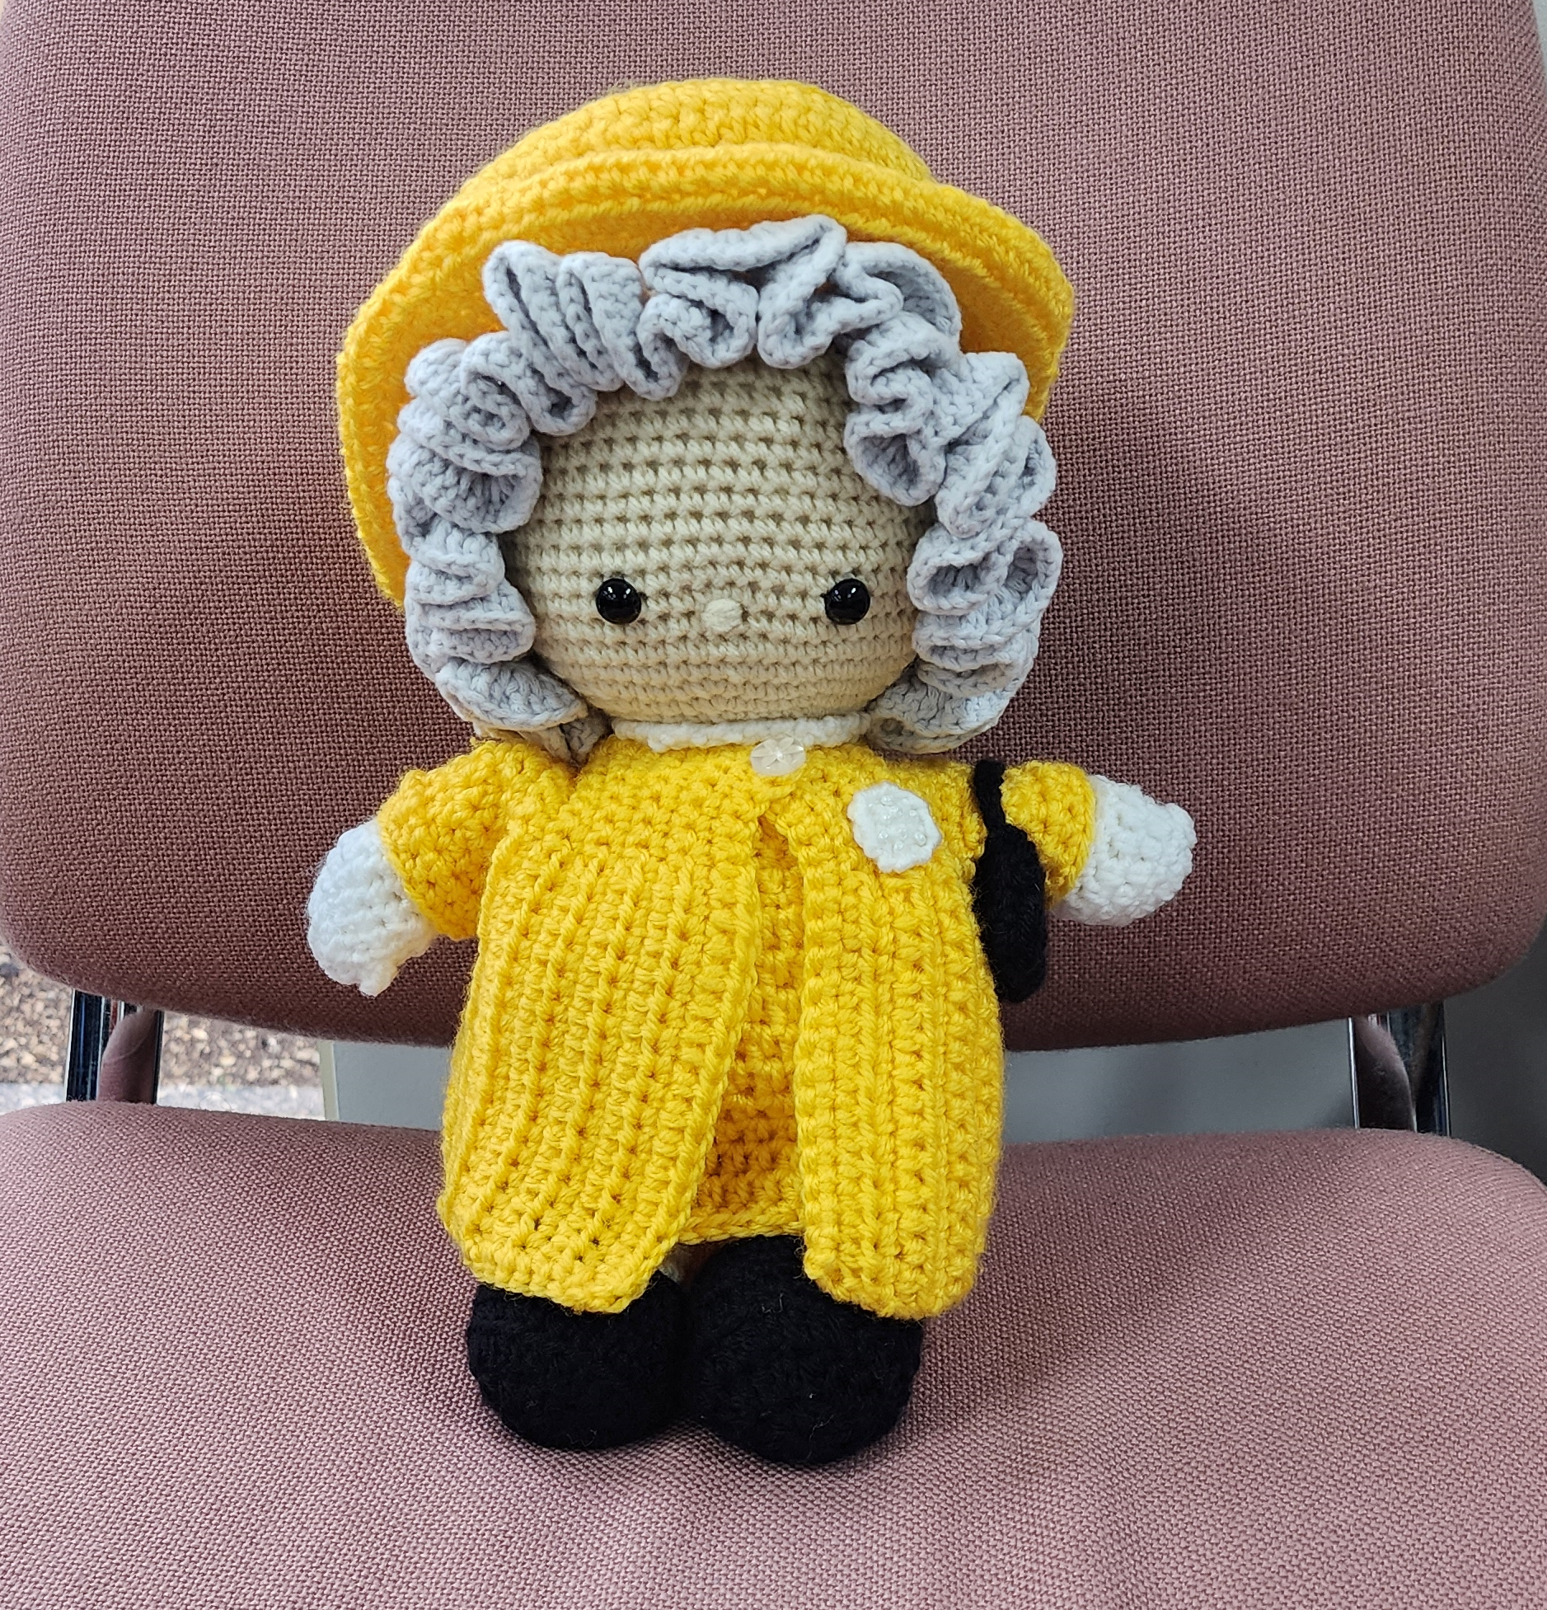
From Little Things,
Big Things Grow
Cultivating Patient Engagement Through Health Libraries
Tania Barry
Director, Library and Information Literacy Services
HLi: 10 October 2025
Notes:
simple request grew into two patient-centred programs now supporting patients and residents across Northern Health. This presentation is highlighting the evolving role of health libraries in person-centred care and consumer engagement.

Slide 2
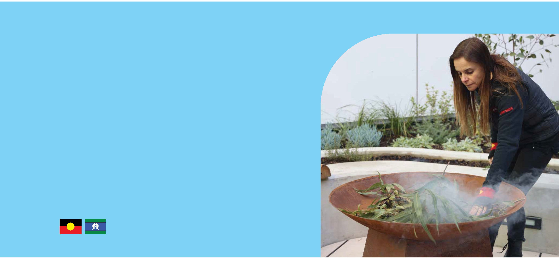

acknowledgement

Slide 3
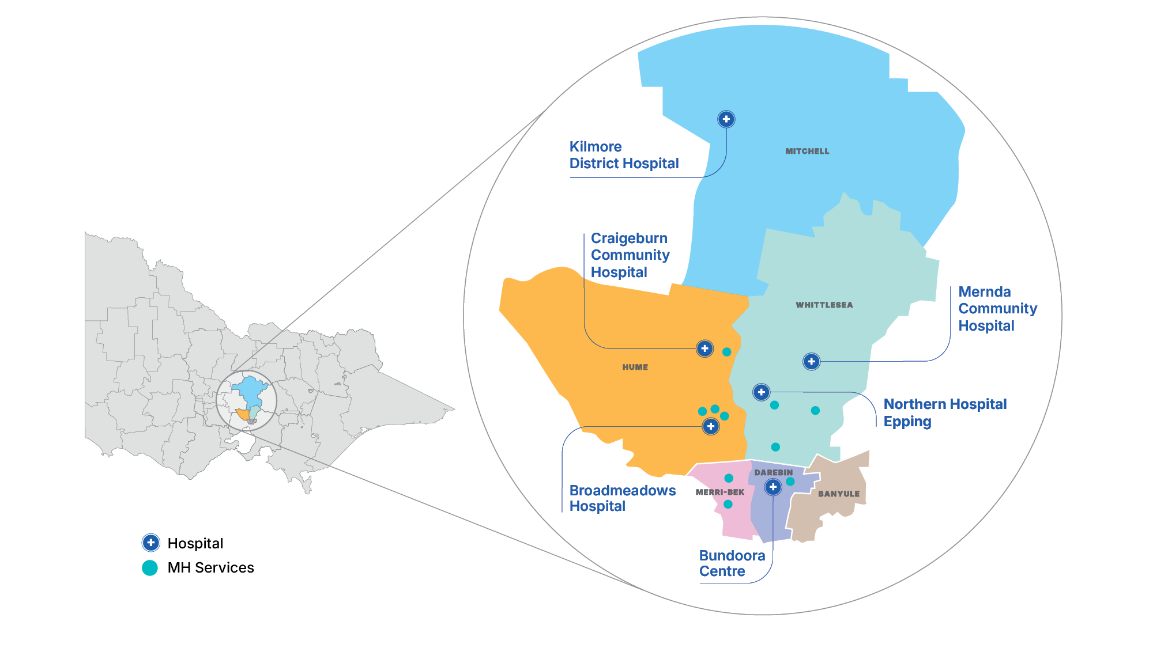
Our locations
Notes:
Primary catchment is over 500,000 people - Projected to grow to over 750,000 by 2036 (74%)
3 local government areas of Hume, Mitchell, Whittlesea, Covers 5,700km²
The Library currently services 5 campuses, plus an additional 10 mental health sites (and another in the pipeline)
We cover the majority of Melbourne’s north and are bordered by a section of Western Health, as well as Melbourne Health, Austin Health and Eastern Health.
185+ countries represented, with 107 languages spoken and 90+ religious beliefs
The diversity of our catchment area, and the wide range of cultural, linguistic, and socio-economic backgrounds, really emphasises the important role we have, as a hospital library, in engaging all staff and making they have the knowledge and tools to deliver healthcare that is responsive to the complexities created by such a diverse population.

Slide 4
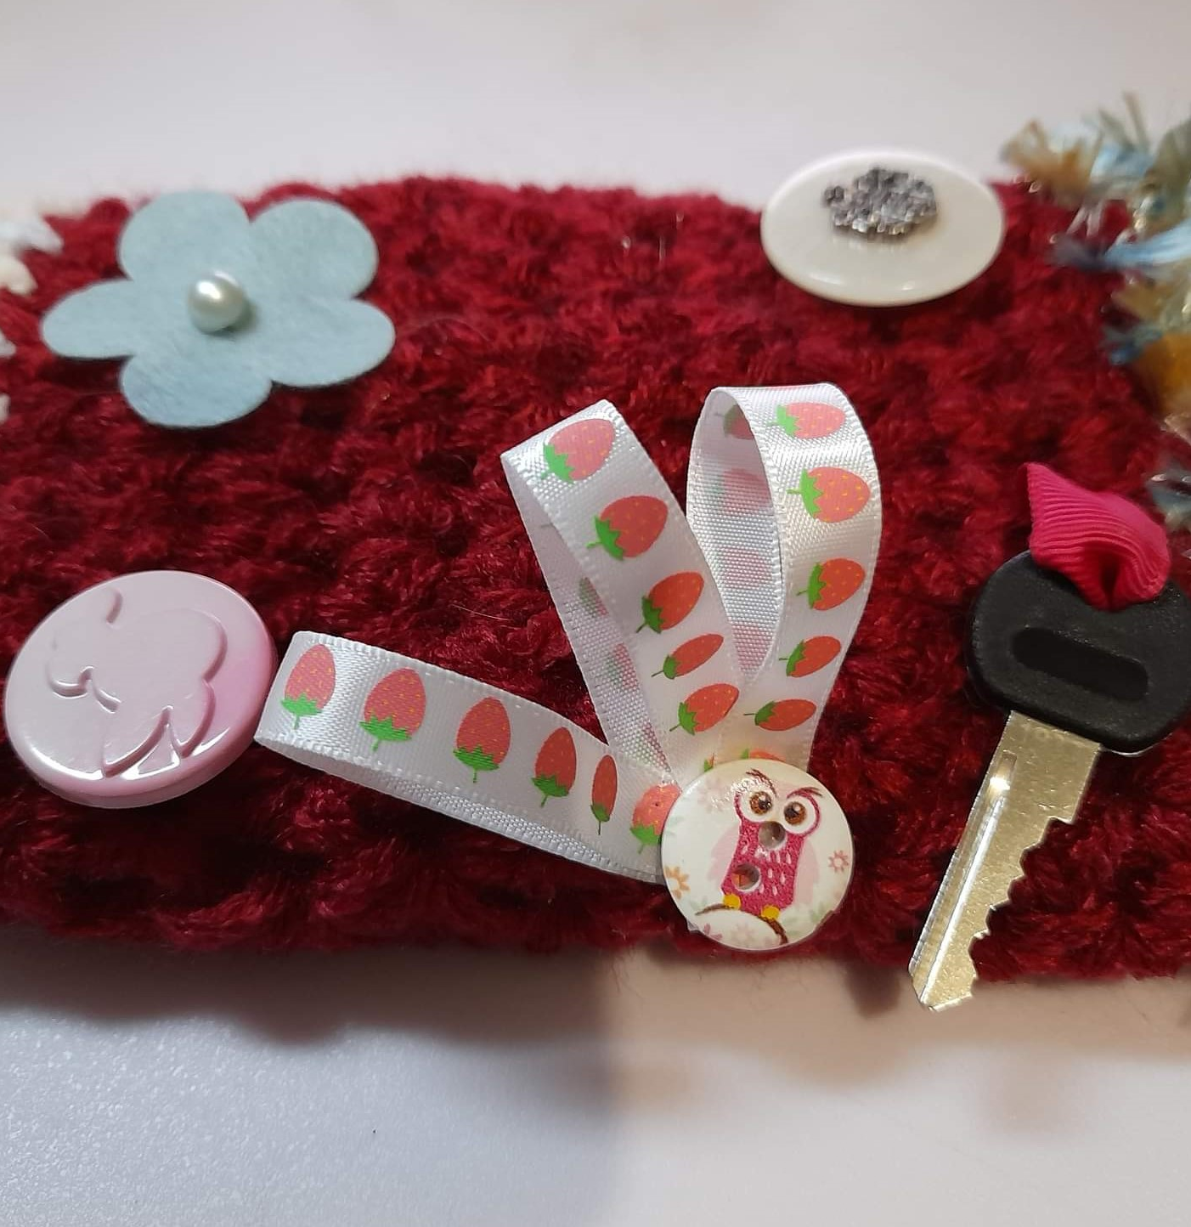
The Spark: A Fiddle Mitt
Request for fiddle mitt distribution at Northern Health
Positive staff/consumer response revealed wider potential
          Calming sensory engagement
          Non-pharmacological distraction
          Psychosocial support
Highlighted an unmet need for tools to reduce anxiety and distress
Notes:
This all started when I was asked if NH would be interested in some fiddle mitts for residents with dementia in our aged care facilities. I reached out to the DoN at Bundoora, which led to me being invited to present at a NUM meeting. The outcome from that presentation was several more requests for fiddle items which were outside my initial offerings of dementia use. Diversional therapy tools for post operative delirium in surgical wards and IV insertion in the paediatric ward as well as psychosocial support in mental health wards. This opened our eyes to how something quite simple could improve patient wellbeing and prompted us to explore what else we could offer.

Slide 5
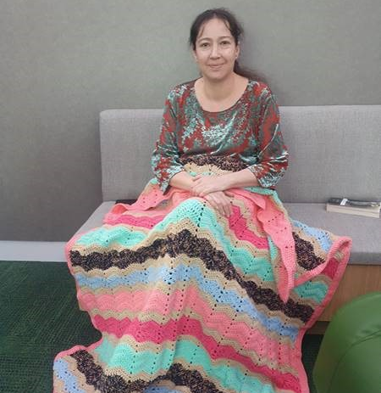
Care and Comfort Program
All donated, handmade items
Support emotional, social & sensory wellbeing
Impact driven, not ad hoc
Integrated into care pathways
          Bunny rugs, beanies, cardigans - Neonatal
          Beanies, lap blankets – Aged Care
          Self care packages – Mental Health
          Large Toys – Rehab, Mental Health
          Colouring pages – Rehab, Oncology, Mental Health
          Large print puzzles – Aged Care, Dialysis
          Fiddle items – GEM, Mental Health, Aged Care, Paediatrics
Coordinated by the NH Library
Notes:
From this initial call out to supply fiddle items, clinical staff, predominately NUMs, requested various items that they would be able to use with their patients to reduce anxiety and distress and support emotional, social and sensory wellbeing. Program is impact driven, based on needs and items requested would be integrated into clinical care pathways. Items included bunny rugs and newborn beanies and cardigans for NNU for babies being discharged with no clothing and others who are being discharged into foster care, lap blankets and beanies for adults in our aged care facilities to create a sense of ownership and individuality, self care packages with handmade soap, face scrubbies and face washers in our MH wards to encourage personal self care that also supports sensory modulation and large toys to offer rehab patients a non-pharmacological strategy to reduce anxiety during repositioning. In response, the NHL formally developed the Care and Comfort Program—coordinated and delivered by the library, with support from volunteers. Everything in the program is handmade and donated.

Slide 6
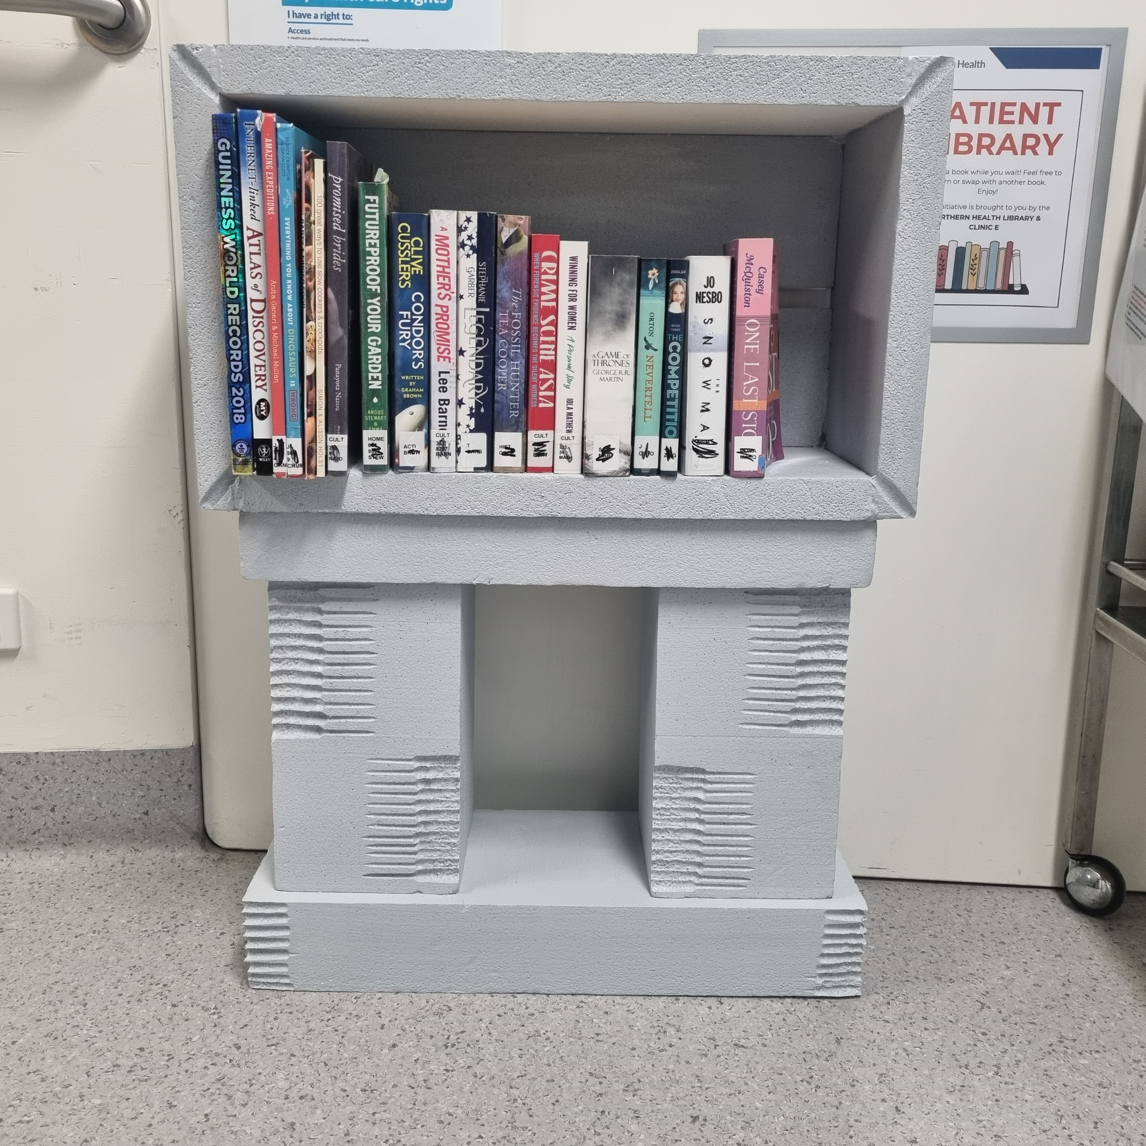
Patient Libraries
Separate initiative, complementing Care & Comfort
Streamlined, low effort for site staff
Recreational reading resources
          Inclusive
          Culturally appropriate
          Accessible
Encourage cognitive stimulation
Reduce boredom and anxiety during care stays
Notes:
During development of the C&C program, I received feedback that some consumers were interested in accessing the Library, which prompted the idea of setting up a Patient Library for patients. I had been exploring the concept of a LFL and this request gave me the platform I needed to start the ball rolling. It is a separate initiative that complements the C&C Program. Designed to be as streamlined and low effort as possible for site staff.
Patient Libraries provide free access to books and magazines across 5 NH sites, including a further 10 MH sites. The libraries are designed to be inclusive, culturally appropriate and accessible to patients and residents of all ages and backgrounds. Rotating collections and shelf signage using plain language and visual cues support ease of use and engagement. The libraries encourage cognitive stimulation and reduce boredom and anxiety during care stays.

Slide 7
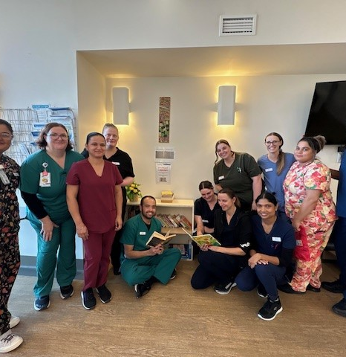
Unique Model
Centrally coordinated, multi-site roll out
Donation and distribution system led by NH Library
Ensures relevance, consistency, sustainability and equity
Impact driven, not ad hoc
Distributed by clinical staff, creating connection touchpoints
Builds rapport and trust between staff and patients
Programs are active across multiple NH sites
Access for diverse cohorts
          Aged care
          GEM
          Mental health
          Rehab
Notes:
What makes this unique is that both programs are centrally coordinated by the library and delivered across multiple sites. We manage all donation processes, logistics and communications—ensuring relevance, equity, consistency and long-term sustainability. Both programs, especially C&C, are impact driven – items are sourced based on staff-identified patient needs. Distributed through clinical staff, creating touchpoints for connection with patients and residents, building rapport and trust during care stays.
These programs now reach patients and residents across many NH settings, such as aged care, GEM, mental health and rehab. We continue to expand based on feedback and demand, with strong engagement and requests for inclusion from staff across wards.

Slide 8
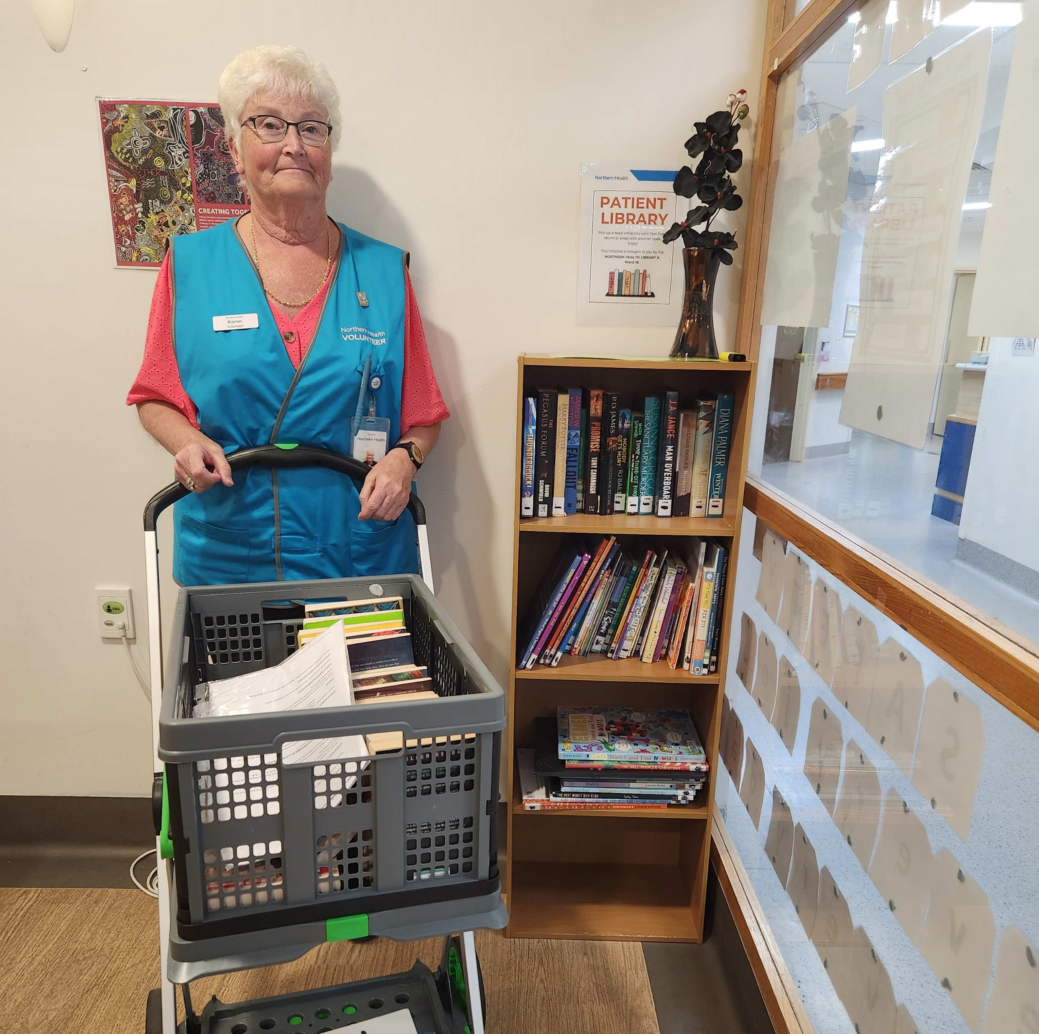
Powerful Partnerships
NH Library → facilitator and coordinator
Partners
          Internal – Allied Health, nurses, Support Services, Program Coordinators, Volunteers
          External – Community groups, Service Clubs, public libraries
Currently 12 external partners
Notes:
None of this would be possible without partnerships—with staff, volunteers, community groups, craft donors and public libraries. The library plays a key coordinating role, but the success of these programs lies in shared purpose and community support. As I mentioned earlier, the NHL is the facilitator and coordinator of both programs, working closely internally with AH, nurses, support services, program coordinators and volunteers. Externally we have built relationships with various community groups, services clubs and public libraries.

Slide 9

NSQHS Standards/ALIA Competencies
Aligns with NSQHS Standard 2-Partnering with Consumers
Builds relationship between consumers/clinical staff
ALIA proposed revised competencies
          Health Env, Communities & Stakeholders (6)
          Leadership & Management (8)
Extends the Library’s role
          Knowledge access → Wellbeing support
Patient and consumer partnerships are also a pillar of person-centred care – that is, care that focuses on the relationship between a patient and a clinician, and recognises that trust, mutual respect and sharing of knowledge are needed for the best health outcomes.
(Harding E, Wait S, Scrutton J. The state of play in person-centred care. London: The Health Policy Partnership; 2015)
Notes:
both initiatives support Standard 2 of the NSQHS Standards which recognises the importance of involving patients in their own care, as well as providing clear communication to them. As libraries, we are uniquely placed to enhance the care experience—not through clinical care, but by providing the means to build the relationship between consumers and clinical staff.
They also demonstrate how health libraries enact HLA’s proposed revised competencies—particularly comps 6 (Health Env, Communities and Stakeholders) and 8 (leadership and Management)
Together these demonstrate how we can extend the library’s role beyond knowledge access into wellbeing support
Patient and consumer partnerships are also a pillar of person-centred care – that is, care that focuses on the relationship between a patient and a clinician, and recognises that trust, mutual respect and sharing of knowledge are needed for the best health outcomes.⁴
Harding E, Wait S, Scrutton J. The state of play in person-centred care. London: The Health Policy Partnership; 2015 (accessed Sep 2017).

Slide 10
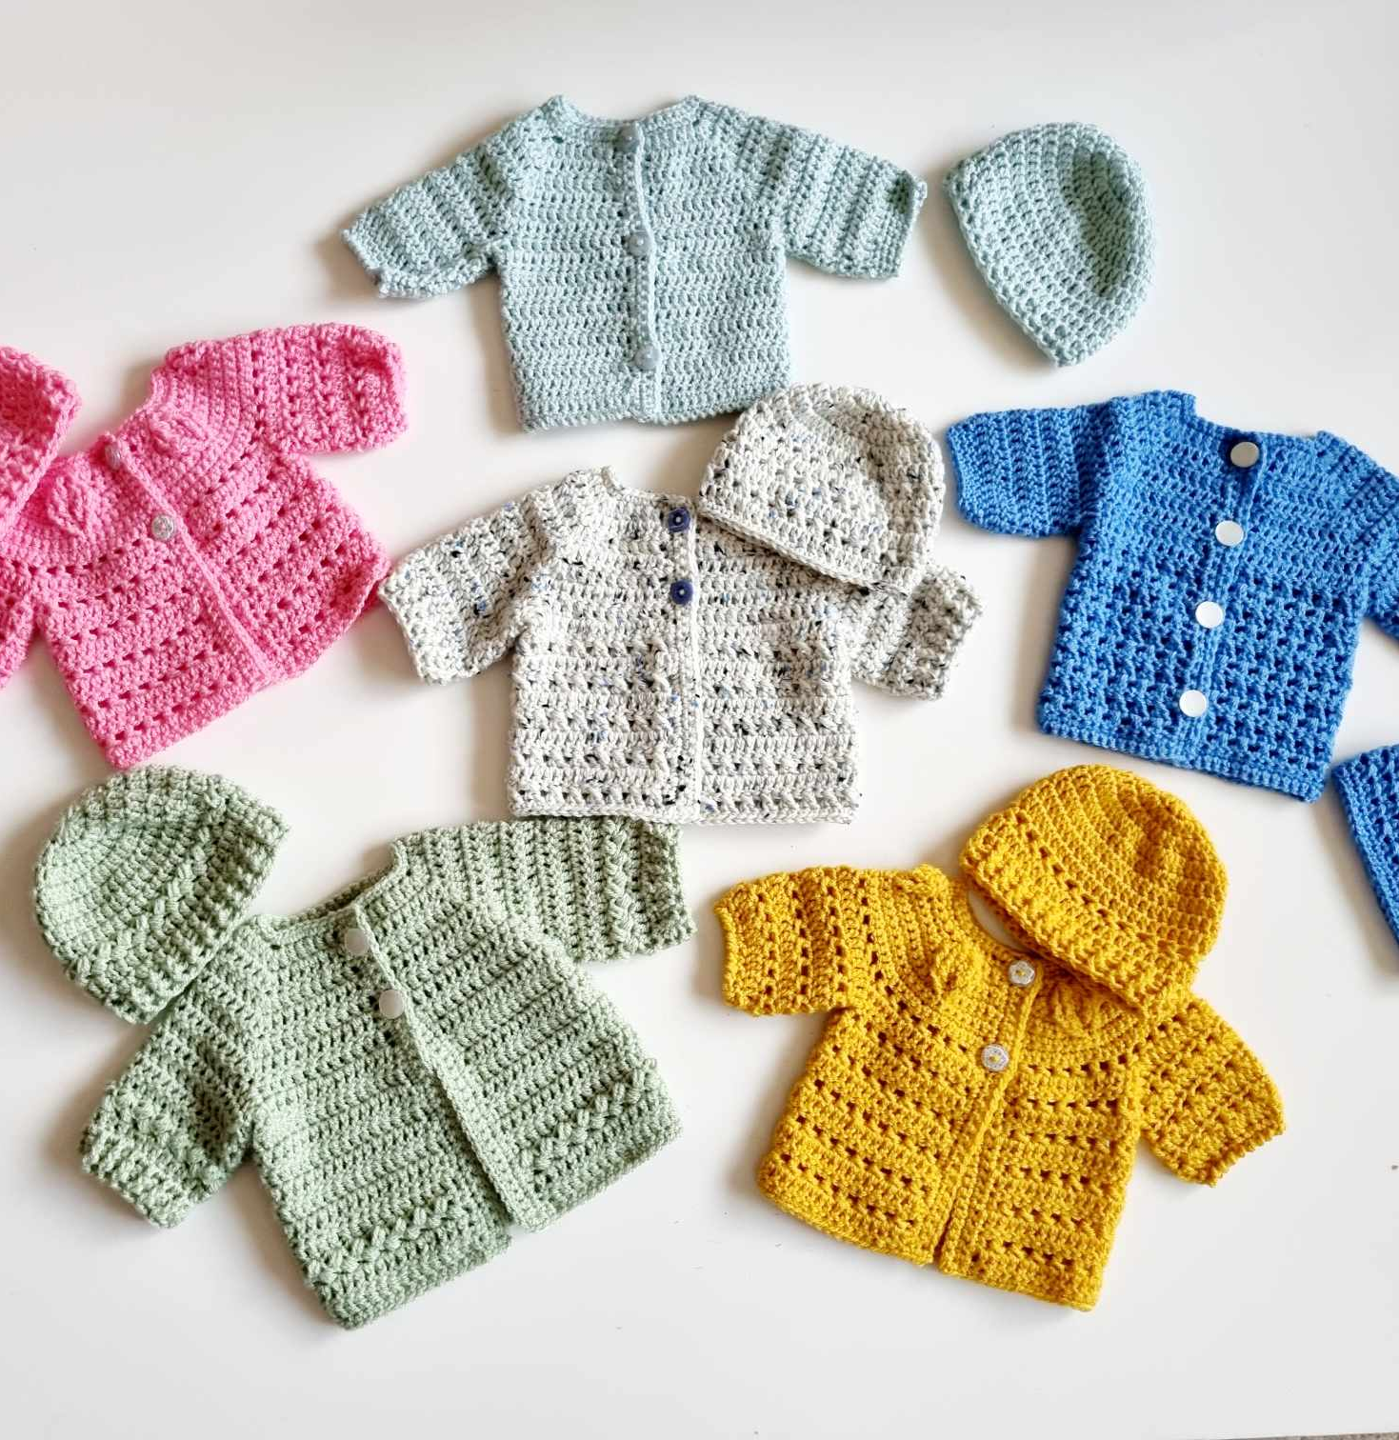
Demonstrating Impact
55 Patient Libraries
~4,000 books and magazines
~1,500 comfort items
Improved patient engagement/ward culture
Endorsed entry to 2025 VPH Awards
Quarterly report to S2 Committee
Differs from volunteer led model
          Impact led and responsive
          Strengthens relationships between consumers/clinical staff
Demonstrated cost savings
          ~$280,000
Notes:
Since implementation, which is really from January this year, we've have now established 55 Patient Libraries across NH with over 4000 books and almost 1500 comfort items. Staff report improved patient engagement and ward culture. The programs have caught the eye of our exec team, who are often looking for feel good stories. I provide a quarterly report on progress to the S2 committee and both programs were endorsed for entry to the 2025 Victorian Public Healthcare Awards. and have also been using these to demonstrate cost savings through the use of repurposed items and also in staff savings through increased productivity. 3 ways I do this – the value of the items used in both initiatives (so books, magazines, fiddle items, shelving etc) that reflect a direct cost saving to NH if the organisation was to purchase these items, the time saved by staff in setting up either a Patient Library or the C&C program and the ongoing maintenance of the PLs. I have developed processes and formulas on how to calculate these. To date, the savings amounts to almost $280,000

Slide 11
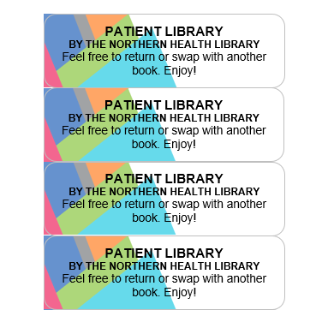

Lessons Learned
Start small, build trust
Establish governance early
Harness community enthusiasm
Make the work visible
Stay responsive to feedback
          Exclusion of potential trigger books
          Softcover only for safety
          Easy readers for low English literacy
Never assume
Don’t be afraid to lead
Notes:
Start small and build trust – incremental growth ensures credibility and engagement
Establish governance early – underpins sustainability, viability, and believability
Harness community enthusiasm – small tokens of identification (e.g. stickers) can highlight the library’s role
Make the work visible – highlight initiatives at orientation, committee meetings and internal communications
Stay responsive to feedback – adapt programs to meet evolving needs
Never assume – assumptions can limit opportunity; for example, an aged care facility requested baby items for its child replacement therapy program
Lead innovation in non-traditional spaces – demonstrate how libraries can drive patient-centred initiatives that support wellbeing alongside clinical care

Slide 12
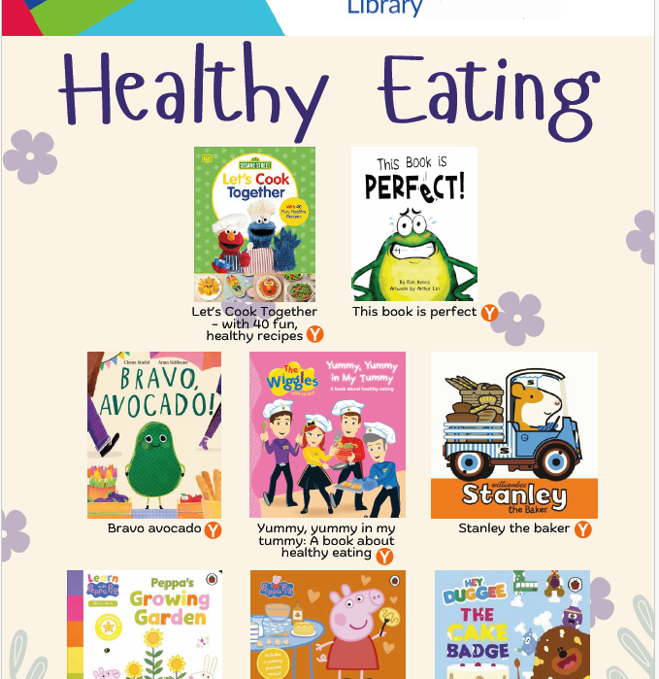
Next Steps
Continue expanding to other sites/areas
          Craigieburn
          Pathology
GP Resource Sheets
Read Aloud Library
Picture book translation
Notes:
Expansion – now working with Craigieburn – DMU, imaging, outpatients and dialysis and also pathology – using some of the items we source to help reduce anxiety in children during blood or sample collections
GP Resource sheets – curated lists of picture books on particular wellbeing topics that highlight relevant titles available in public libraries in our catchment areas. Aim is to have them on display in our paed ward and paed outpatients and make them available to GPs for distribution during consultations. Healthy eating has already been finalised.
Read Aloud Library – provides parents/carers with access t a small collection of picture books that can be read to their baby while in the isolette in NNU to promote the importance of early shared reading as part of a baby’s care, even while in hospital.
Picture book translation – selected picture books are being translated into our top community languages to ensure as many families as possible can participate in shared reading with their baby while in NNU. The project supports culturally inclusive care and helps parents feel more confident reading aloud in their preferred language, still supporting early literacy in a way that reflects NH’s diversity.

Slide 13
Questions?
www.nh.org.au

